Slide 1
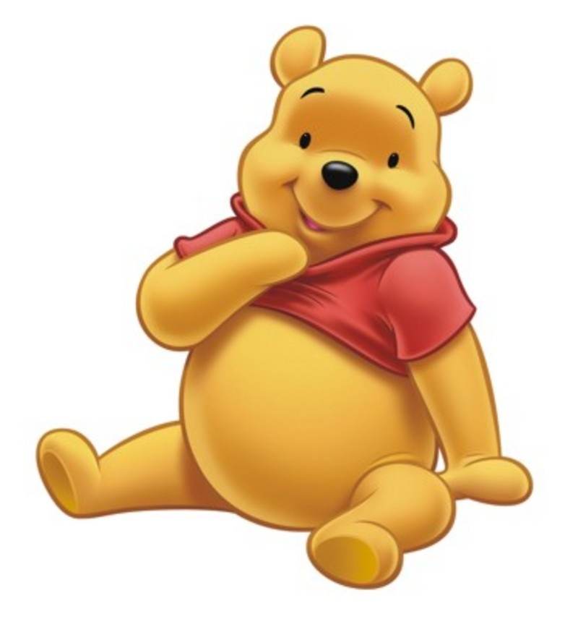

Slide 2
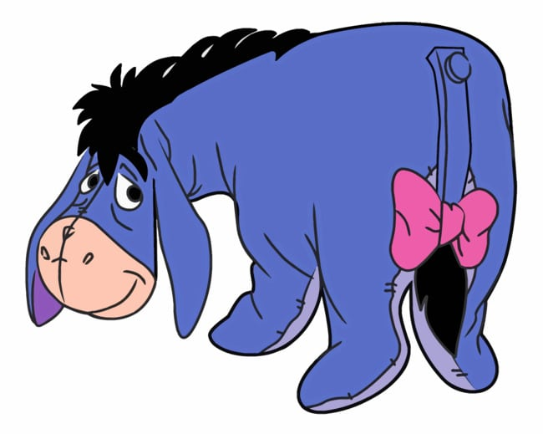

Slide 3
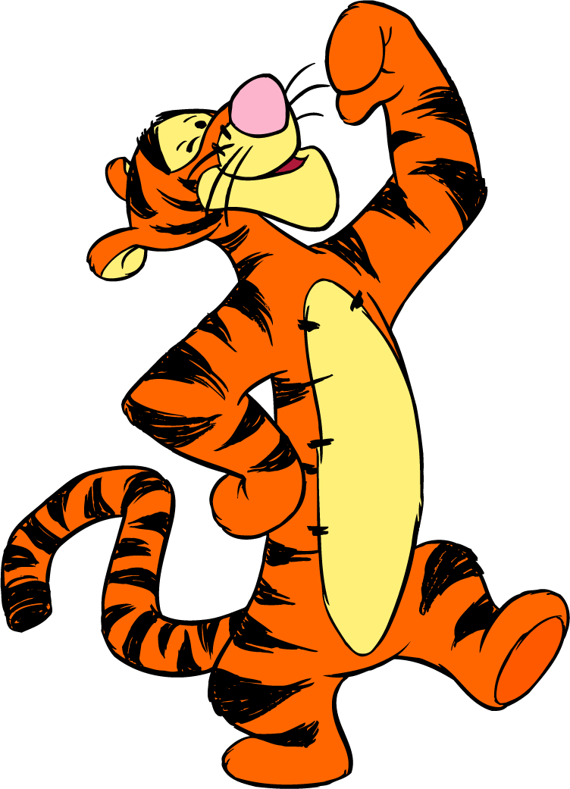

Slide 4
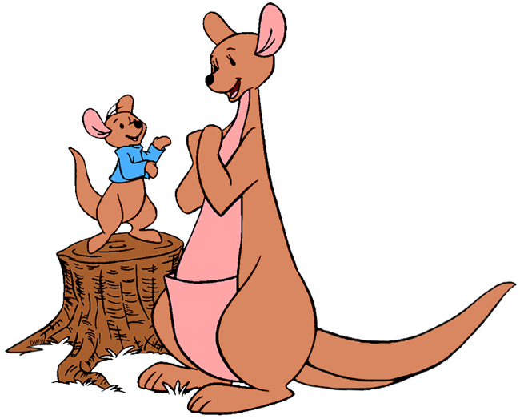

Slide 5
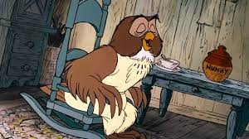

Slide 6
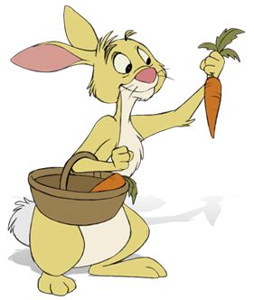

Slide 7
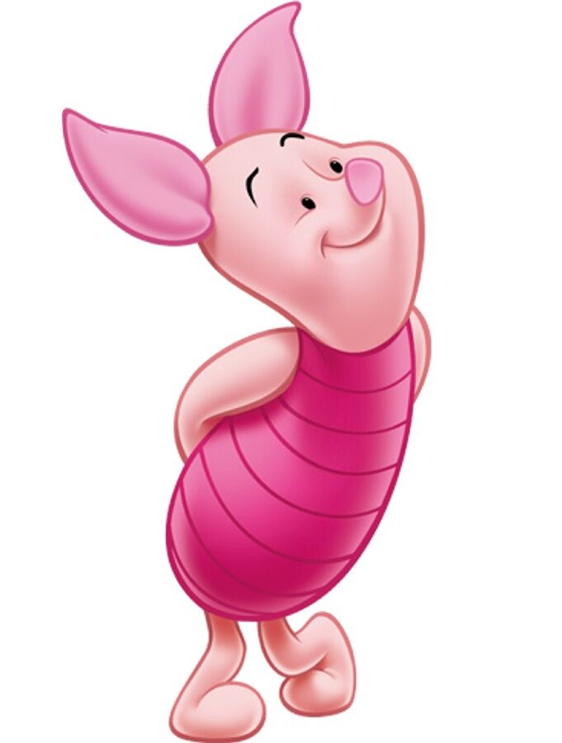

Slide 8
‘Piglet noticed that even though he had a Very Small Heart, it could hold a rather large amount of Gratitude.’
A. A. Milne, Winnie the Pooh

