Slide 1
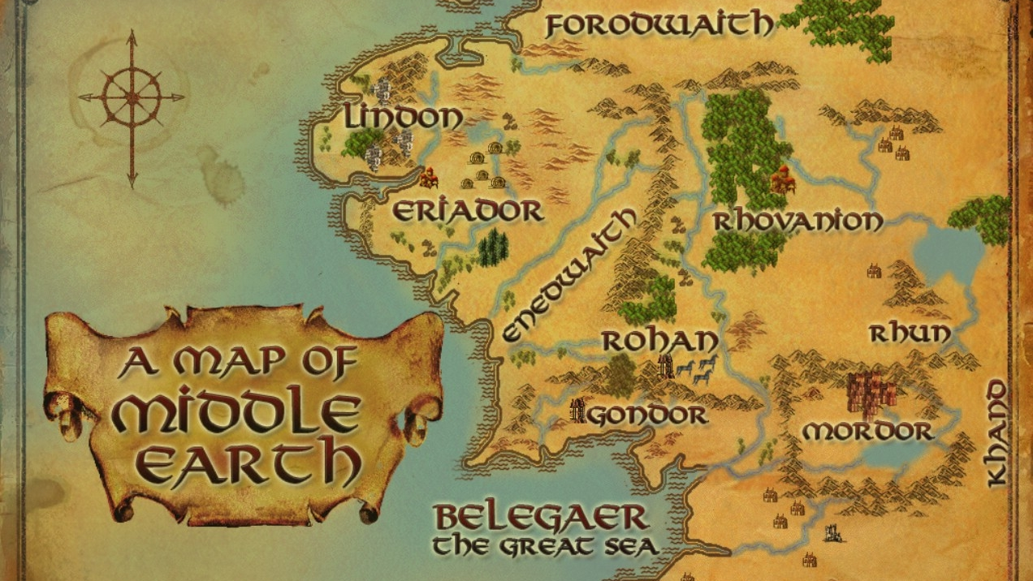
Welcome to Middle-earth

Slide 2
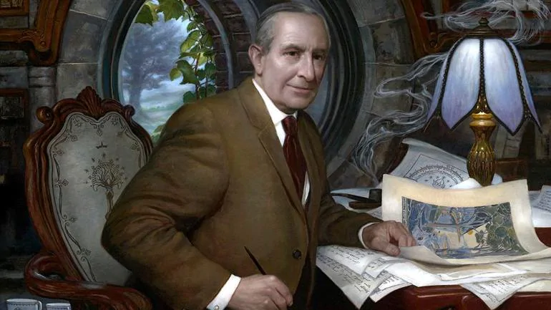

Slide 3


Slide 4
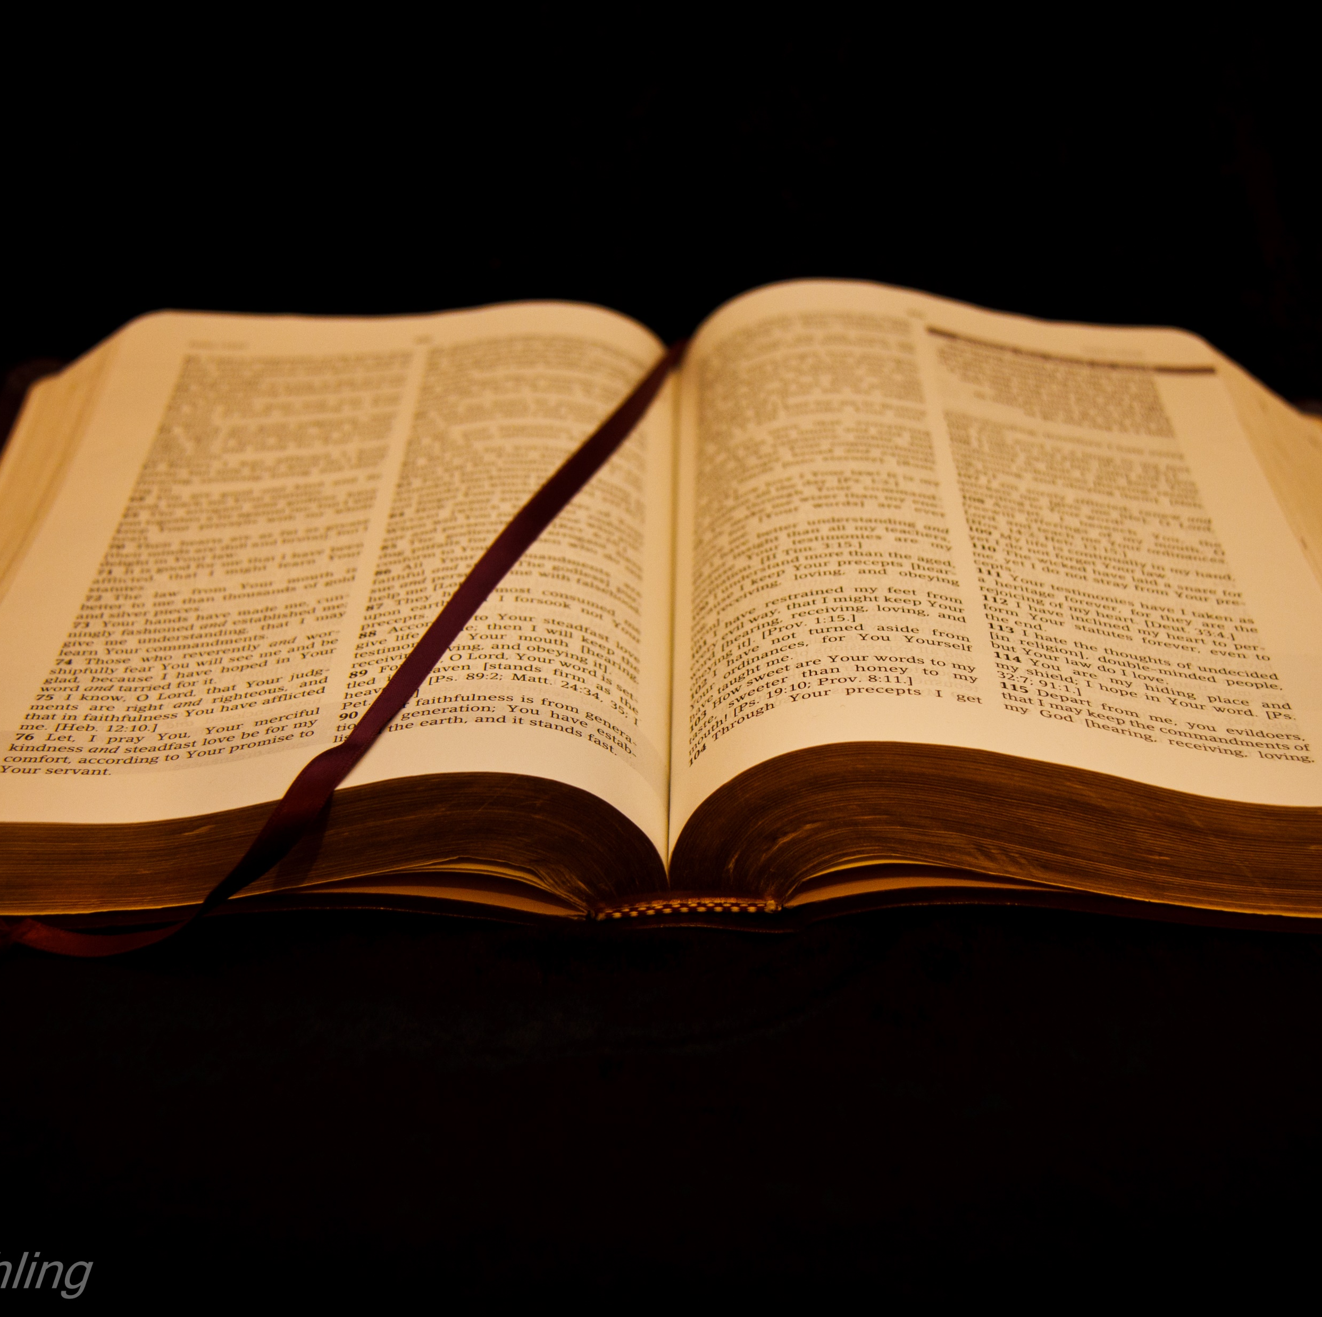
‘There is neither Jew nor Greek, there is neither slave nor free, there is no male and female, for you are all one in Christ Jesus.’
Galatians 3.28
This Photo by Unknown Author is licensed under CC BY

Slide 5
‘Enter through the narrow gate. For wide is the gate and broad is the road that leads to destruction, and many enter through it. But small is the gate and narrow the road that leads to life, and only a few find it.’
Matthew 7.13-14
This Photo by Unknown Author is licensed under CC BY

