Slide 1
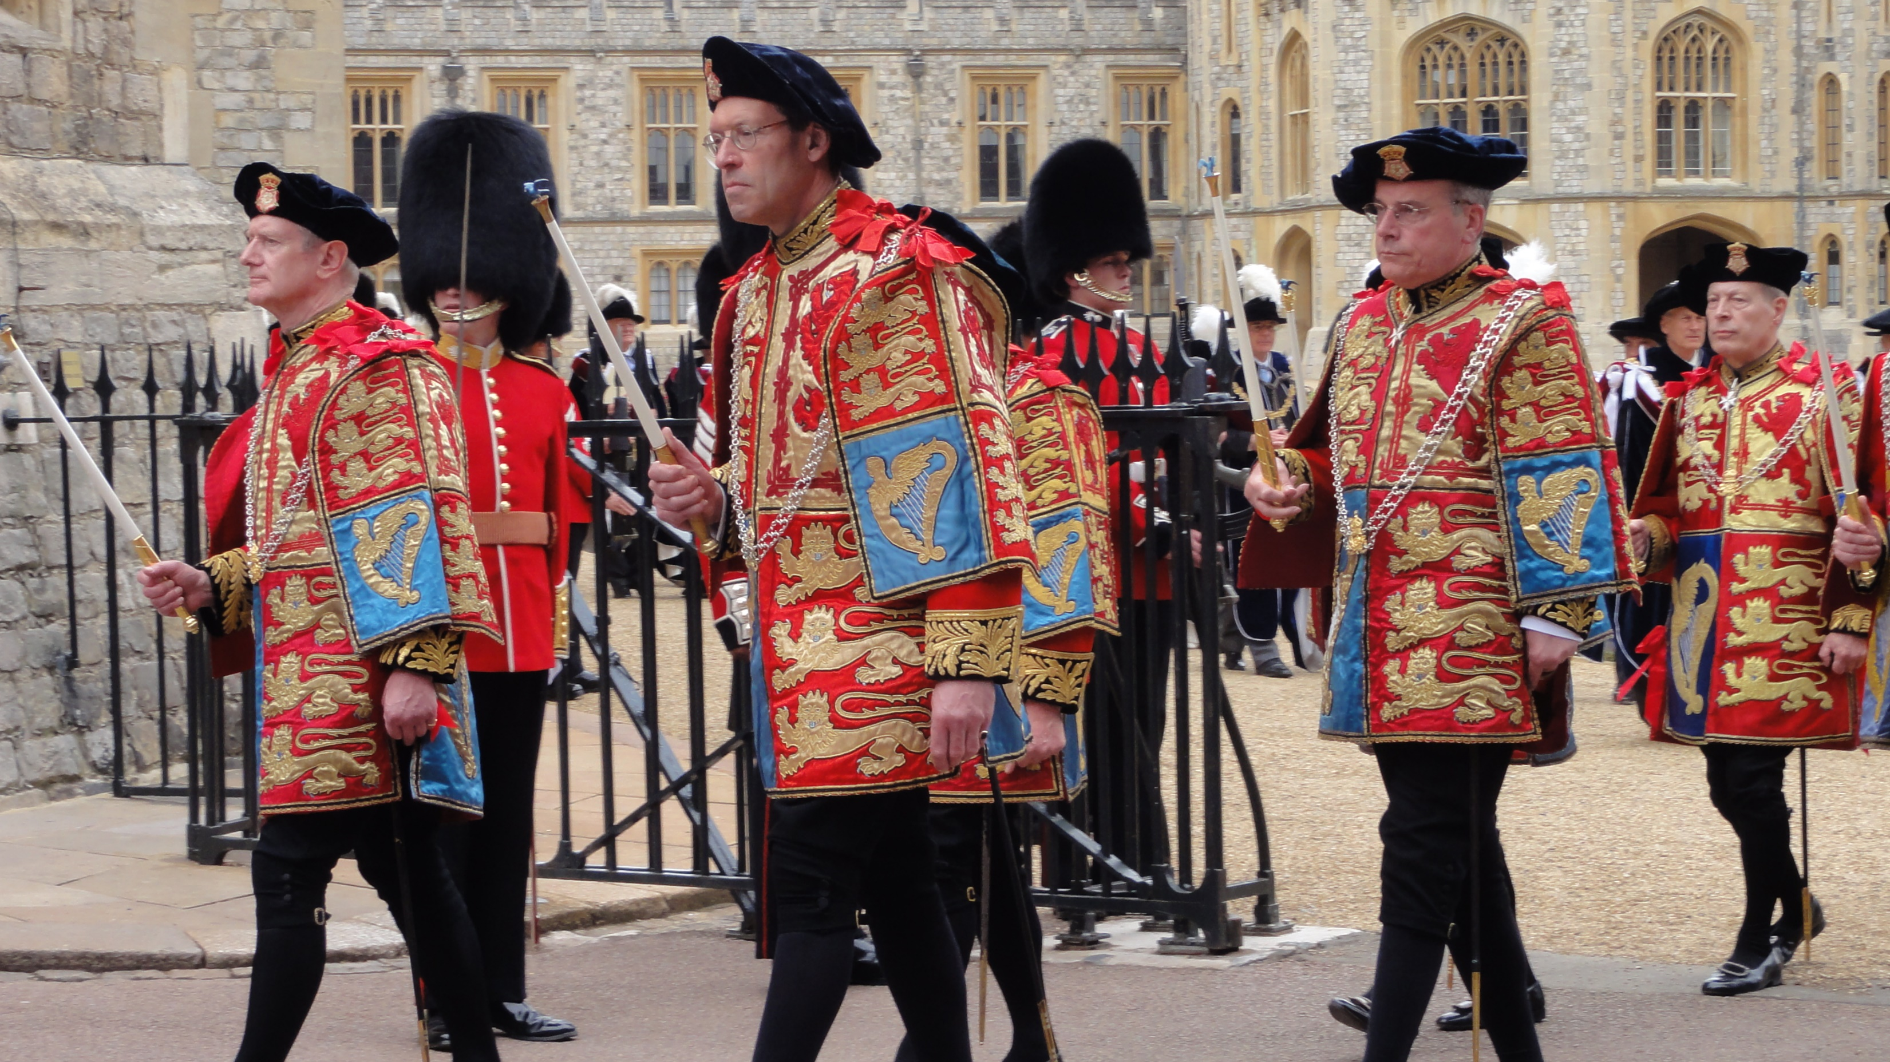

Slide 2
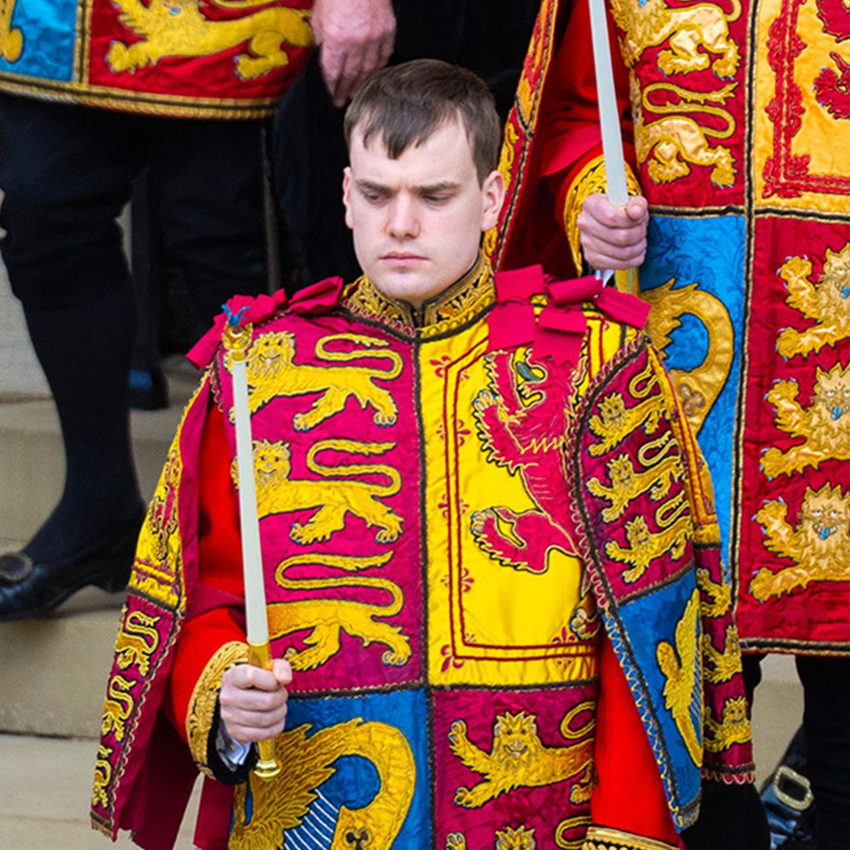
Royal Herald

Slide 3
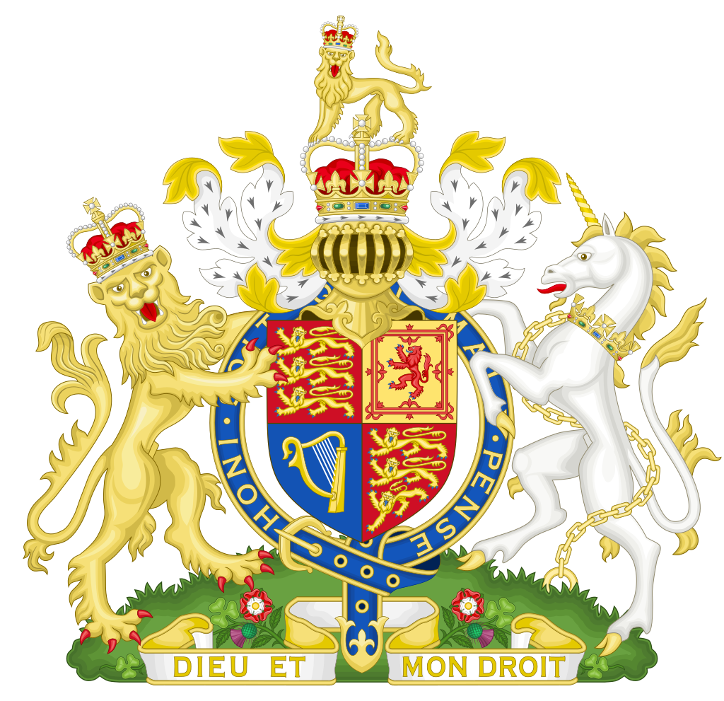

Slide 4
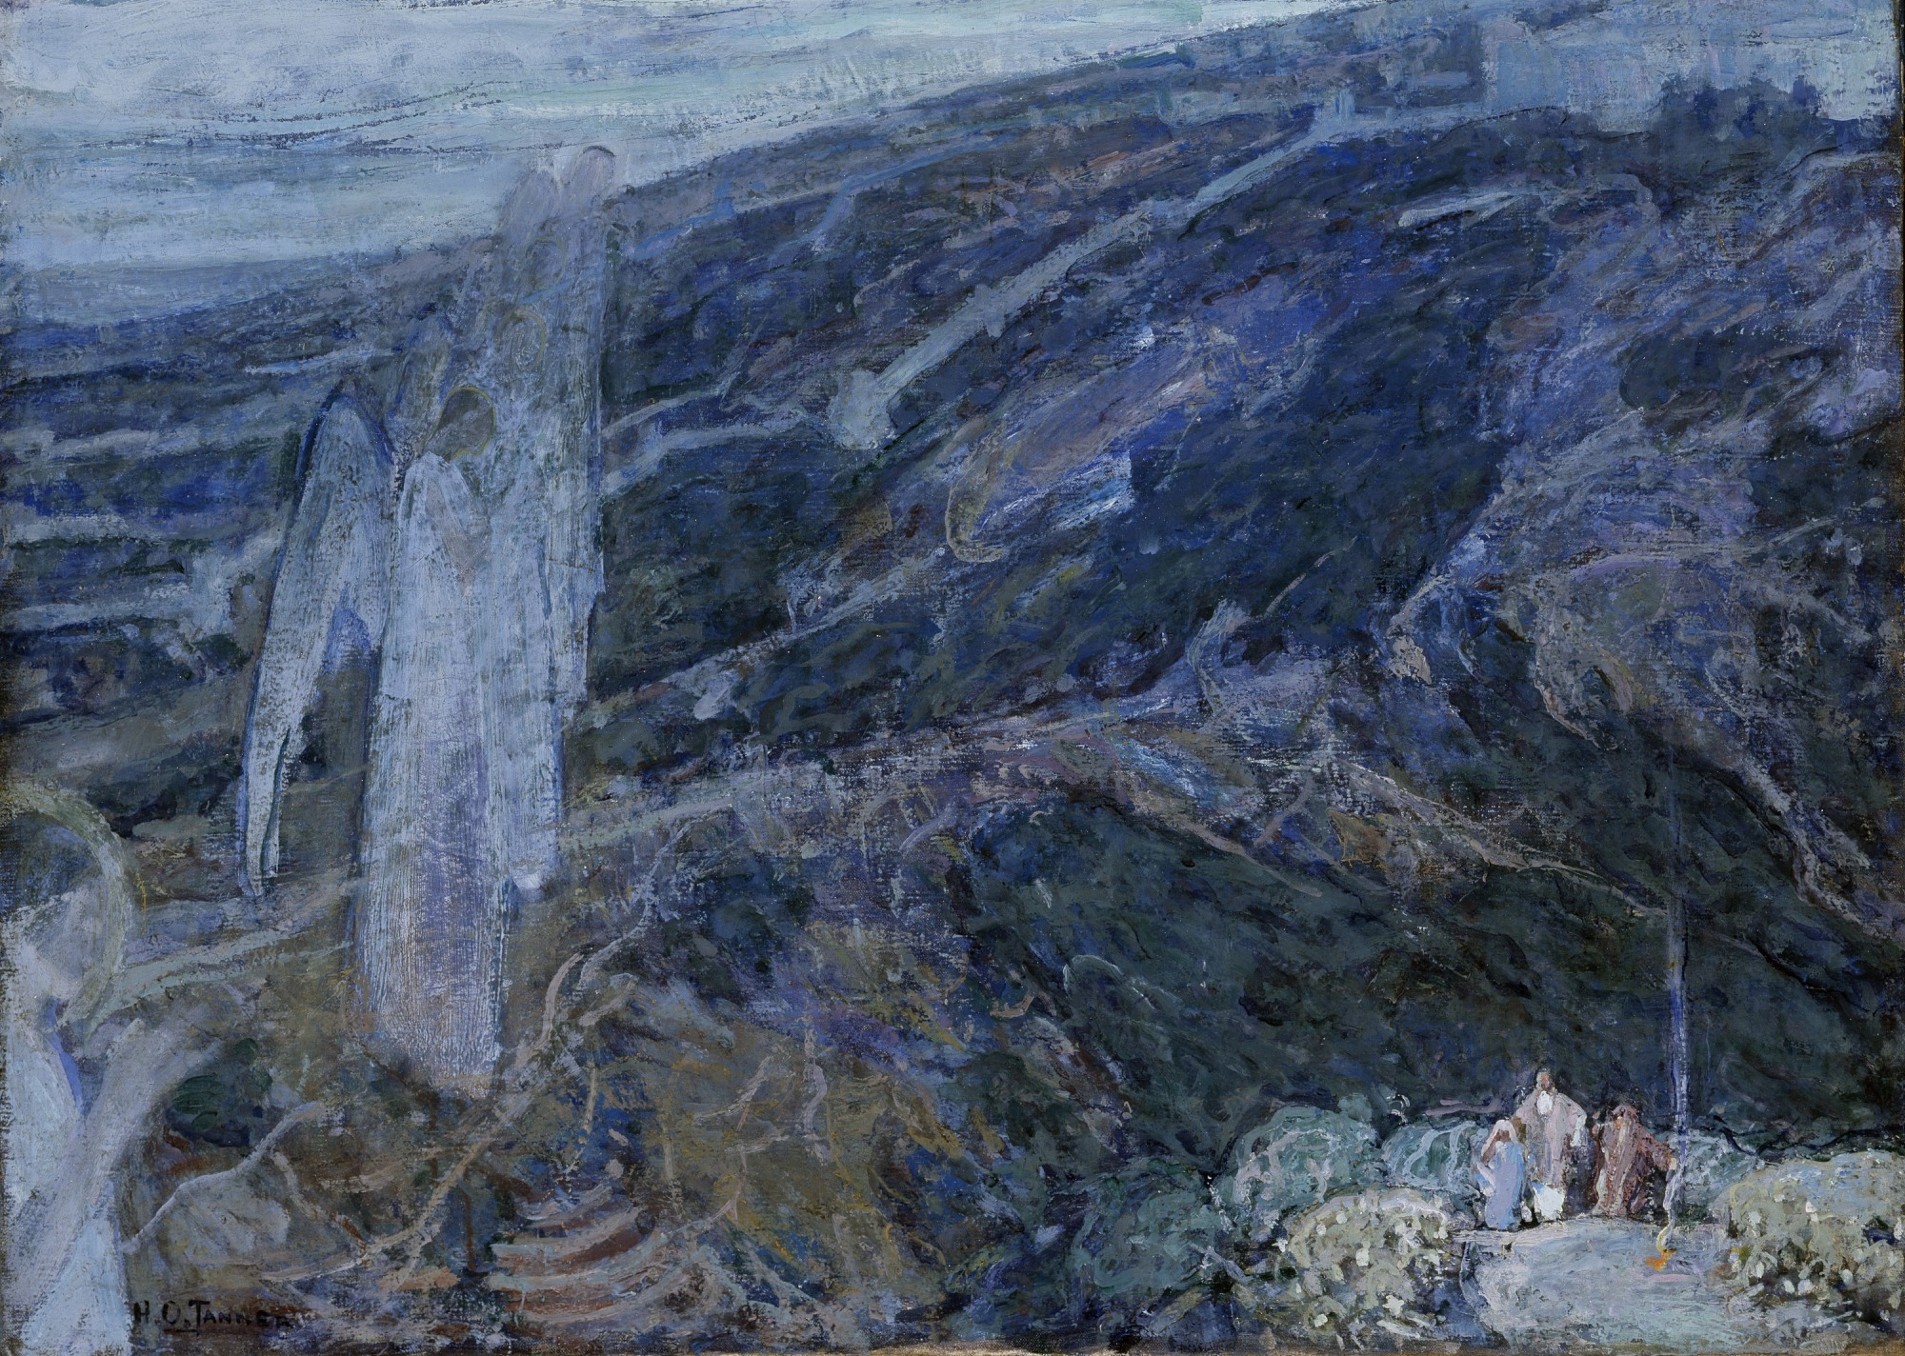

Slide 5
Angels Appearing before the Shepherds by Henry Ossawa Tanner, 1910

