Slide 1
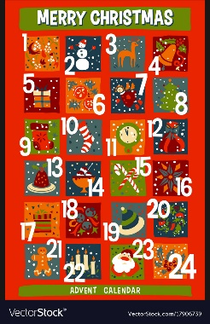
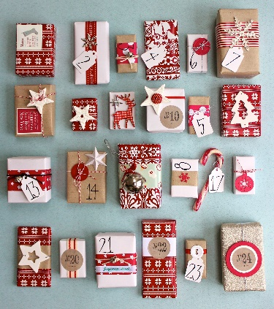
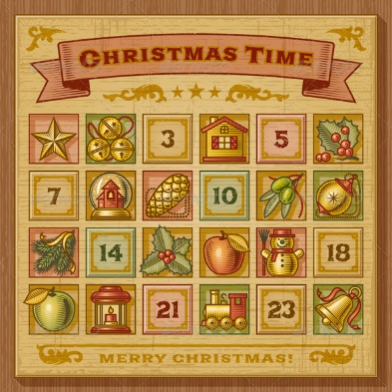
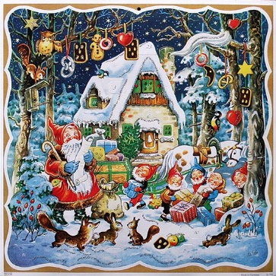

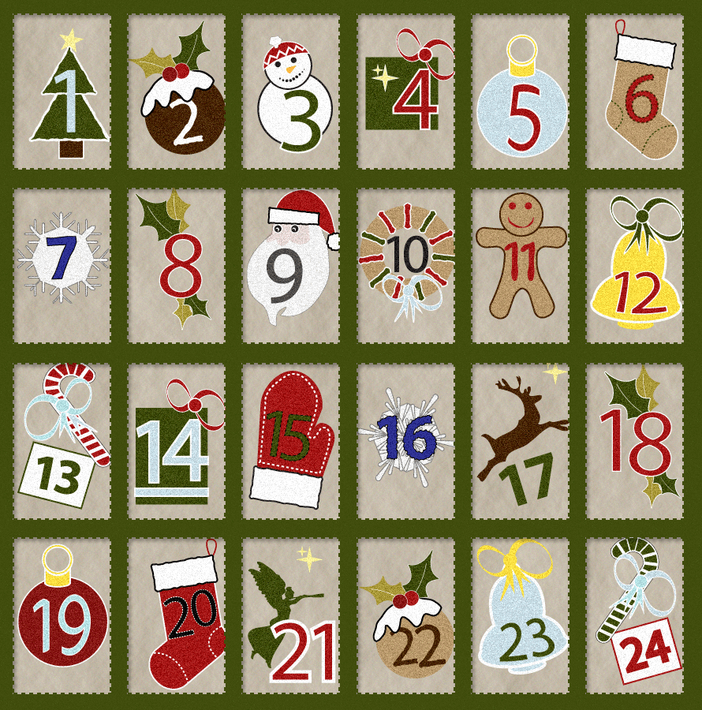

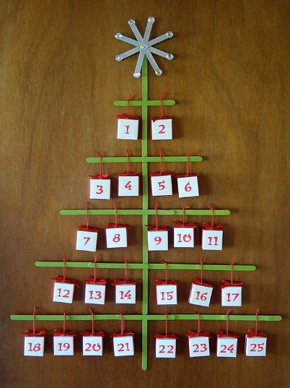

An Advent
Acrostic

Slide 2


Arrival
D
V
E
N
T

Slide 3


Arrival
December
V
E
N
T

Slide 4



Arrival
December
Violet
E
N
T

Slide 5

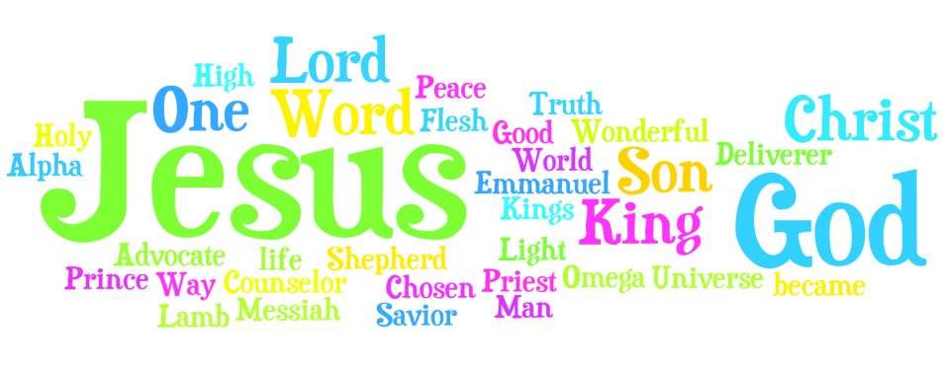
Arrival
December
Violet
Emmanuel
N
T

Slide 6
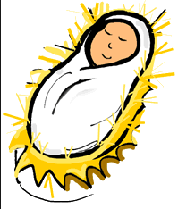
Arrival
December
Violet
Emmanuel
Near
T

Slide 7
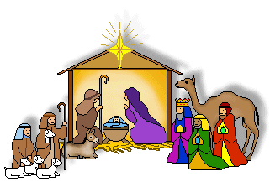
Arrival
December
Violet
Emmanuel
Near
Time

