Slide 1
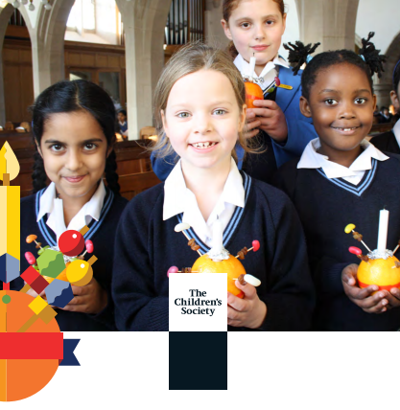

Notes:
What you will need:
A large pillar candle
A box of matches
A Christingle for each class in school
Copies of the readings to give out to readers (see the end of this resource)
Candle templates (see the end of this resource)
Preparation in advance:
Choose children to read and provide them with their reading. Make sure that they are seated in various areas around the assembly space.
Place baskets of candle templates near the entrance/exit or give them to class teachers for distribution at the end.
Play Claude Debussy’s ‘Clair de lune’ (see Slide 2 for an embedded YouTube version) as the pupils come into the assembly space.

Slide 2
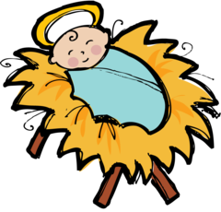


Happy Birthday to You!
Notes:
Welcome the children and staff.
Explain that, at this time of year, Christians prepare for and then celebrate the birth of Jesus.
Ask the children how they celebrate their birthdays – take two or three answers.
Explain that you have baked a special birthday cupcake for Jesus. (Click to bring up the image.) Ask the children what they think is missing from the cake (answer: a candle).
Explain that Christians light candles to celebrate Jesus’ birth, but also to remind them of Jesus.

Slide 3
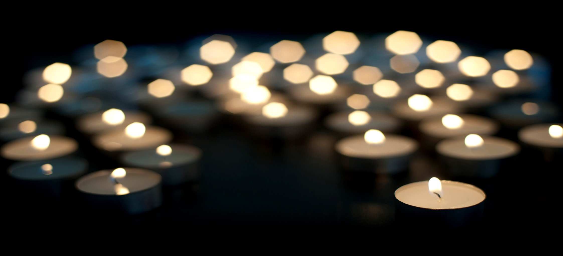
Notes:
(If possible, darken the assembly space at this point.)
When the children have settled, explain that light is often associated with joyfulness and celebrations (you could suggest some, such as Diwali, Hanukkah and Bonfire Night, or ask the children if they can think of examples). Light is also a symbol of hope in times of darkness and suffering.
(Give the readers their cue to read their quotations.)
When the readers have finished, ask another child to help you light a large pillar candle (remind them to be careful and to stand back from the flame after the candle has been lit).

Slide 4

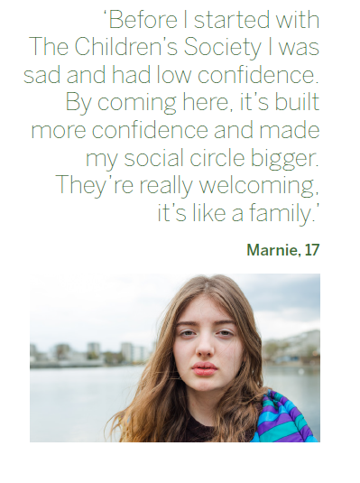
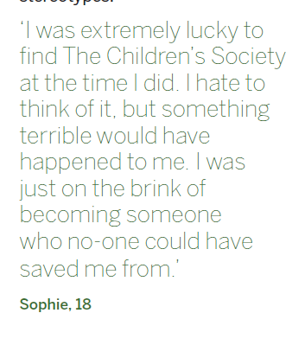
Notes:
Tell the children that The Children’s Society is a charity that supports vulnerable and disadvantaged children to help bring light and hope into their lives. One of the ways in which they do this is to make sure that children and young people have a voice, so that adults listen to them and respond to what they say.
What does it mean to be voiceless?
Invite one child up to the front (you may wish to choose the child in advance and brief them). Show them one of the statements on the cards on page 6 and tell them that they have to try to get everyone to guess what is on the card – but they can’t use their voice. (You could repeat this activity a few times if time allows.) Afterwards, ask the ‘voiceless’ child(ren) to describe how easy or difficult the task was. Make the point that being able to make our voices heard is really important.

Slide 5
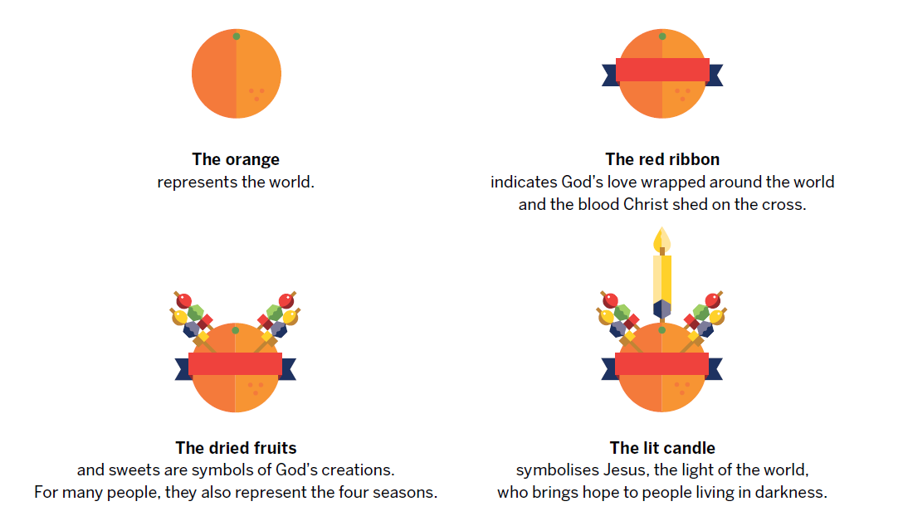
What Is Christingle?
The meaning of the Christingle
Notes:
Explain that, every year, The Children’s Society encourages us to celebrate Christingle as a symbol of Christian beliefs about Jesus, as well as a reminder of the hope and light we can bring into the world.
Hold up an unlit Christingle and explain its symbolism to Christians.
The orange symbolises the whole world, showing that everyone, no matter who they are, deserves to have hope.
The red ribbon symbolises God’s love for everyone in the world.
The fruit and sweets symbolise the good things of the world that we share together.
The candle represents Jesus, who Christians believe is the light of the world.
Explain that the funny thing about candles is that they can give light without losing light – demonstrate by lighting the Christingle from the large pillar candle.
Tell the children that, in the same way, we can bring hope and love to those around us without losing anything.
Explain that you are going to ask the teachers from each class to come up and light a class Christingle so that the light of love and hope can be shared with everyone in school.
(Staff come up and light their Christingles from the worship leader’s Christingle or each other’s Christingles.)

Slide 6

Notes:
Remind the children that we have been focusing on the idea of light as a symbol of hope and love, and the work of The Children’s Society, who bring hope and love to children and young people around the country. Set the children a challenge: ask them to think about the ways in which they can bring light into the world. Tell them to collect a candle template on their way out. Explain that, when they get back to class, you would like them to write or draw one thing in their candle that they are going to do to bring light into the world. It could be something to show their love for someone they care for, or something that will bring hope to someone who is struggling or feeling sad. It could be a promise to support the work of The Children’s Society by telling people about it or raising money for it so that they can continue to help those who need hope.
Suggest that they could make a display of these promises around their class Christingle, so that every time they look at the Christingle, it will remind them of their promise to bring light into the world. (Staff could hand out the candle template to children or you could place the templates in baskets near the exits for children to collect if they wish to.)
(As the children leave, you may like to play another piece of music associated with light and hope, such as ‘Light up the world’, available at: https://www.youtube.com/watch?v=1hTfCwLpbaw)

