Slide 1
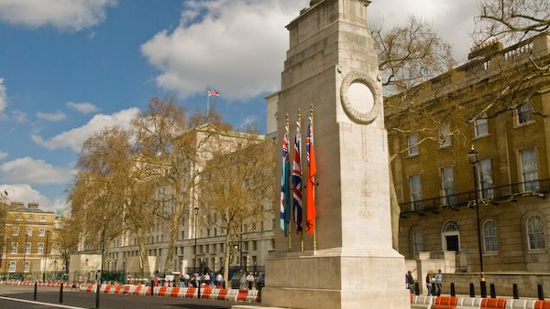
The Cenotaph, Whitehall

Slide 2
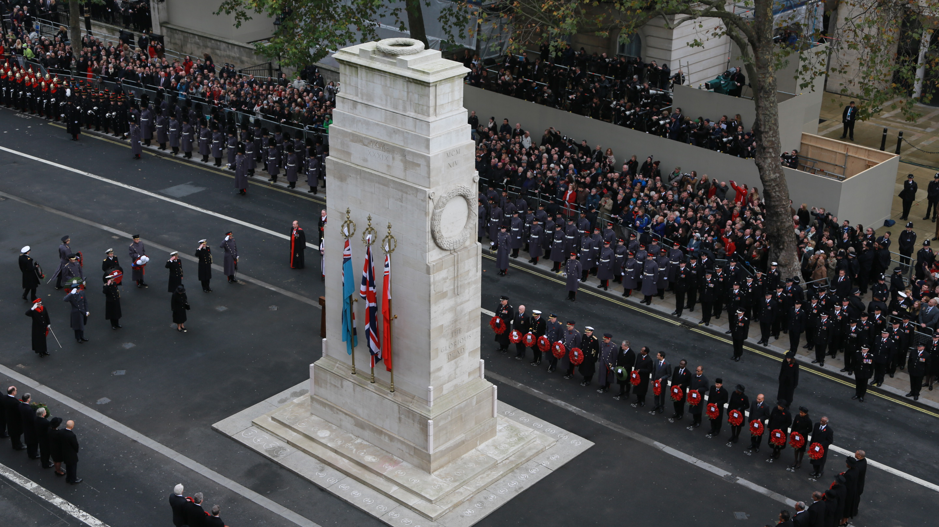
The National Service of Remembrance at the Cenotaph

Slide 3
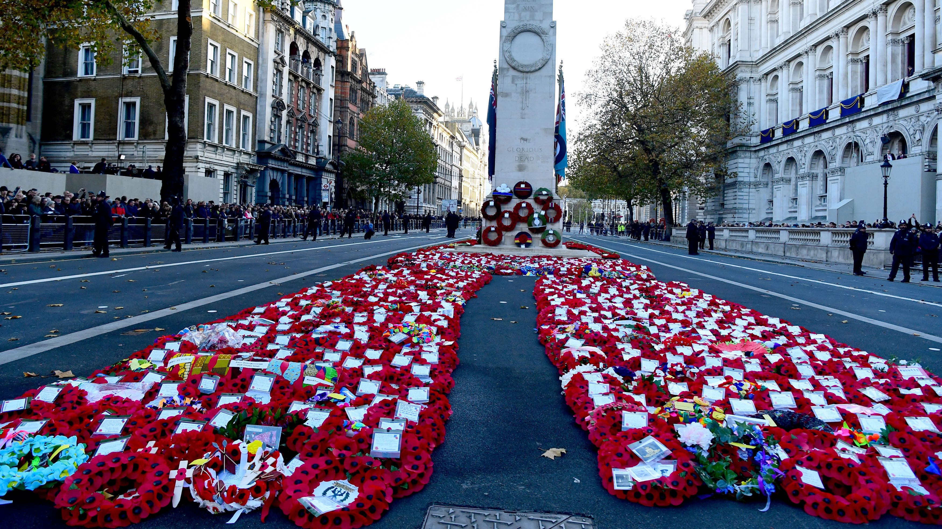

Slide 4
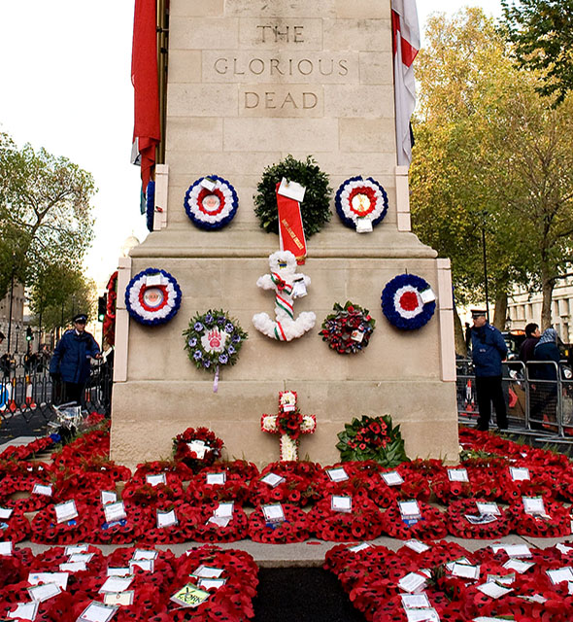
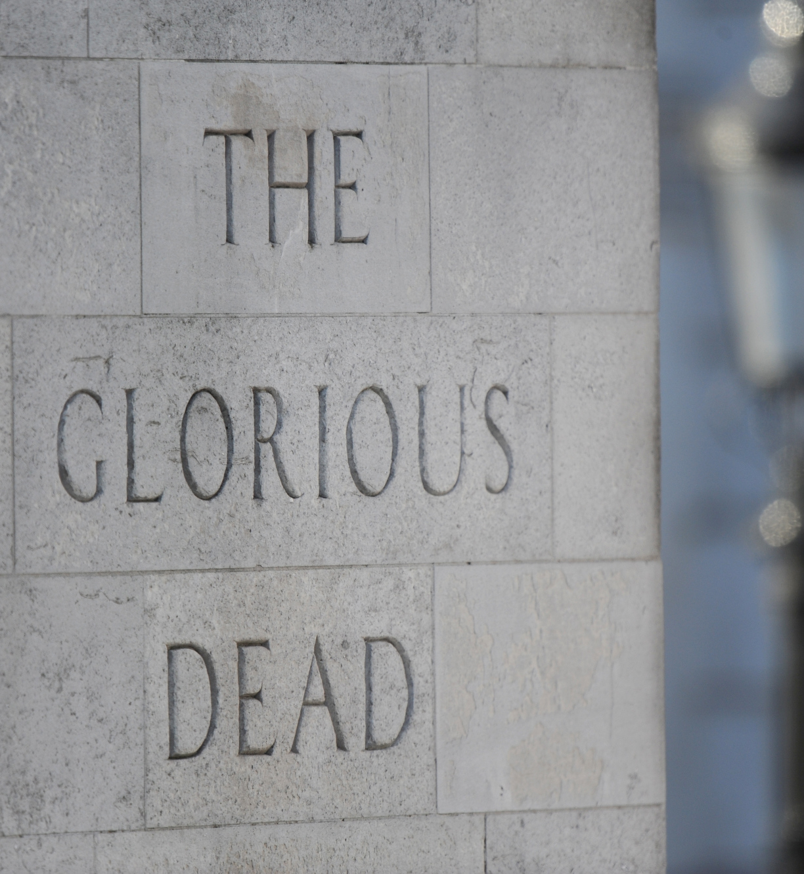

Slide 5
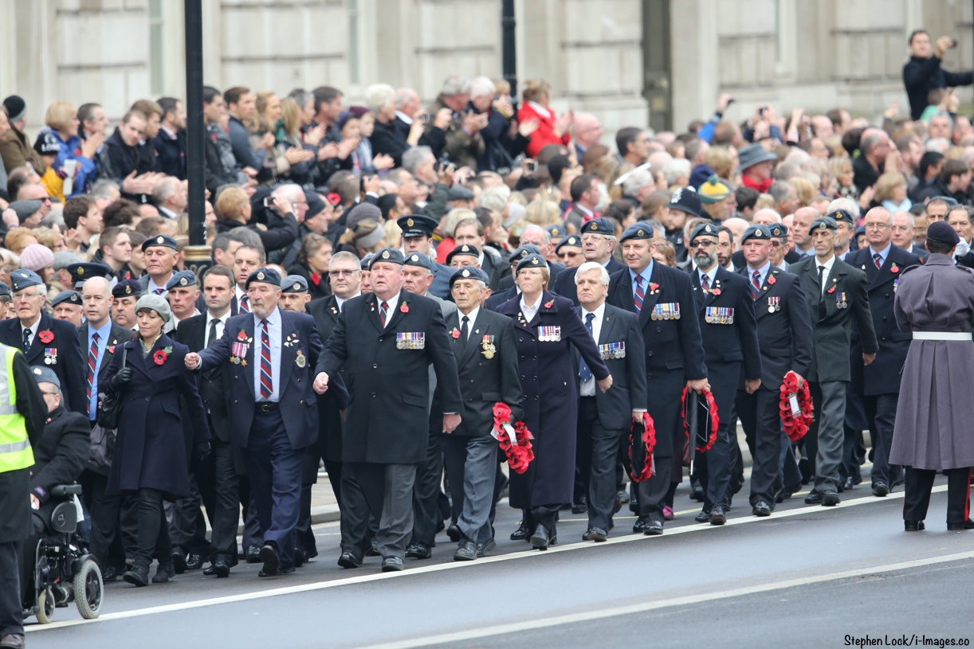

Slide 6


Slide 7


Slide 8

They shall grow not old as we that are left grow old:
Age shall not weary them, nor the years condemn.
At the going down of the sun and in the morning
We will remember them.
Response: We will remember them.

