Slide 1

Welcome to our assembly

Slide 2


Slide 3



Slide 4


Slide 5


Slide 6


Slide 7
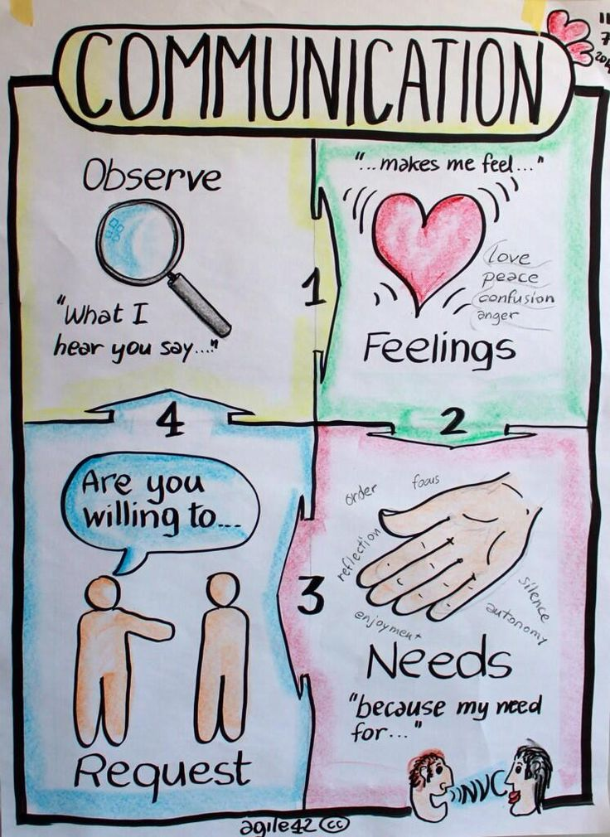

Slide 8



Slide 9


