Slide 1

Welcome to our assembly

Slide 2
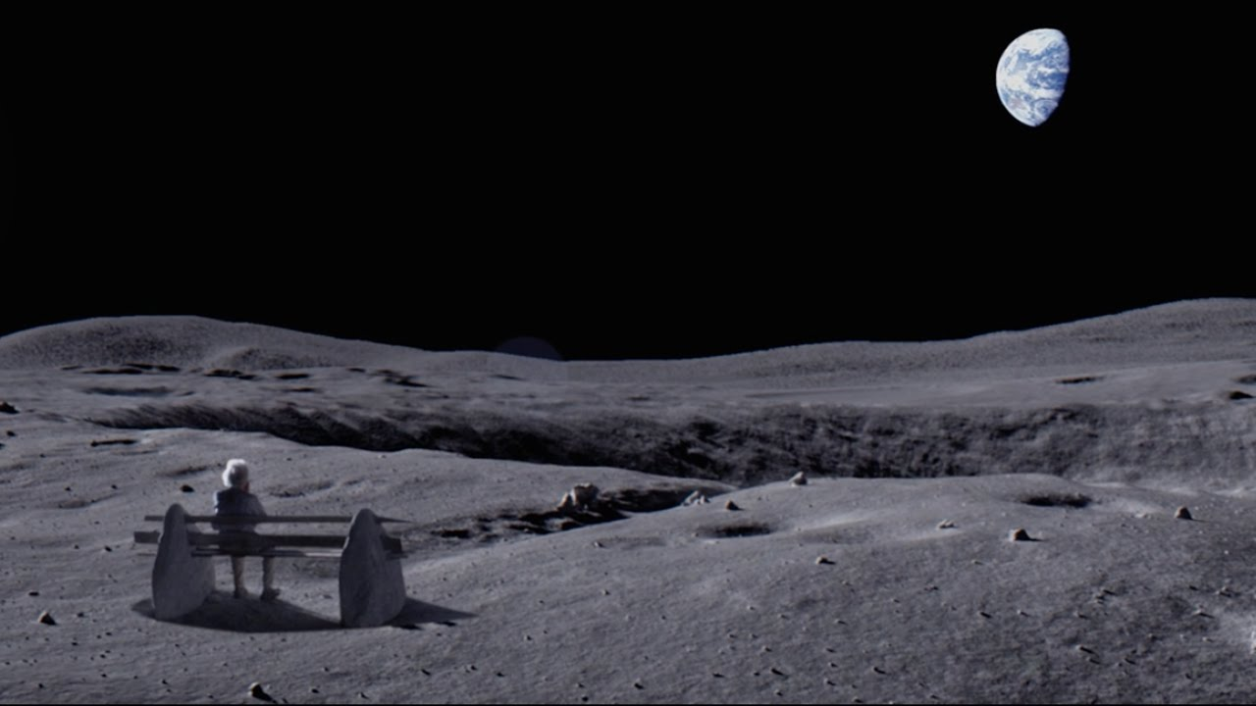

Slide 3
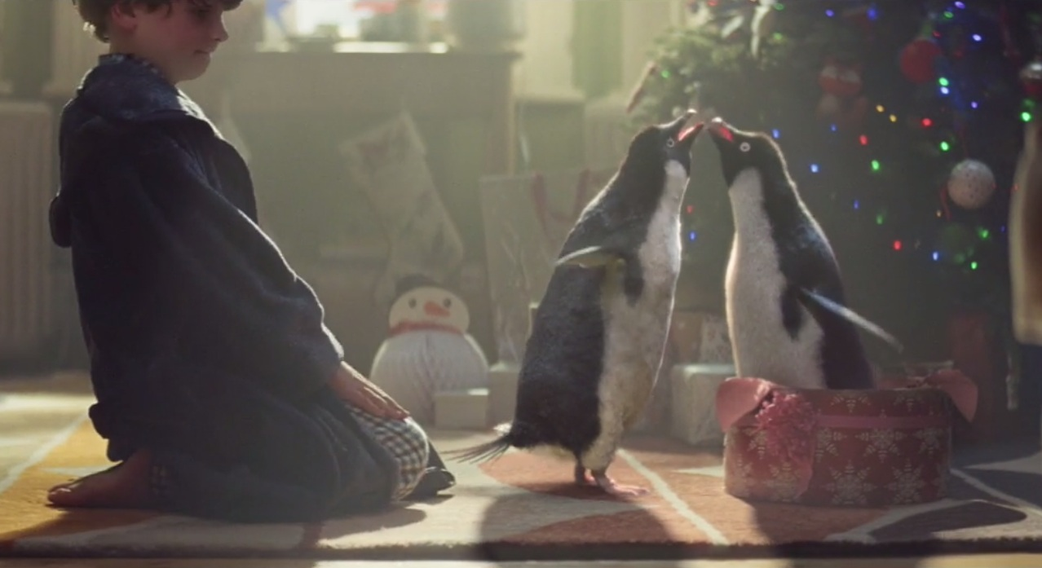

Slide 4
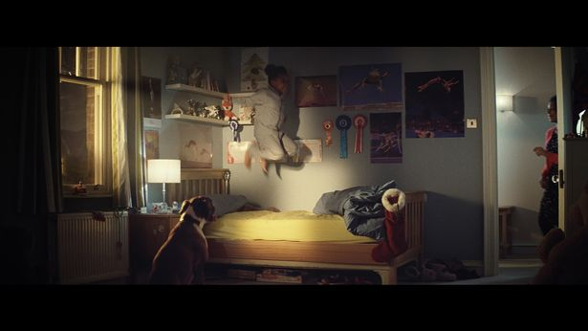

Slide 5
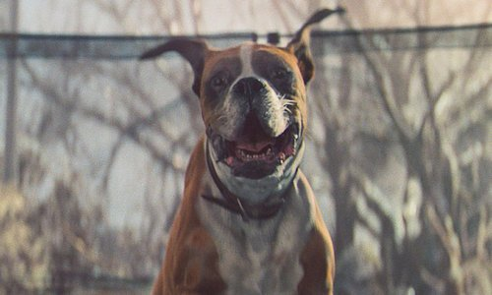

Slide 6
One day, I’ll …

Slide 7
