Slide 1
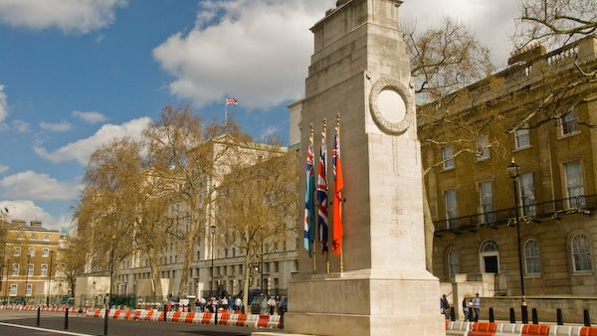
Cenotaph Whitehall

Slide 2
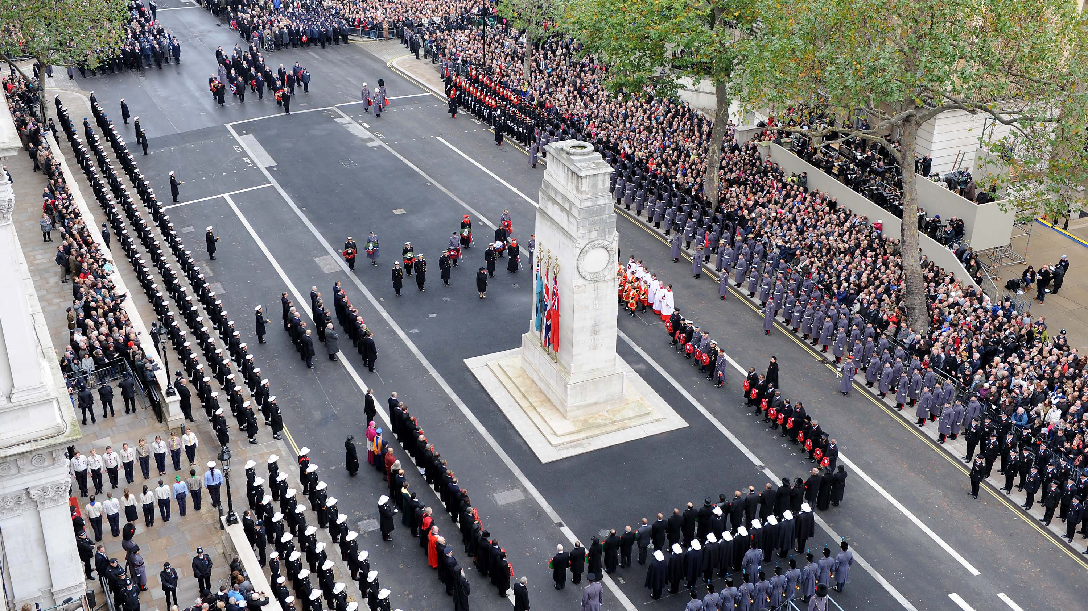
Cenotaph

Slide 3
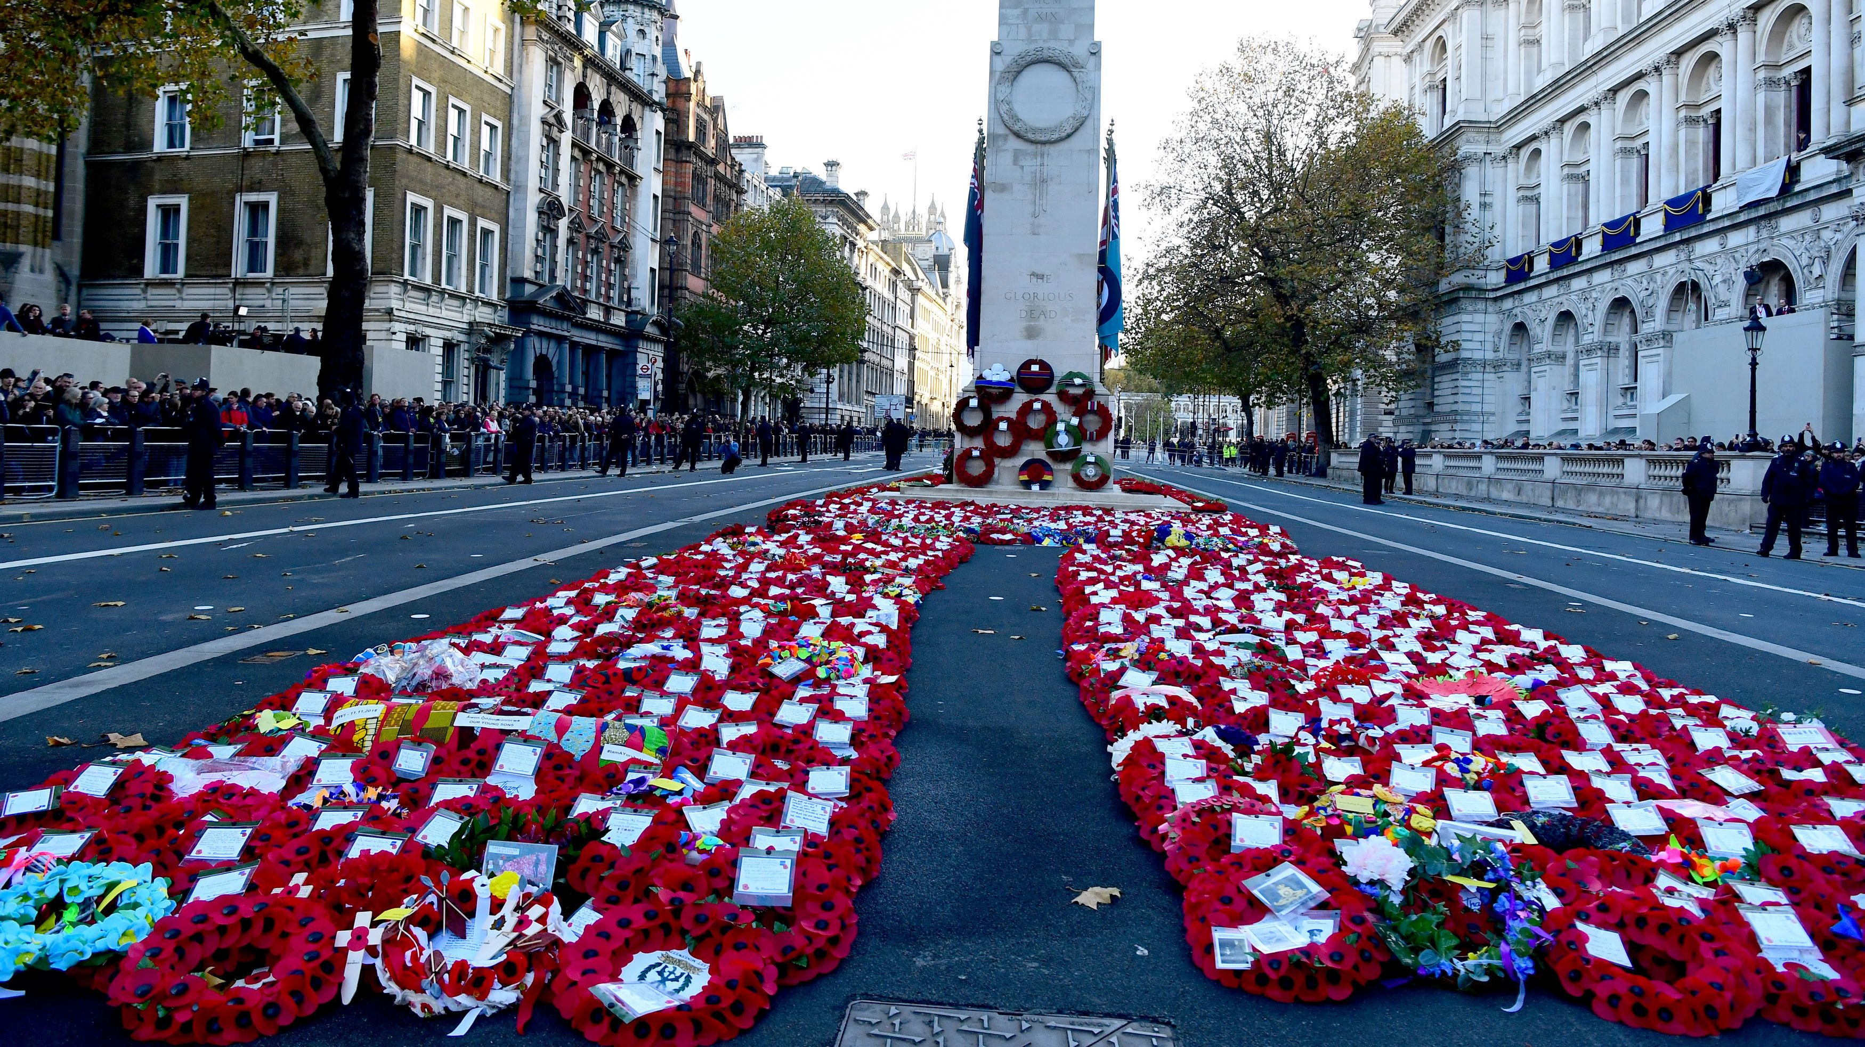

Slide 4
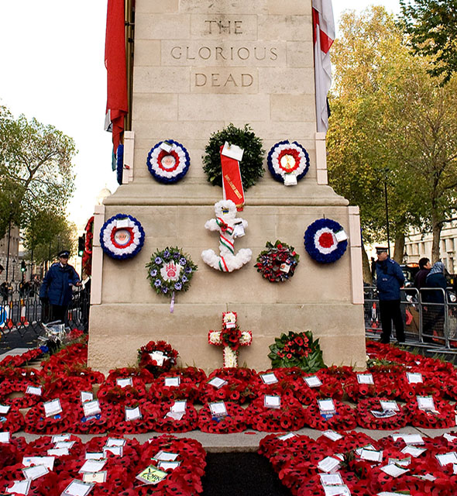
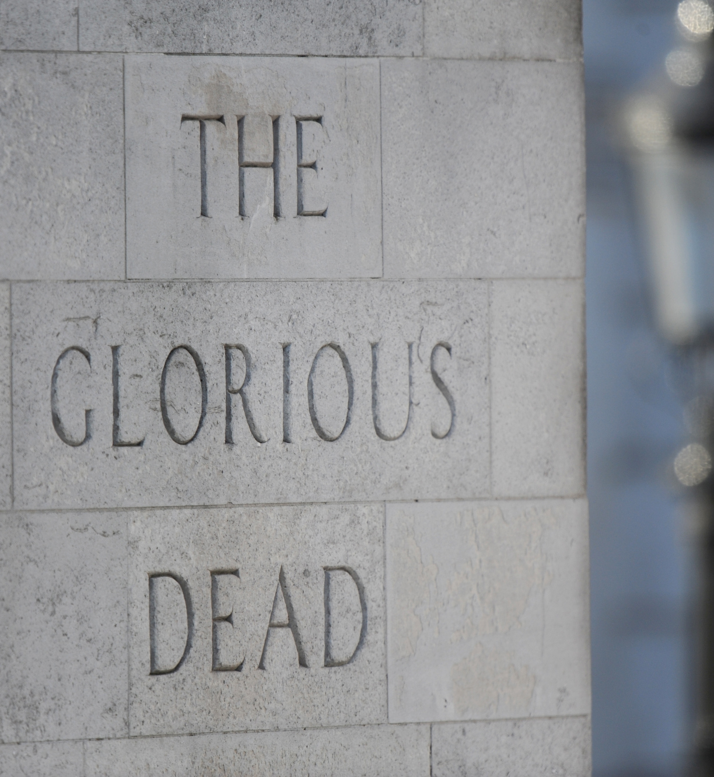

Slide 5
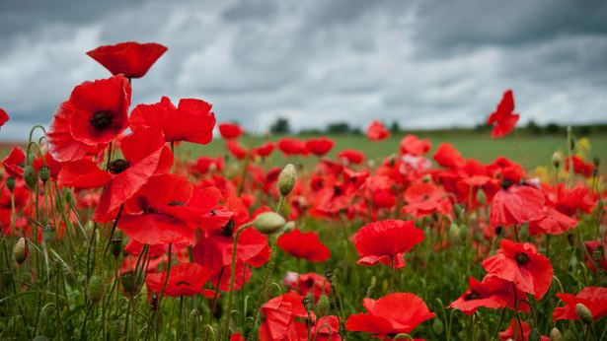

Slide 6


Slide 7
They shall not grow old as we that are left grow old:
Age shall not weary them, nor the years condemn.
At the going down of the sun and in the morning.
We will remember them.
Response: We will remember them.

