Slide 1

Welcome to our assembly

Slide 2
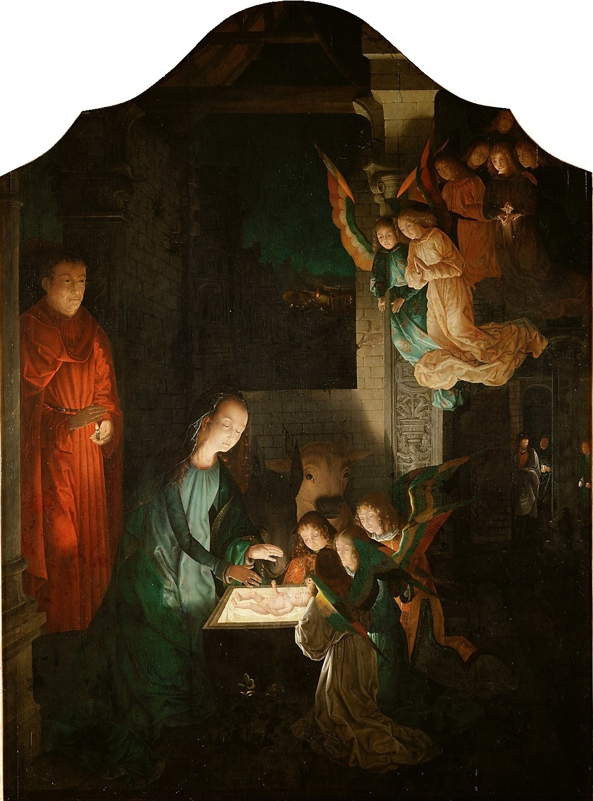
The Nativity at Night by Michel Sittow, c. 1500

Slide 3

‘No one lights a lamp and puts it in a place where it will be hidden, or under a bowl. Instead, they put it on its stand, so that those who come in may see the light.’
(Luke 11.33)

Slide 4


Slide 5
This little light of mine,
I’m gonna let it shine.
This little light of mine,
I’m gonna let it shine.
This little light of mine.
I’m gonna let it shine,
Let it shine, let it shine,
oh let it shine.

Slide 6


