Slide 1

Welcome to our assembly

Slide 2
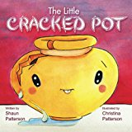
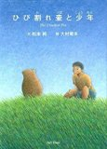
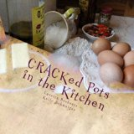
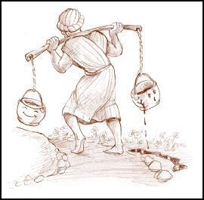

Slide 3
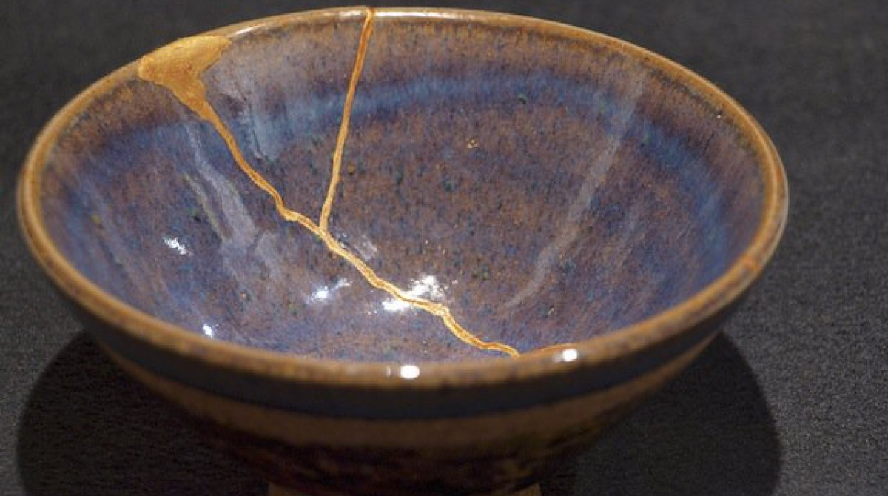
Kintsugi
継ぎ?, きんつぎ – literally ‘golden joinery’

Slide 4
Psalm 147:3
He heals the
brokenhearted and
binds up their wounds.

