Slide 1
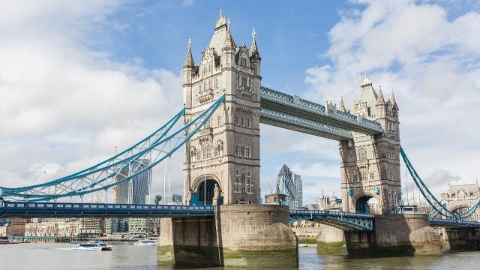
Tower Bridge in London

Slide 2
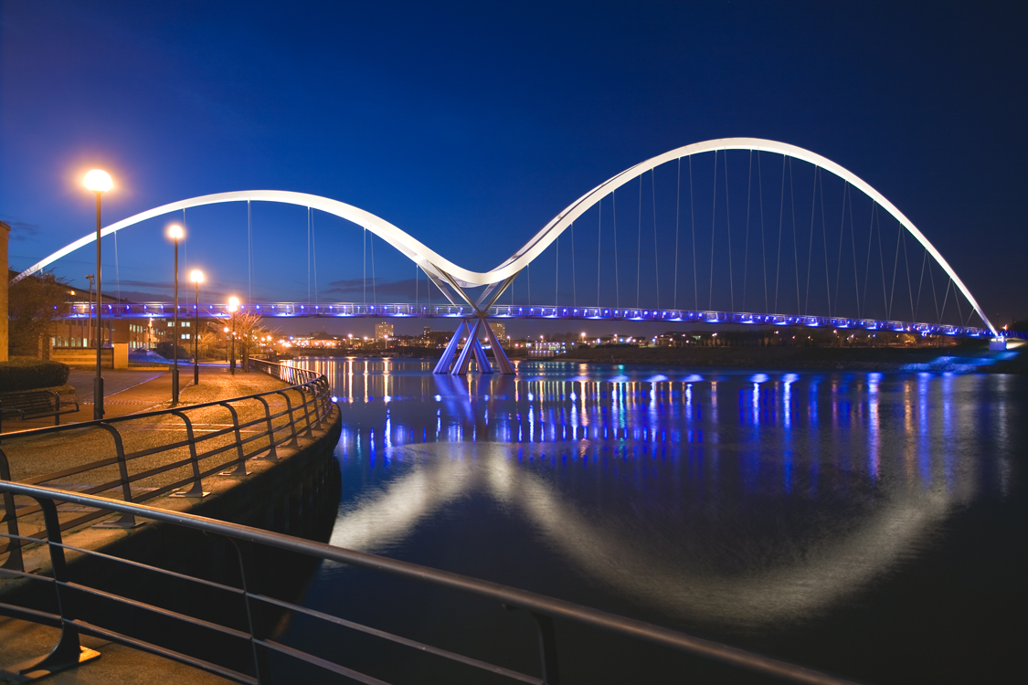
Infinity Bridge in Stockton

Slide 3
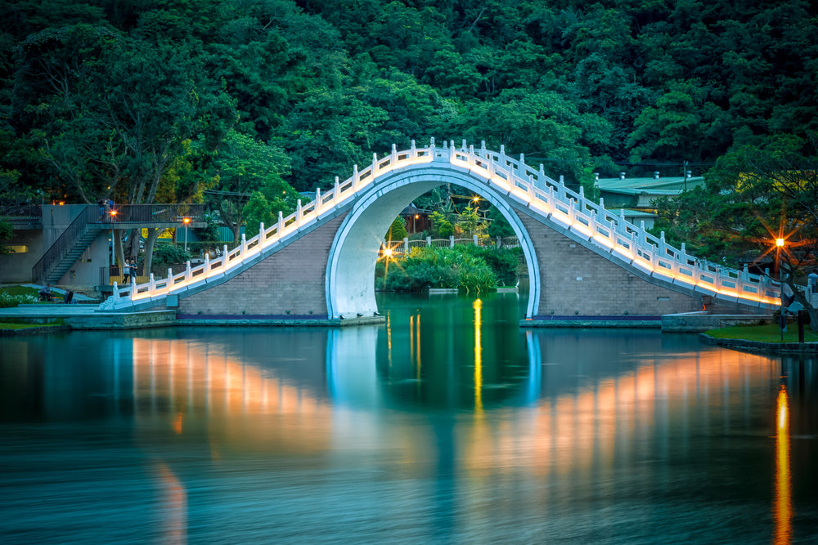
Moon Bridge in Taiwan

Slide 4
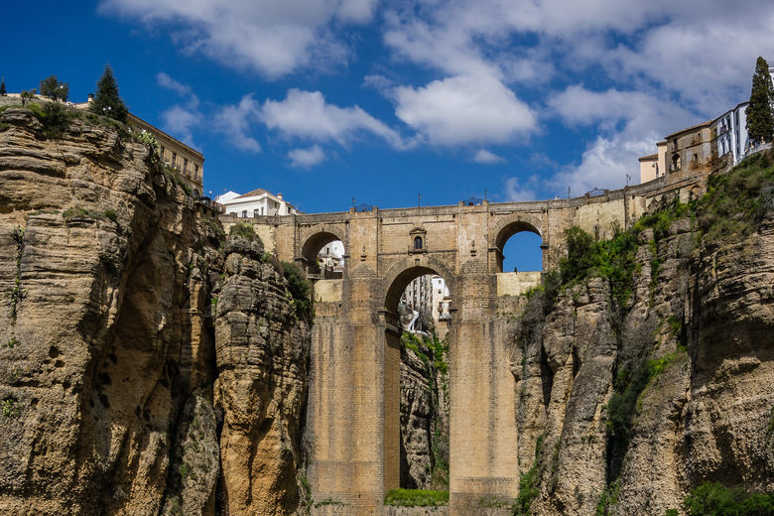
Puente Nuevo Bridge in Spain

Slide 5
Would you cross these bridges?

Slide 6
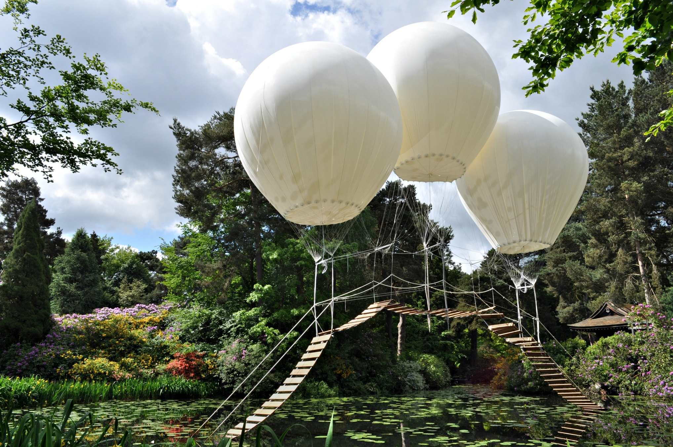
Pont de Singe bridge in Tatton Park

Slide 7
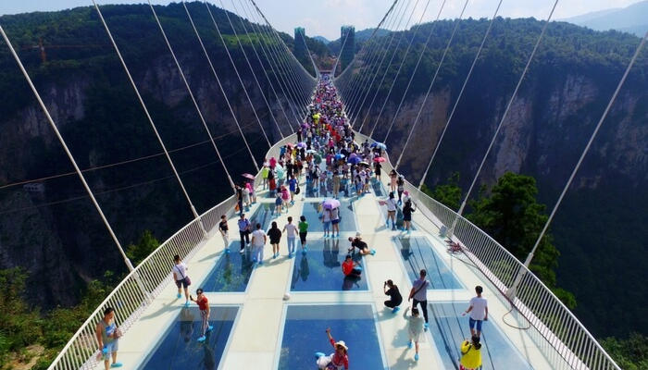
Zhangjiajie Bridge in China

Slide 8
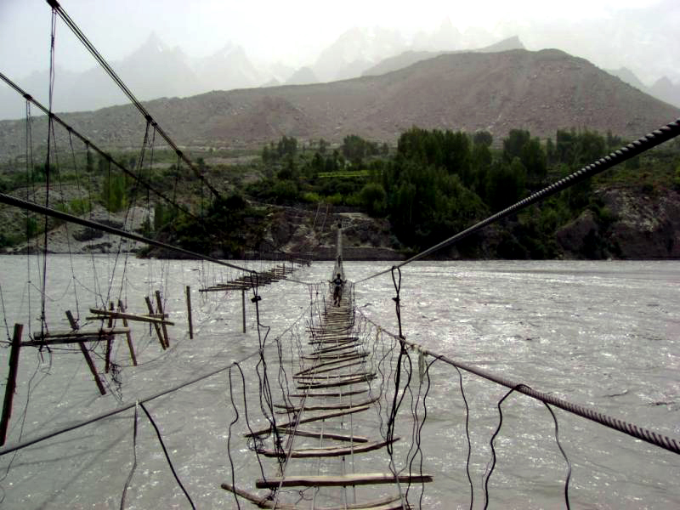
Hussaini Hanging Bridge in Pakistan

Slide 9
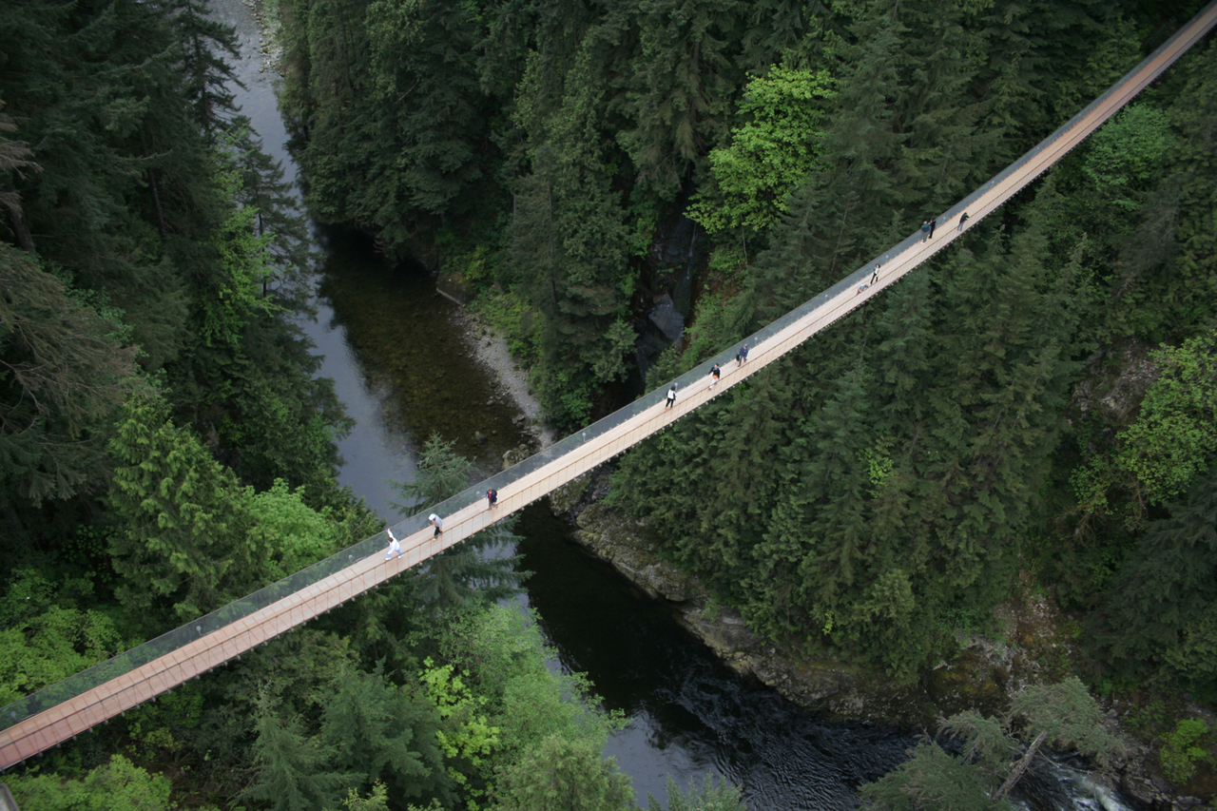
Capilano Suspension Bridge in Canada

