Slide 1
What is the root word?
limited
limitless
delimited
limiting
unlimited
limitations

Slide 2
The answer is:
limit
limited
limitless
delimited
limiting
unlimited
limitations

Slide 3
Discuss
What does limit mean?

Slide 4
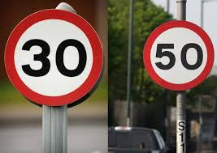
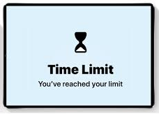
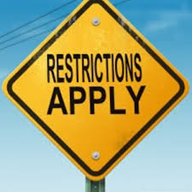
The meaning of limit is
‘something that stops you from doing something or holds you back’
Speed limit sign

Slide 5


Having no limits on your thoughts (unlimited thinking) will help you to achieve anything!

