Slide 1
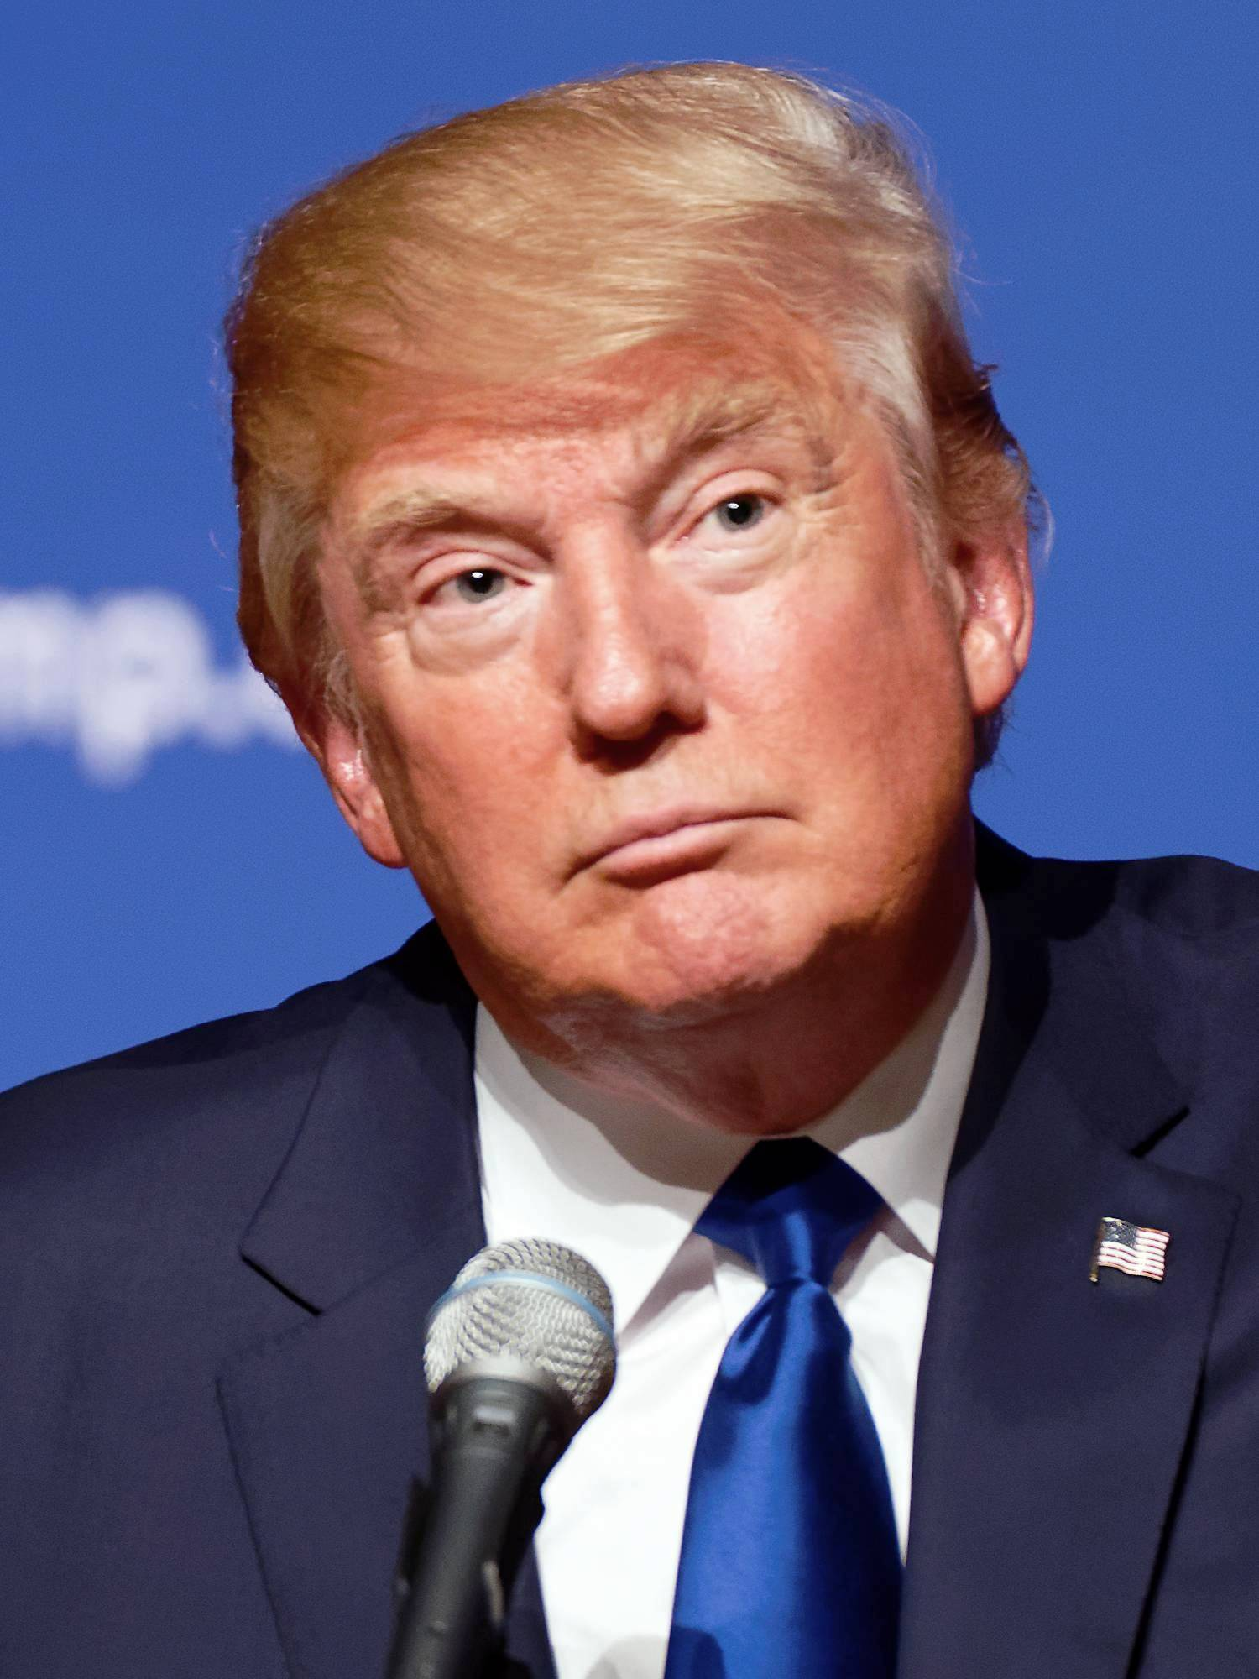
President Donald Trump

Slide 2
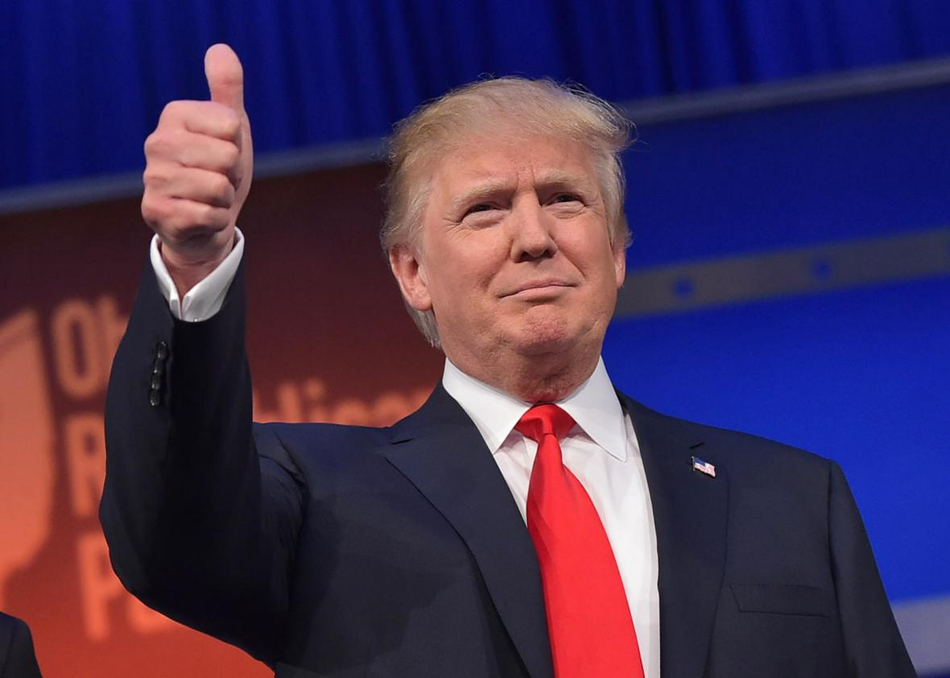
Who is he?

Slide 3



Slide 4


Slide 5


Slide 6
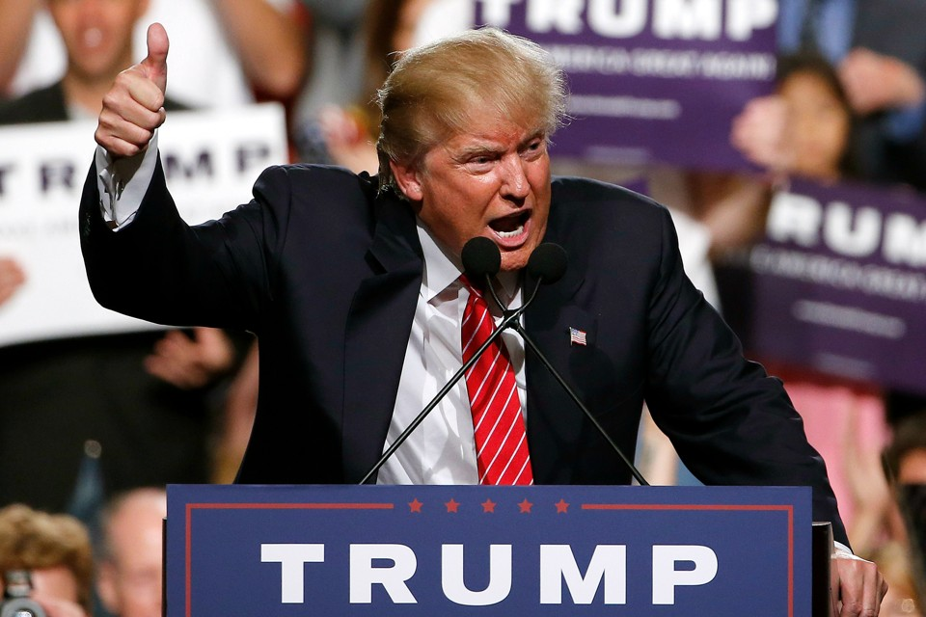

Slide 7
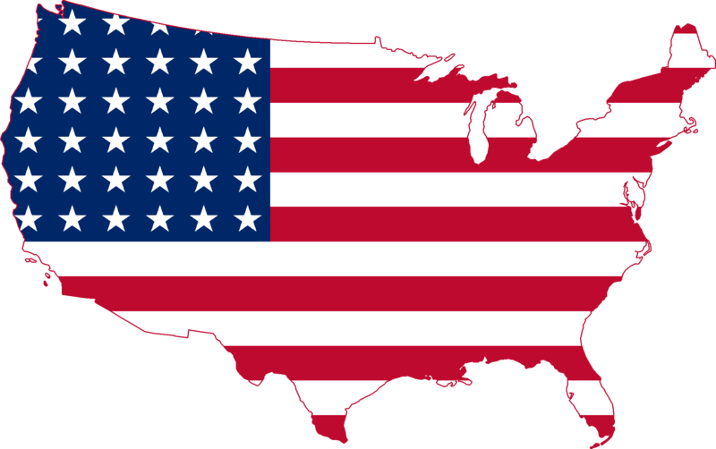
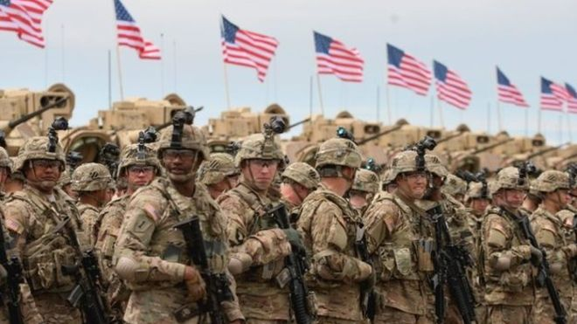

What is important to him?

Slide 8

Easy or hard job?

Slide 9
‘Pray especially for rulers and their governments to rule well’
1 Timothy 2.2 (The Message version of the Bible)

