Slide 1
Welcome to our assembly

Slide 2
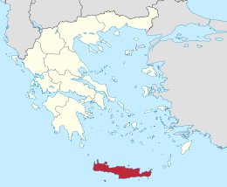


Slide 3
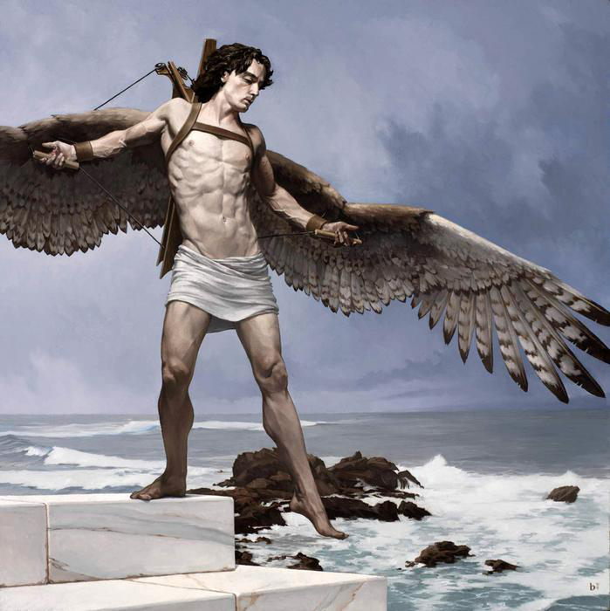

Slide 4
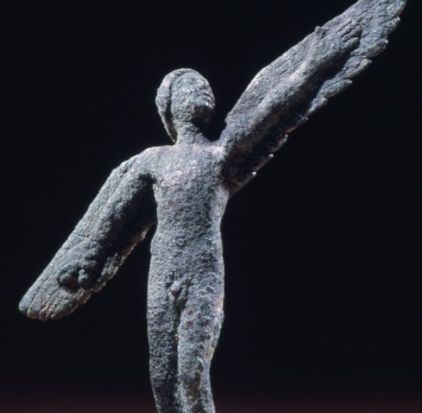
Classical Greek bronze figure of Icarus,
c. 430 BC

Slide 5
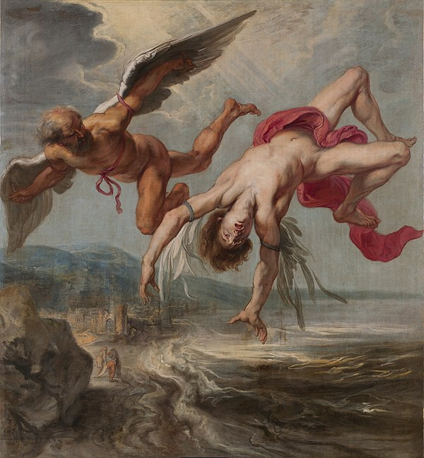
Jacob Peter Gowy’s The Fall of Icarus, 1635–1637

Slide 6
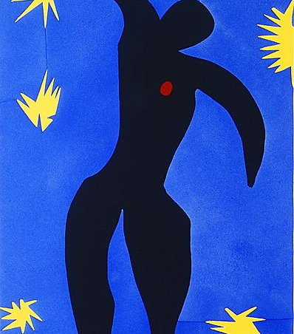
Henri Matisse’s Icarus, 1947

Slide 7
The way of a fool is right in his own eyes, but a wise man listens to advice.
Proverbs 12.15
Where there is no guidance, people fall, but in an abundance of advisors,
there is safety.
Proverbs 11.14

Slide 8
The plans of the diligent lead surely to advantage, but everyone who is hasty comes surely to poverty.
Proverbs 21.5

Slide 9


