Slide 1

‘Something that has not yet developed, but is able to come into existence’

Slide 2
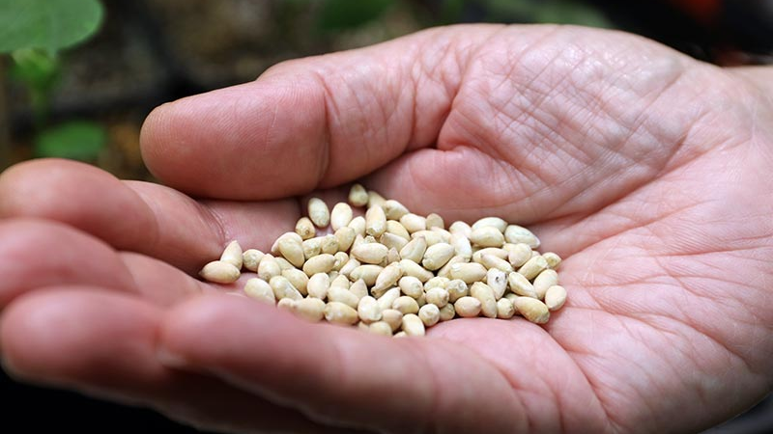

Slide 3


Slide 4
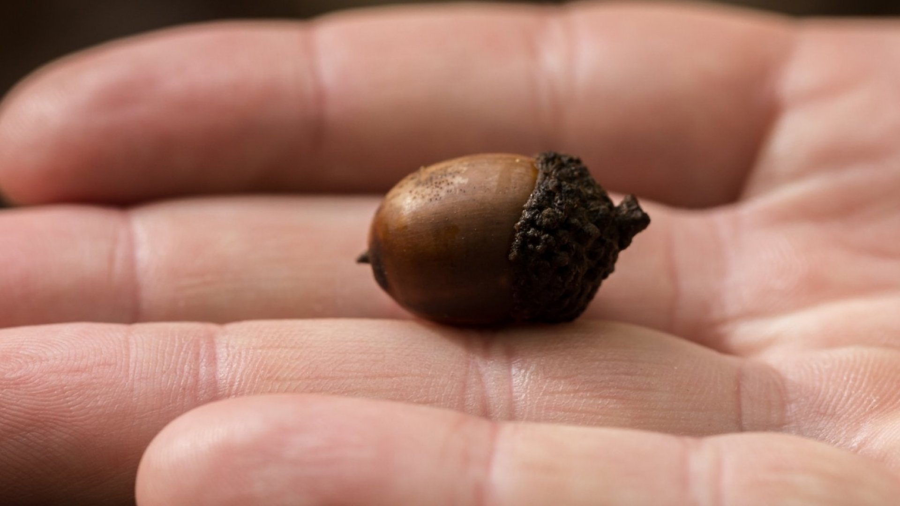

Slide 5


Slide 6


Slide 7


Slide 8


Slide 9


Slide 10
‘Something that has not yet developed, but is able to come into existence’

