Slide 1


Slide 2


Slide 3


Slide 4


Slide 5
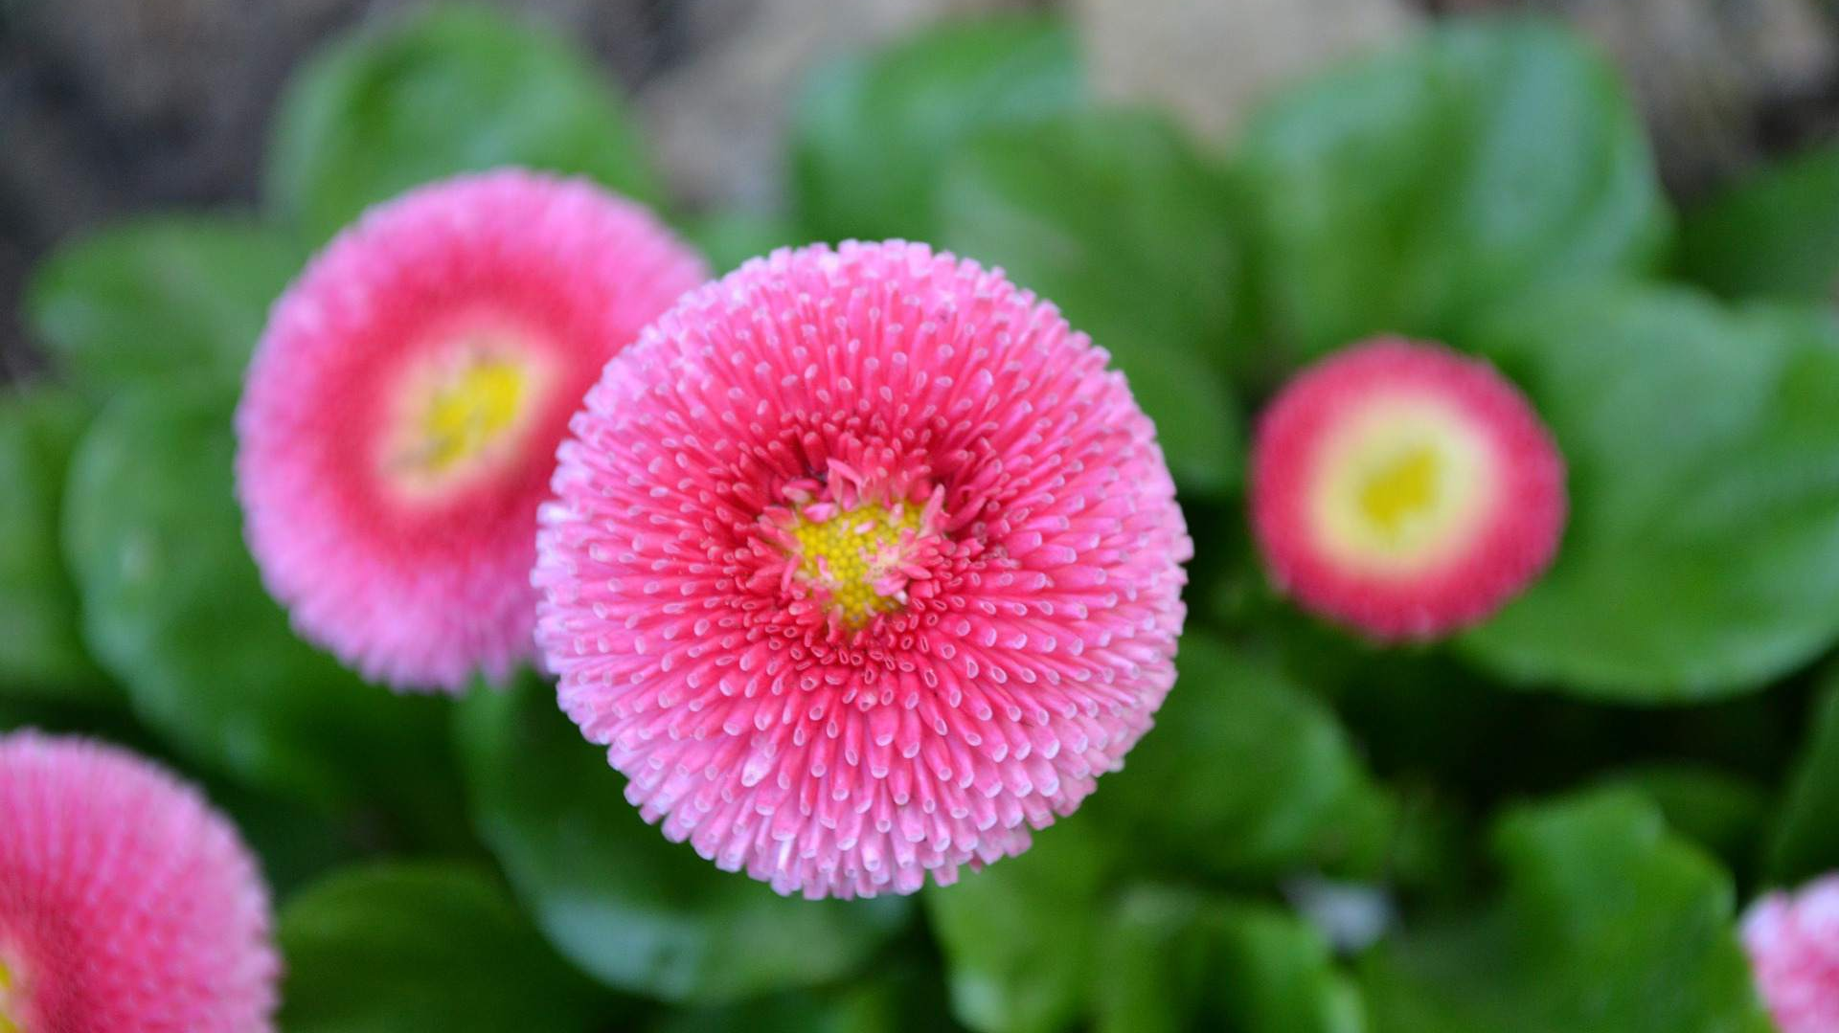

Slide 6


Slide 7


Slide 8


Slide 9
‘We don’t grow when things are easy, we grow when we face challenges.’

