Slide 1
Welcome

Slide 2



Slide 3


Slide 4
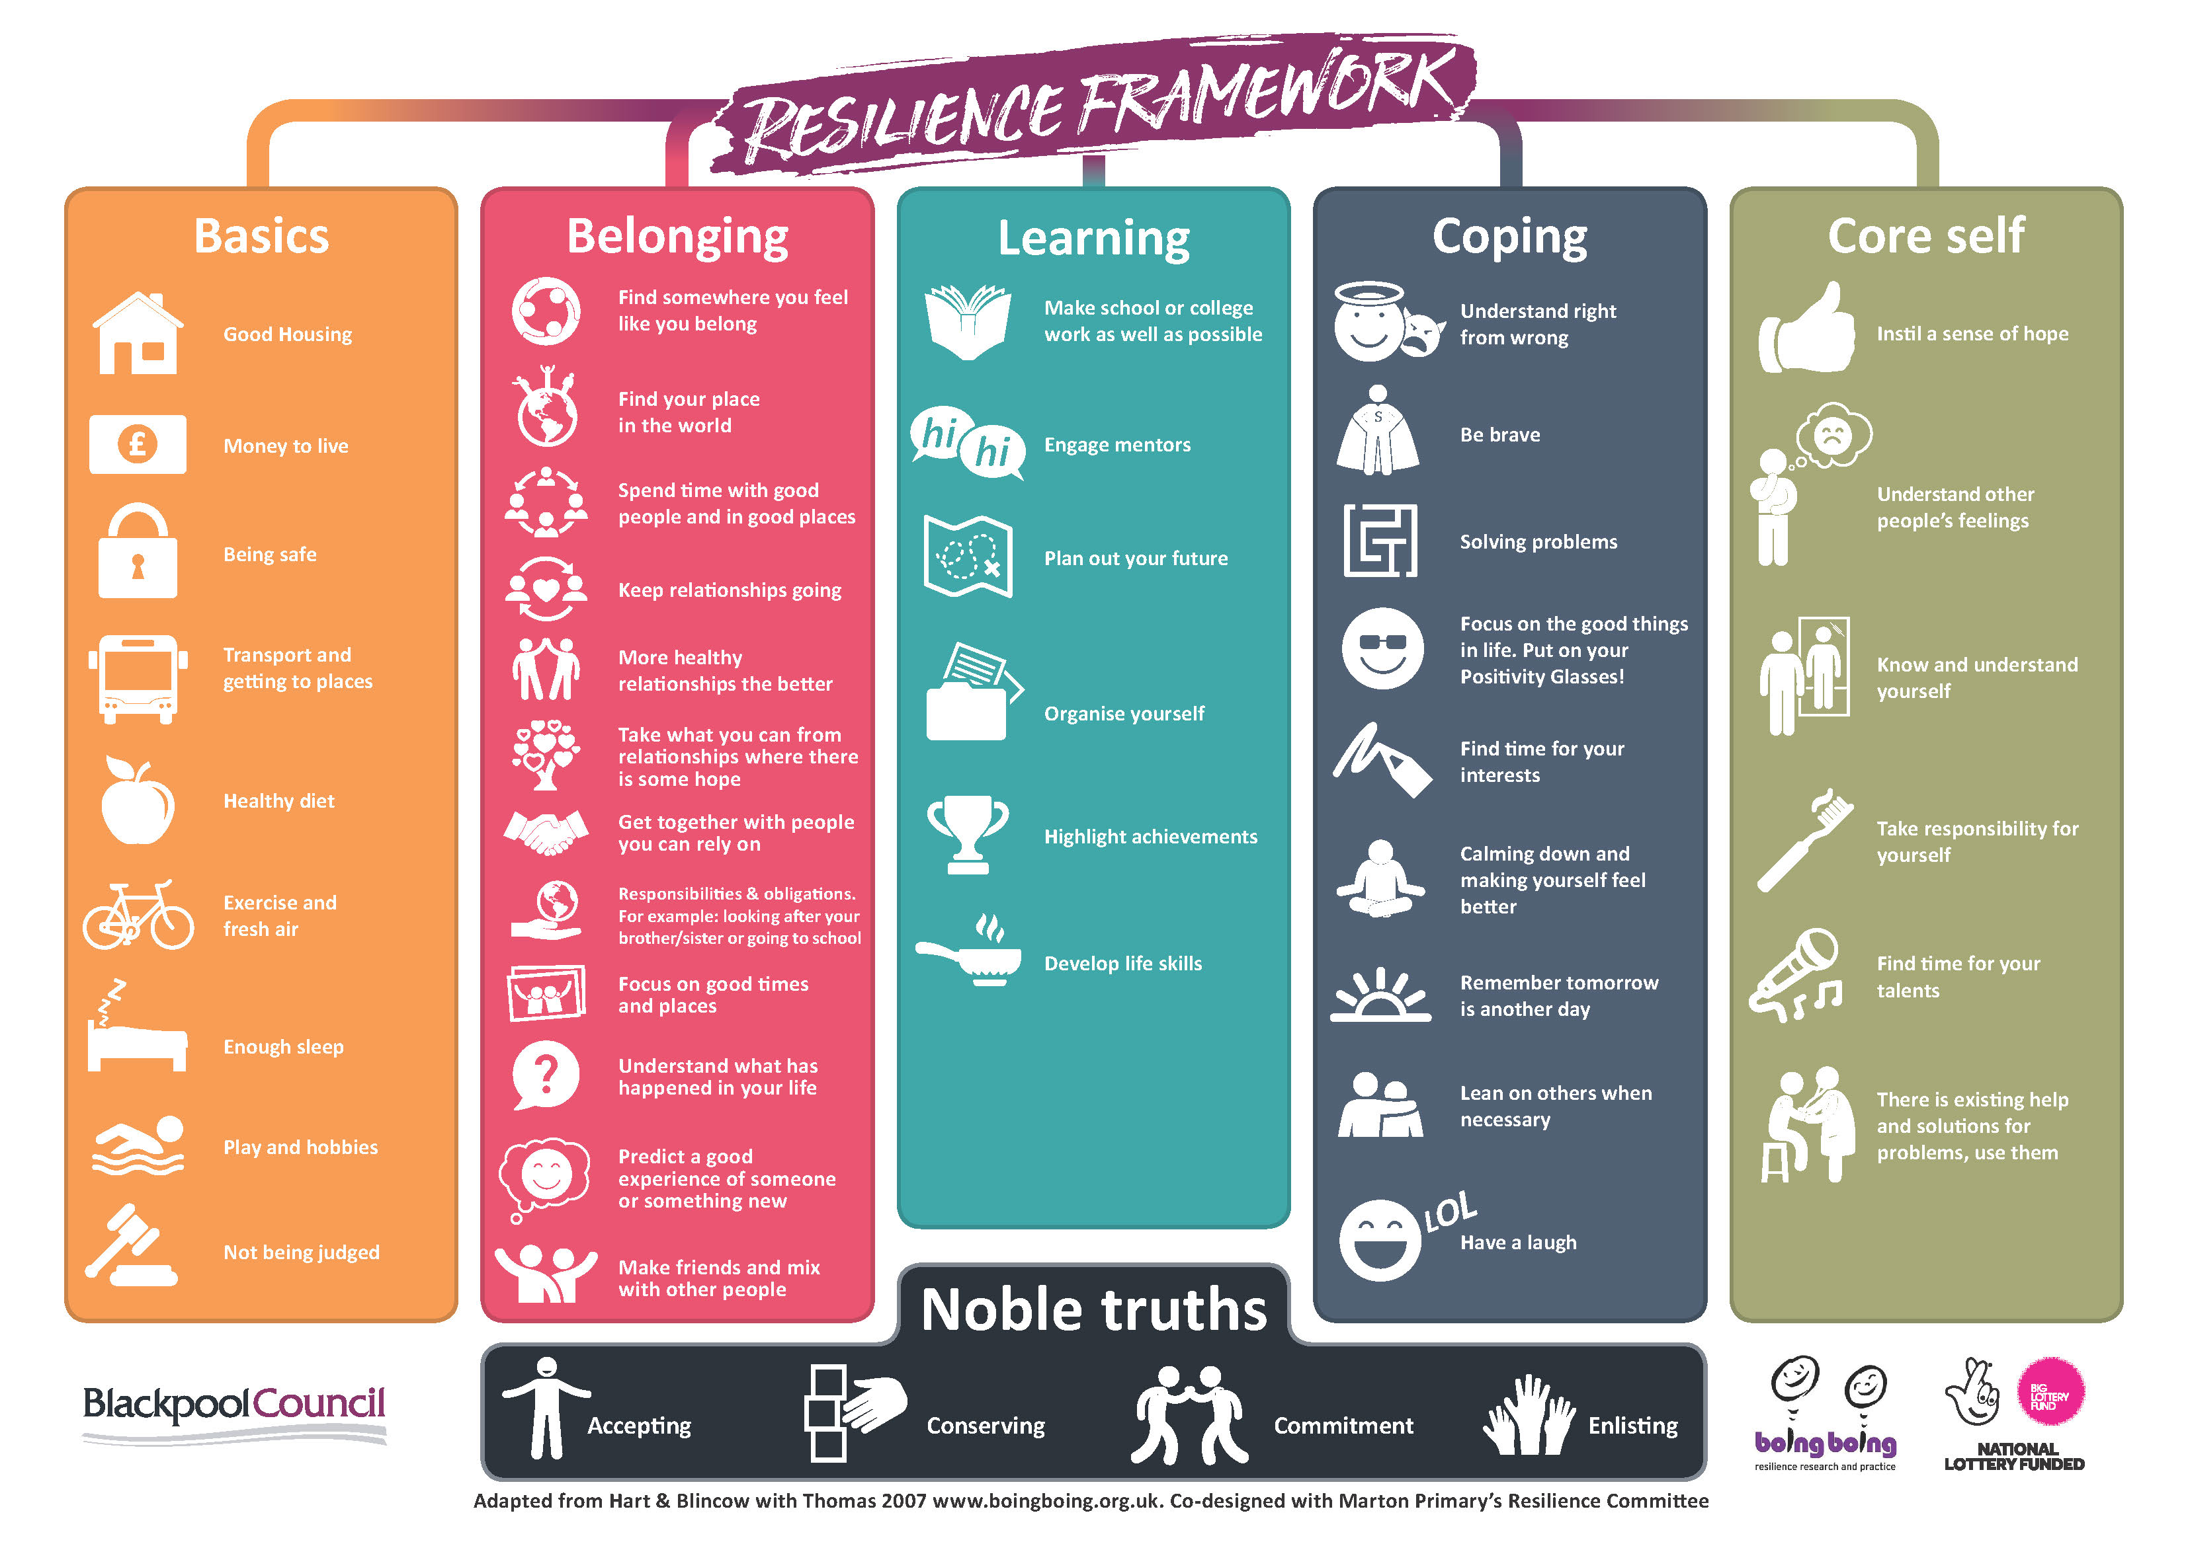

Slide 5
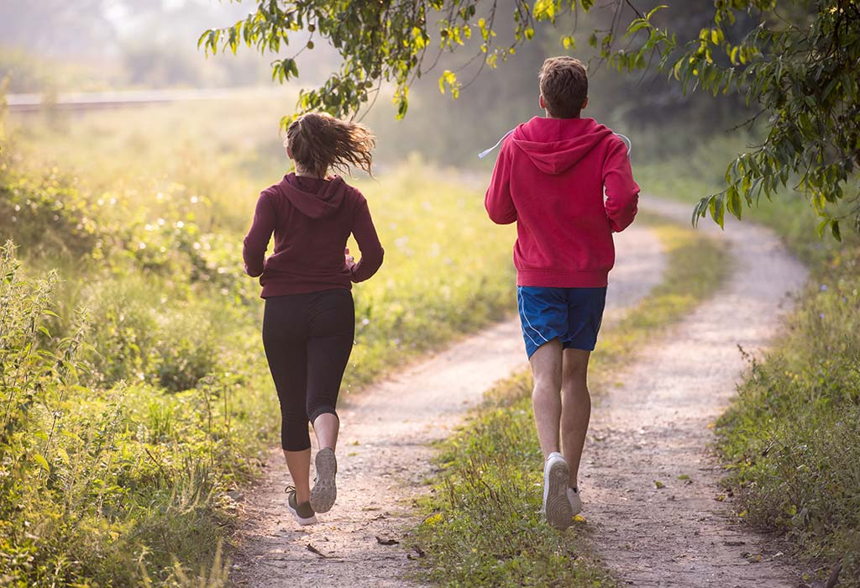
Basics: exercise and fresh air

Slide 6
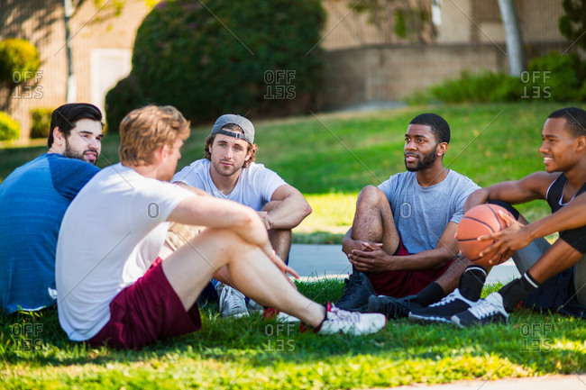
Belonging: make friends and mix with other people

Slide 7
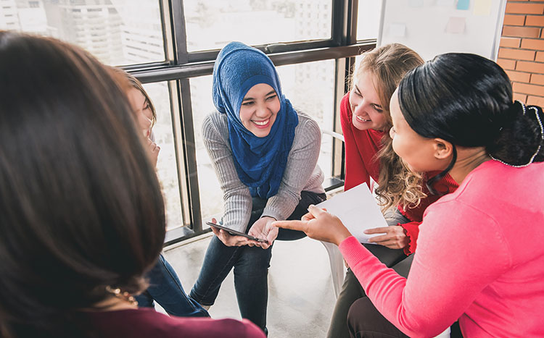
Learning: develop life skills

Slide 8

Coping: remember tomorrow is another day

