Slide 1
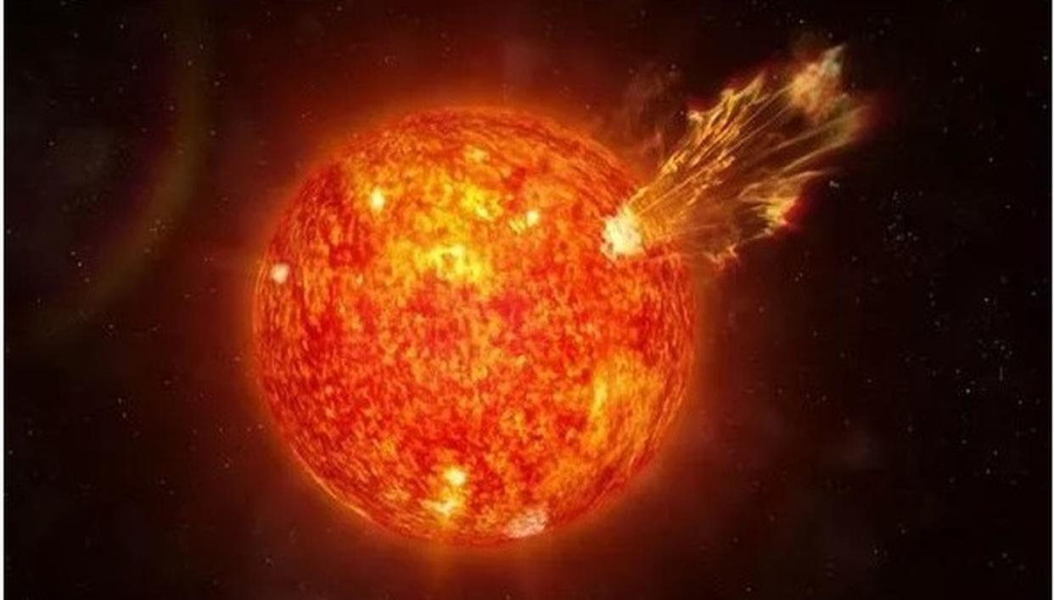

Slide 2
The Sun is actually a star.

Slide 3
The Sun is the nearest star to the Earth – that is why it looks so big!

Slide 4
The Sun is a ball of burning gas.

Slide 5
It takes about eight minutes for light to travel from the Sun to the Earth..

Slide 6
The Sun is the largest object in our solar system.

Slide 7
The Sun is so big that the Earth could fit inside it more than a million times!.

Slide 8
You should never look at the Sun directly.

Slide 9
You should wear sunscreen to protect you from the Sun..

Slide 10
Without the Sun, the Earth would have no heat or light so nothing could live on it.

