Slide 1
Can you name 10 Olympic Sports?

Slide 2
How many Olympic sports do you think there are ?

Slide 3
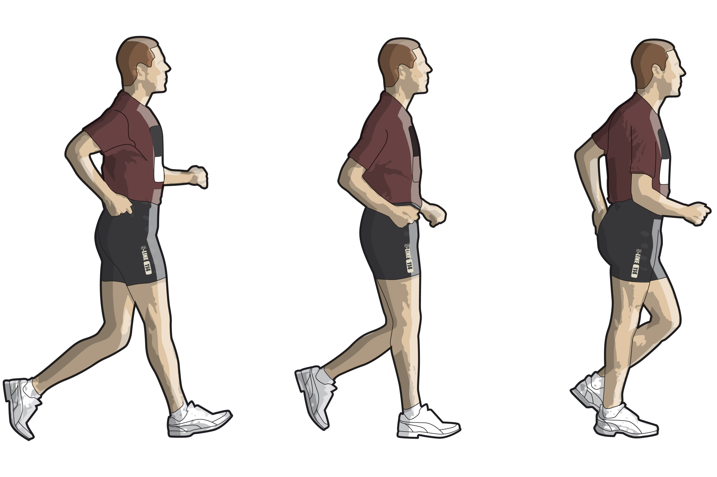

Slide 4
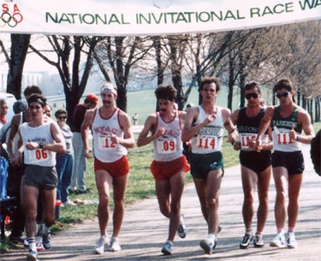
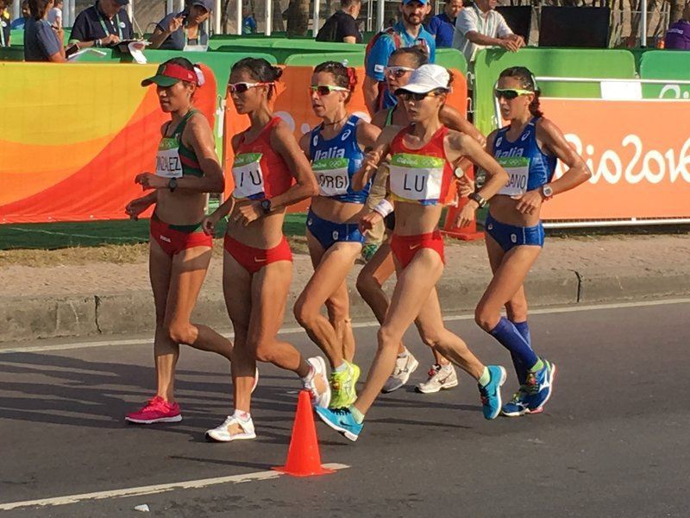

Slide 5


