Slide 1




What do you want to be?

Slide 2
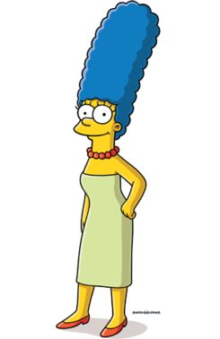
It is important to have ‘CV virtues’. These are the skills and achievements we would want to write on a CV or job application.
https://www.youtube.com/watch?v=NQwVJgmZaA8

Slide 3
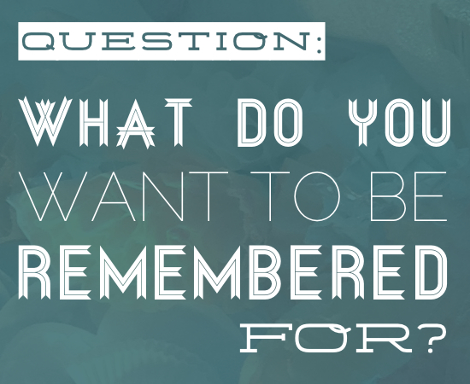
Who do you want to be?
‘Eulogy virtues’

Slide 4
Humility
Selfless Love
Gratitude

Slide 5
‘Whatever is true, whatever is honourable, whatever is just, whatever is pure, whatever is lovely, whatever is commendable, if there is any excellence, if there is anything worthy of praise, think about these things.’
(Philippians 4.8)

