Slide 1
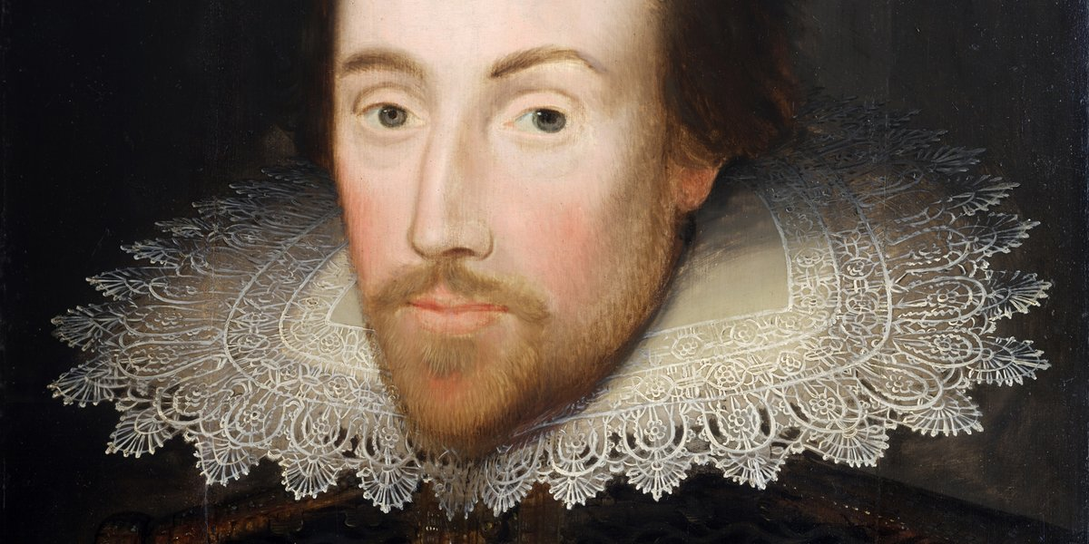

Slide 2
Blushing
Excitement
Lonely
Uncomfortable
Bedroom
Champion
Blanket
Amazement
Fashionable
Puking
Olympian
Bump

Slide 3
As a tree gives us fruit, healing words give us life. But evil words crush the spirit.
Proverbs 15:4

Slide 4
Pleasant words are like a honeycomb. They make a person happy and healthy.
Proverbs 16:24

Slide 5
What you say affects how you live. You will be rewarded by how you speak.
Proverbs 18:20

