Slide 1
Beauty in Nature.

Slide 2
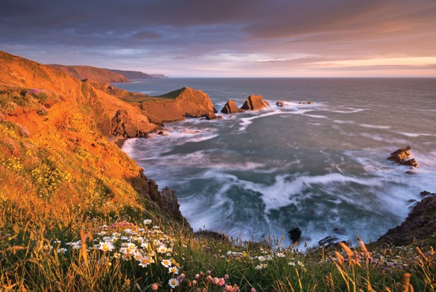
Hartland Quay, Devon

Slide 3
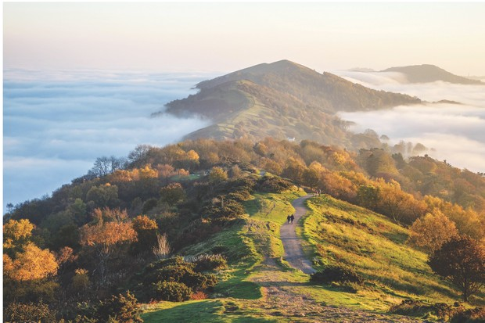
Malvern Hills, Worcestshire

Slide 4
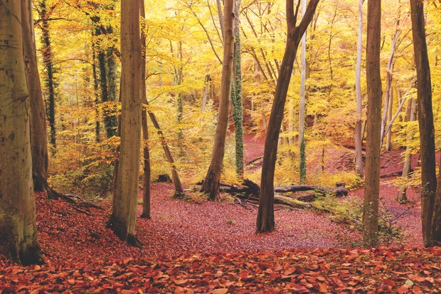
Burnham Beeches, Buckinghamshire

Slide 5
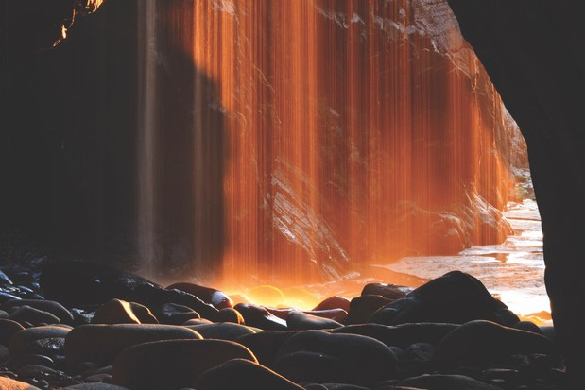
Plemont Beech cave, Jersey

Slide 6
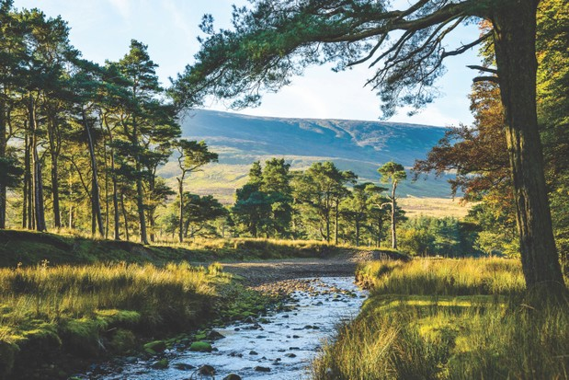
Forest of Bowland, lancashire

Slide 7
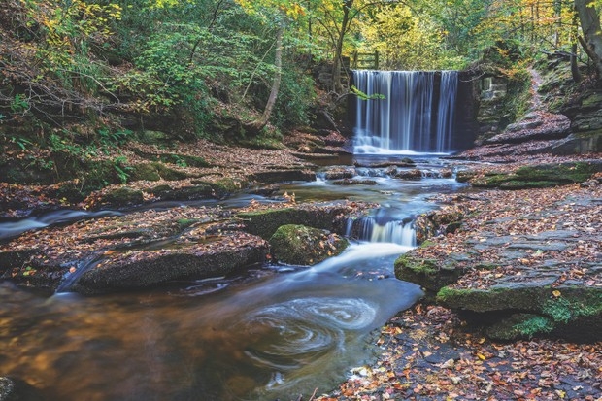
Plas Power Woods, Wreham

Slide 8
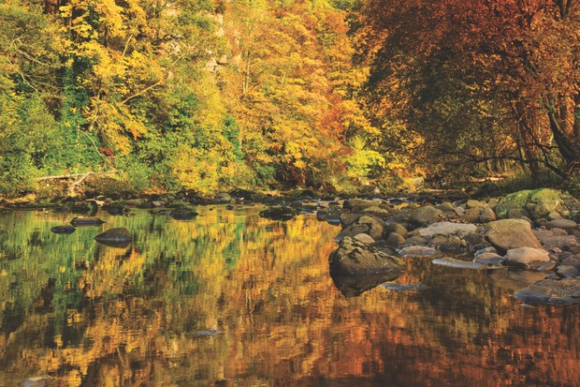
Allen Banks, Northumberland

Slide 9
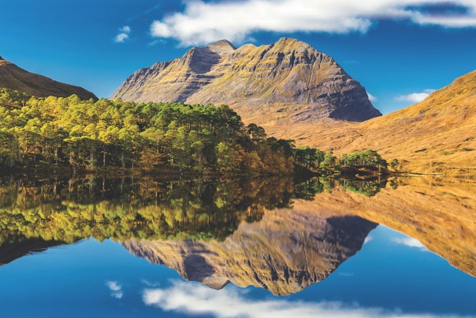
Loch Tay, Scotland

Slide 10
Liathach and Loch Clair, Glen Torridan, Scotland

Slide 11
Recent photographs from Countryfile.
Photographs taken in autumn.

