Slide 1
Welcome

Slide 2
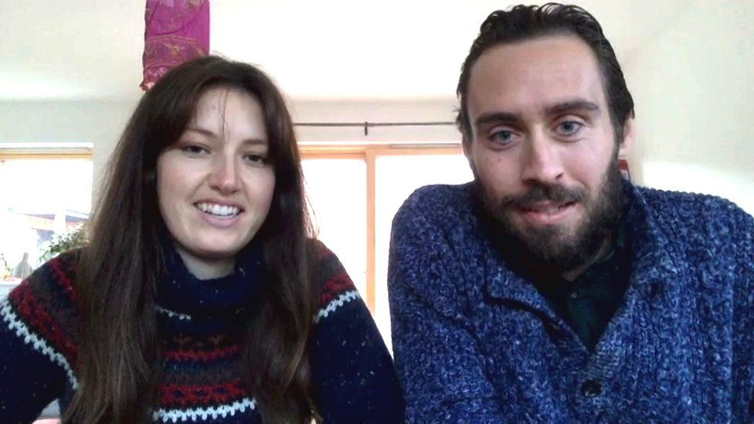

Slide 3
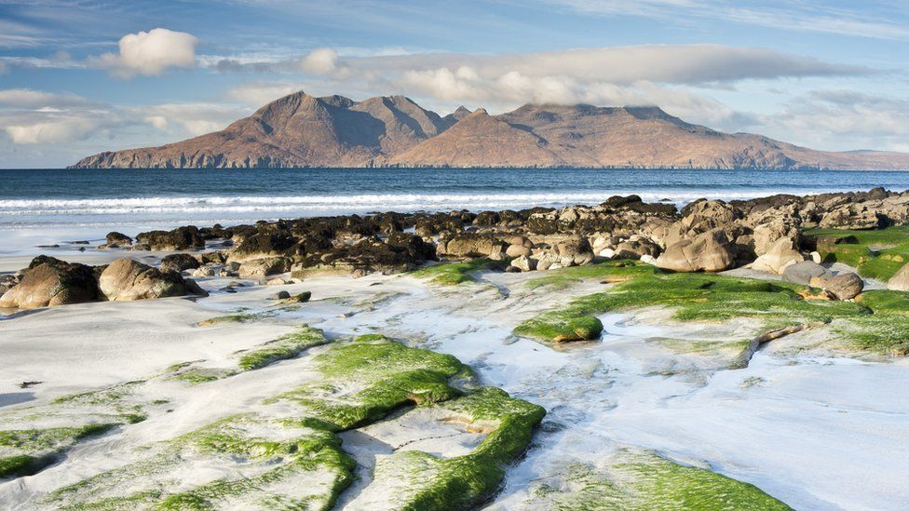

Slide 4
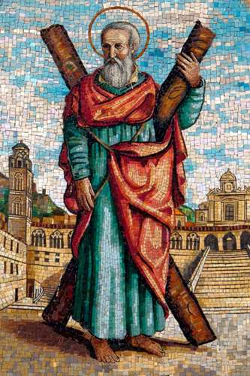
Andrew, Fisherman – Disciple.

Slide 5
Matthew 4:18-22
Jesus Calls His First Disciples
¹⁸ As Jesus was walking beside the Sea of Galilee, he saw two brothers, Simon called Peter and his brother Andrew. They were casting a net into the lake, for they were fishermen. ¹⁹ “Come, follow me,” Jesus said, “and I will send you out to fish for people.” ²⁰ At once they left their nets and followed him.
²¹ Going on from there, he saw two other brothers, James son of Zebedee and his brother John. They were in a boat with their father Zebedee, preparing their nets. Jesus called them, ²² and immediately they left the boat and their father and followed him.

