Slide 1

Welcome to our assembly

Slide 2


Slide 3
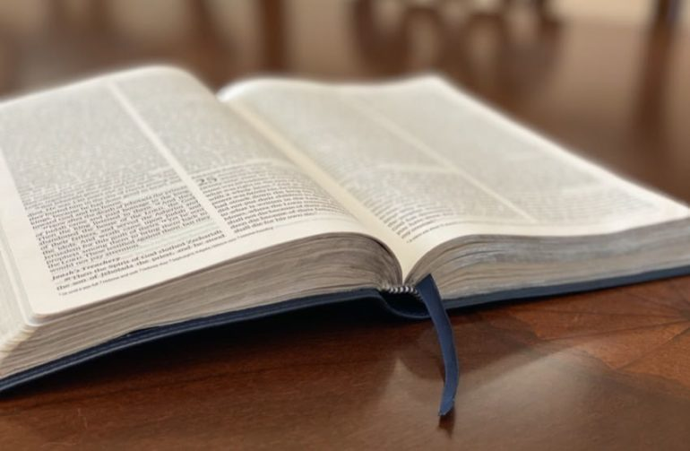
He answered, ‘Love the Lord your God with all your heart and with all your soul and with all your strength and with all your mind; and love your neighbour as you love yourself.’
Luke 10.27

Slide 4
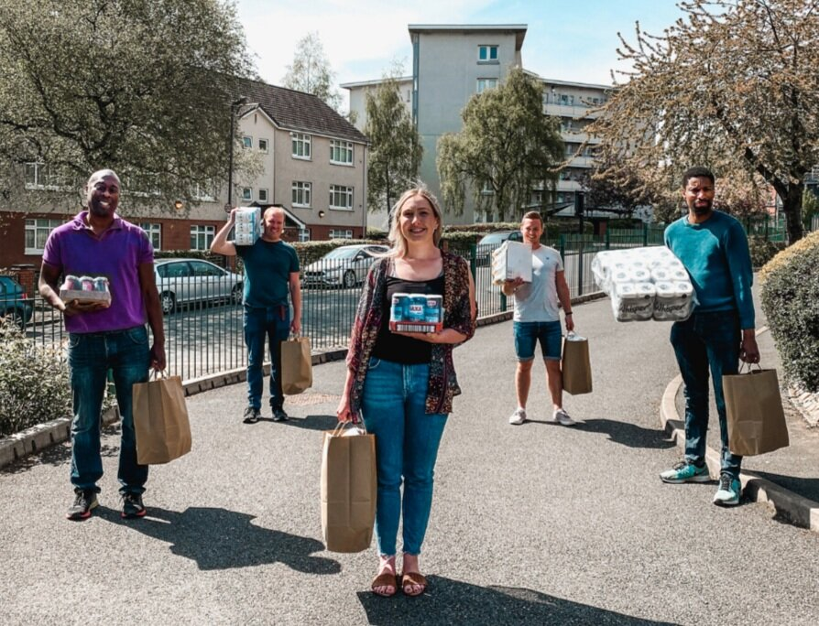
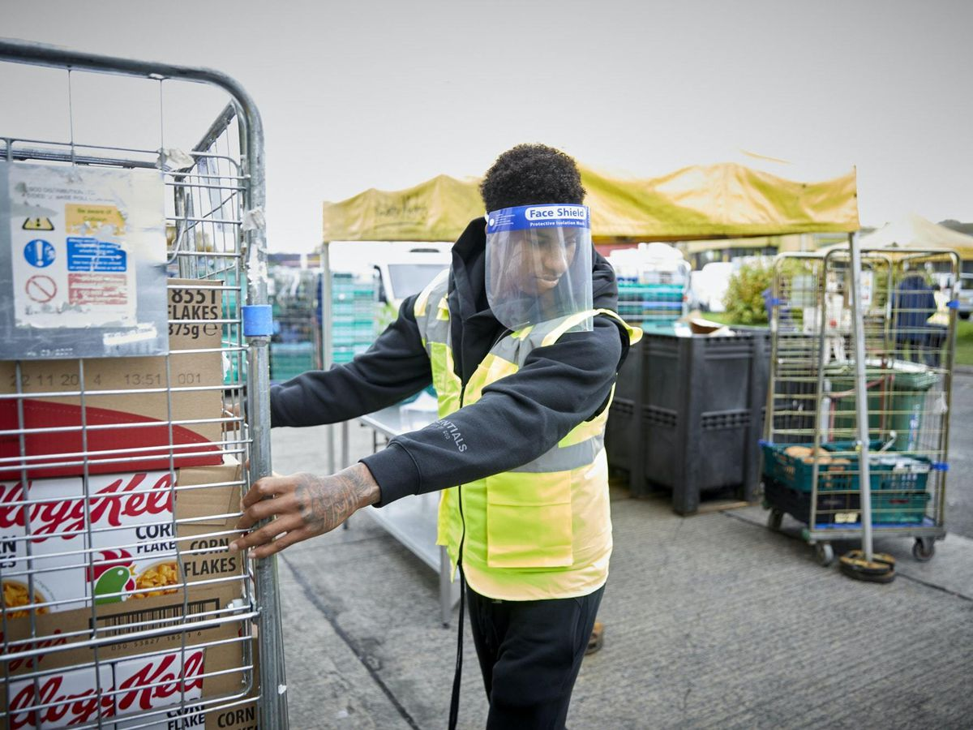

Slide 5
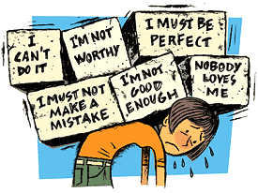

Slide 6


Slide 7

Catch more Zs
Prioritize ‘you’ time
#Doyourthing
Stop criticizing yourself
Talk it out
Get moving
Less of the lattes
Digital rethink

