Slide 1
Sort out the synonyms for happy and sad.
jolly | cheery | sorrowful | troubled
bitter | distressed | delighted | dejected
gloomy | heartbroken | jubilant | elated
ecstatic | glad | despondent | contented

Slide 2
Sort out the synonyms for happy and sad.
jolly | cheery | sorrowful | troubled
bitter | distressed | delighted | dejected
gloomy | heartbroken | jubilant | elated
ecstatic | glad | despondent | contented

Slide 3
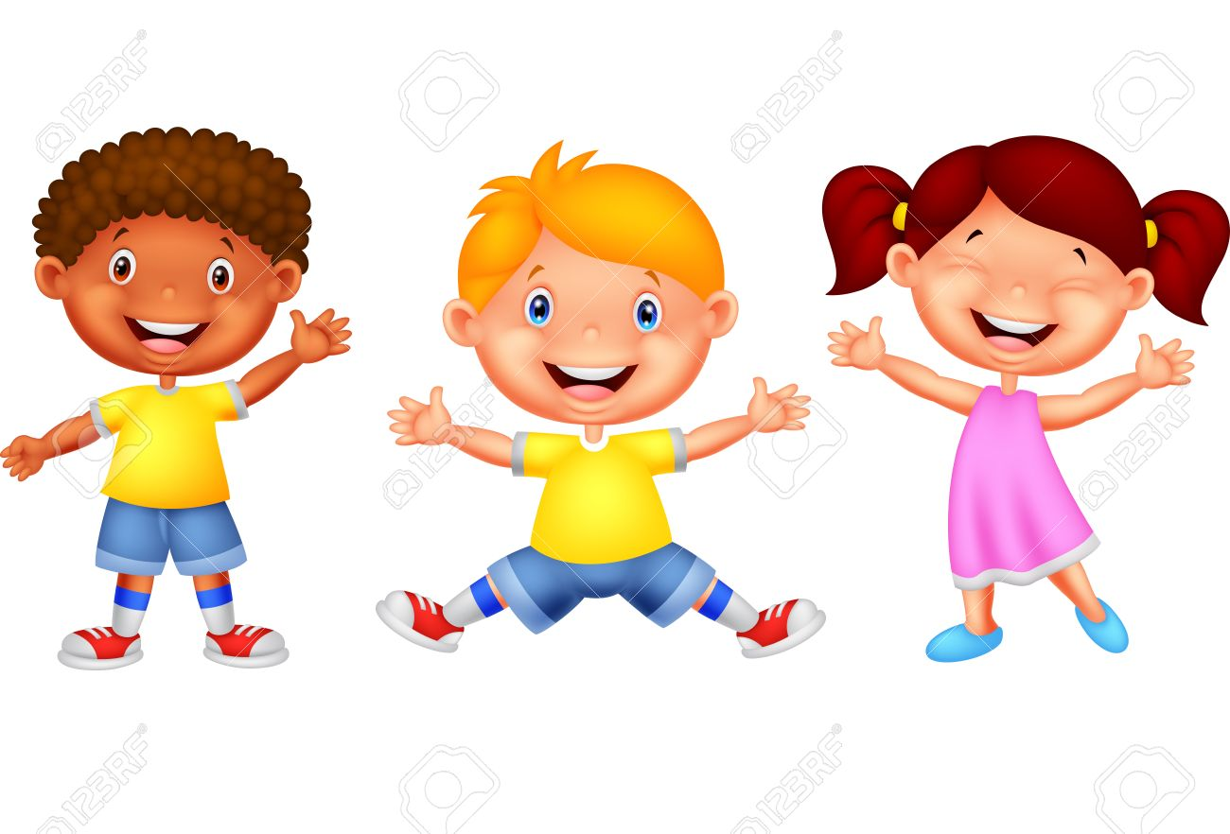
Which other synonym can we use for happy that has three letters?

Slide 4


Slide 5
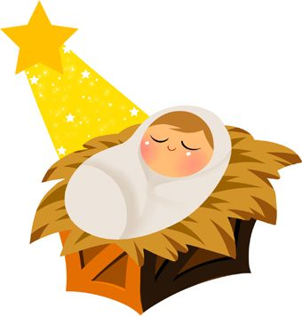

Jesus
O
Y

Slide 6
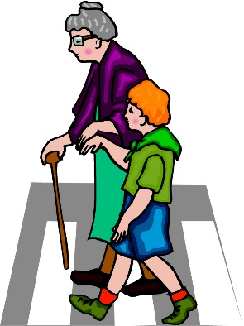
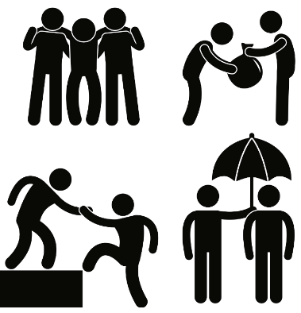
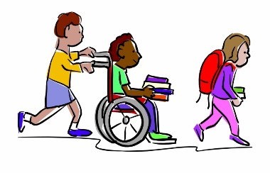
Jesus
Others
Y

Slide 7

Jesus
Others
Yourself

