Slide 1
Question….
Who is the funniest?

Slide 2
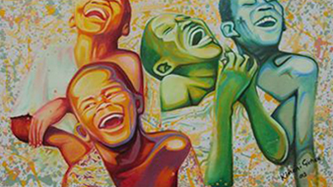

Slide 3
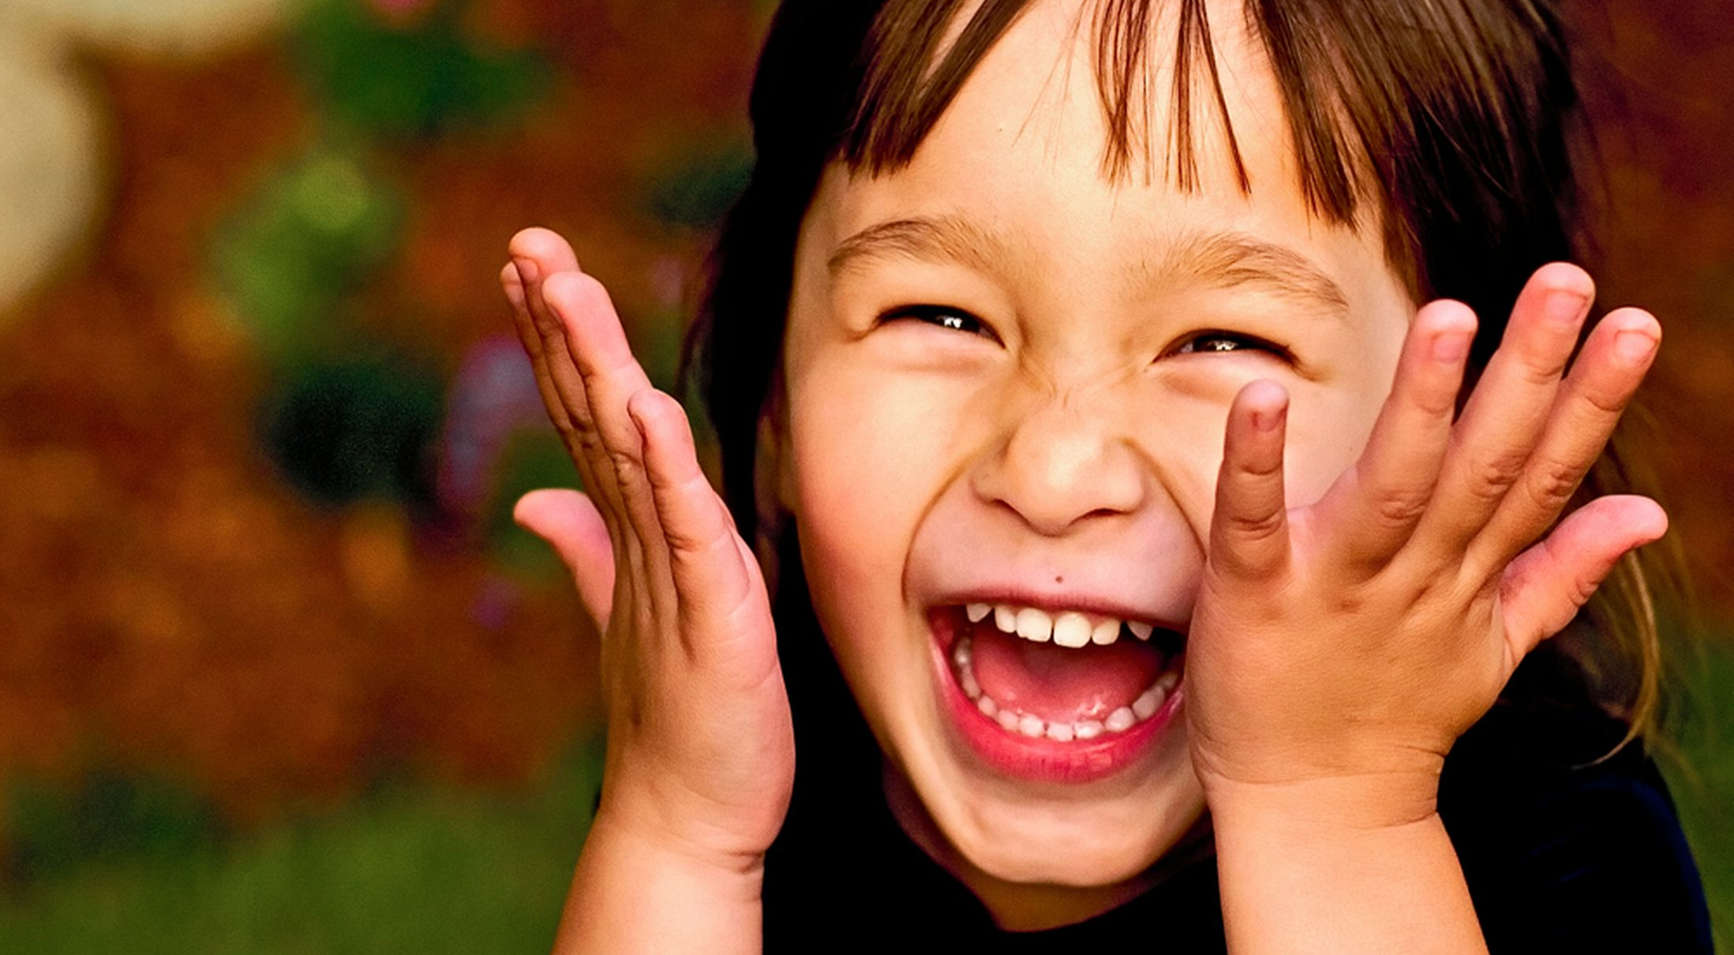
Smile more
Do more of what makes you laugh.
Learn to see the funny side in you

