Slide 1

Can you name five fruits or vegetables that begin with the letter ‘a’?

Slide 2
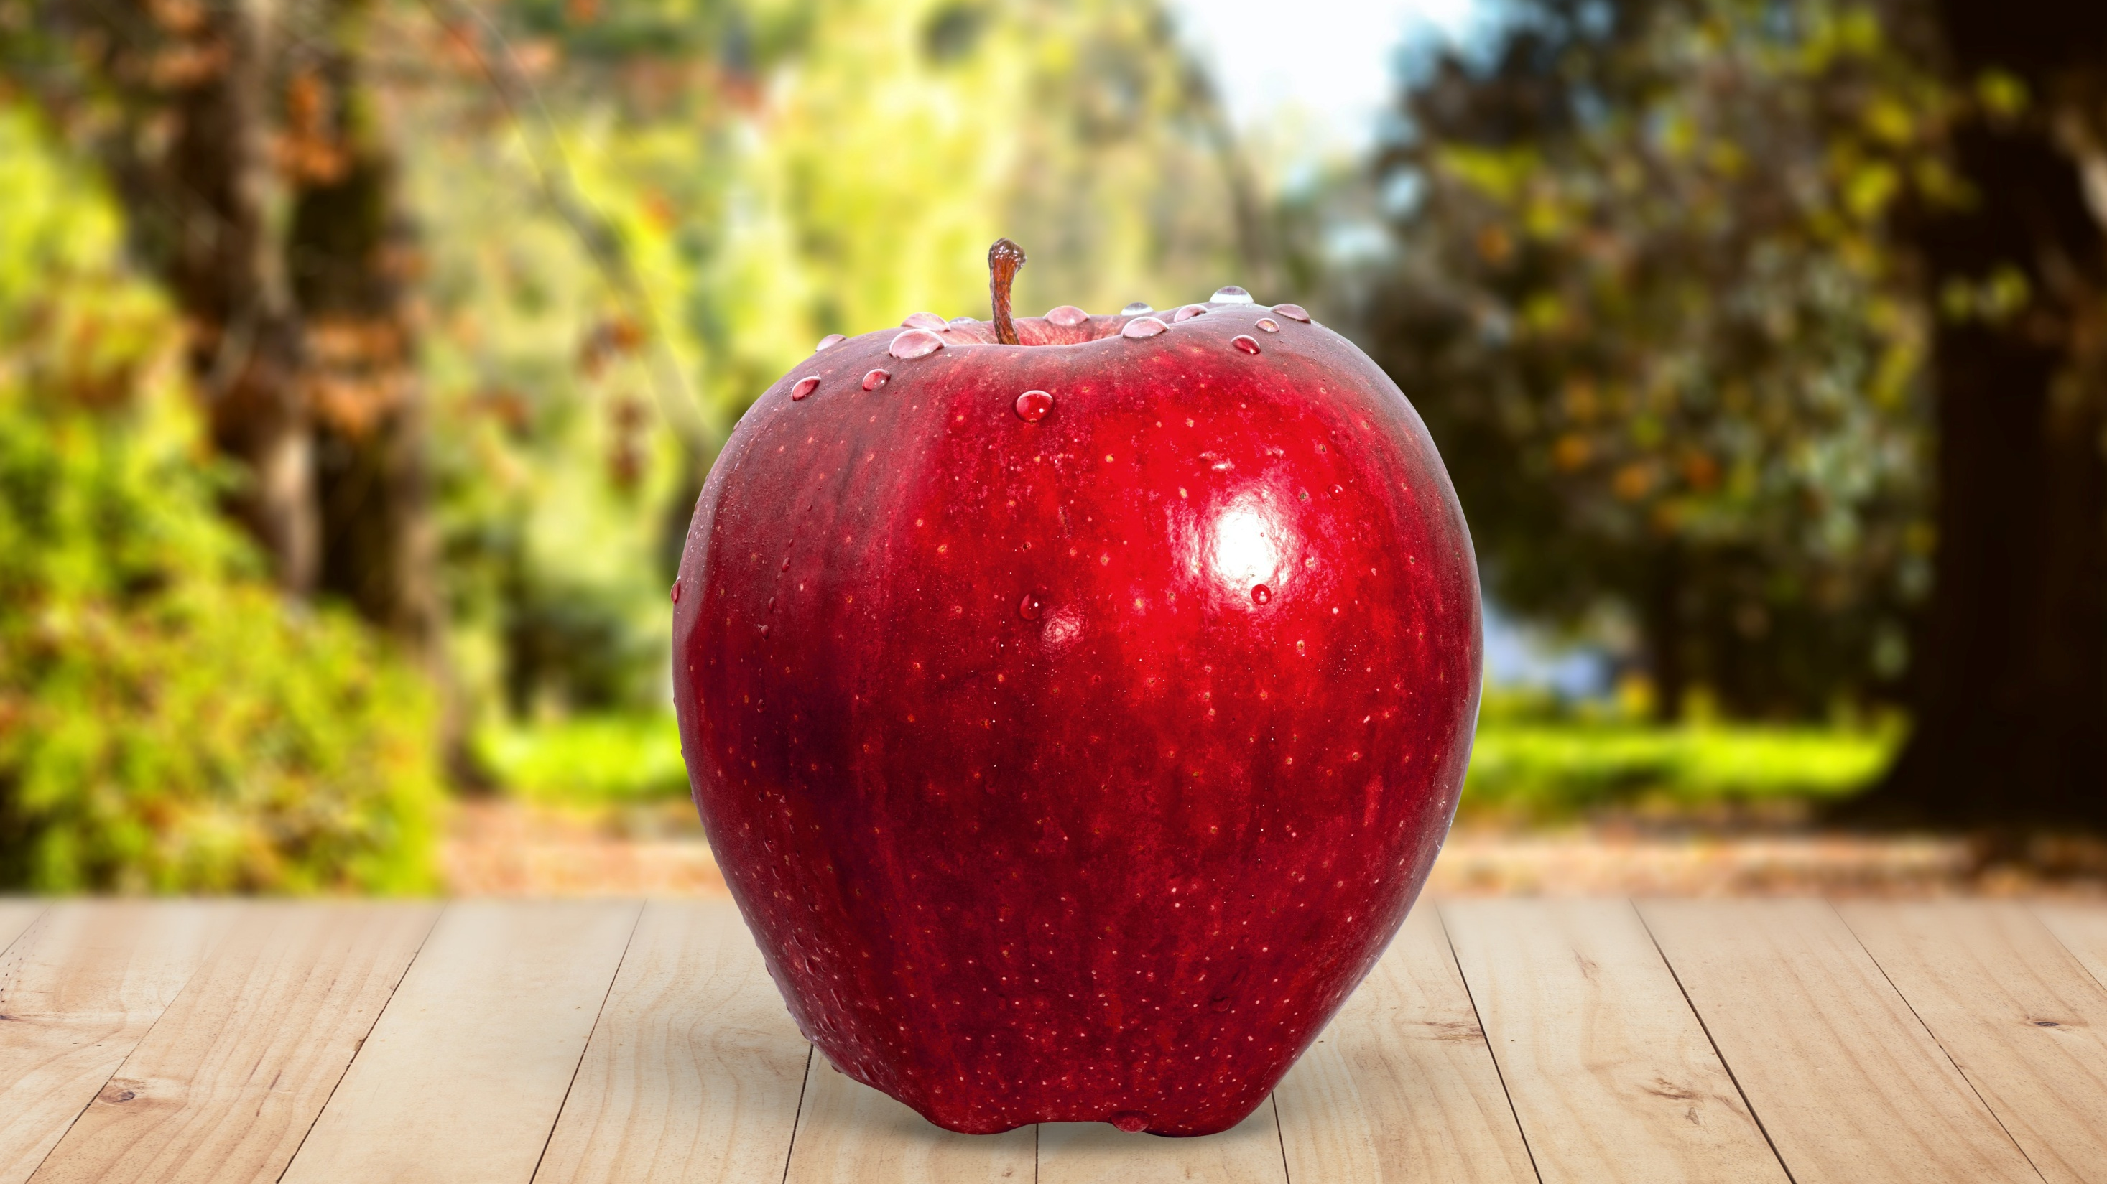

Slide 3
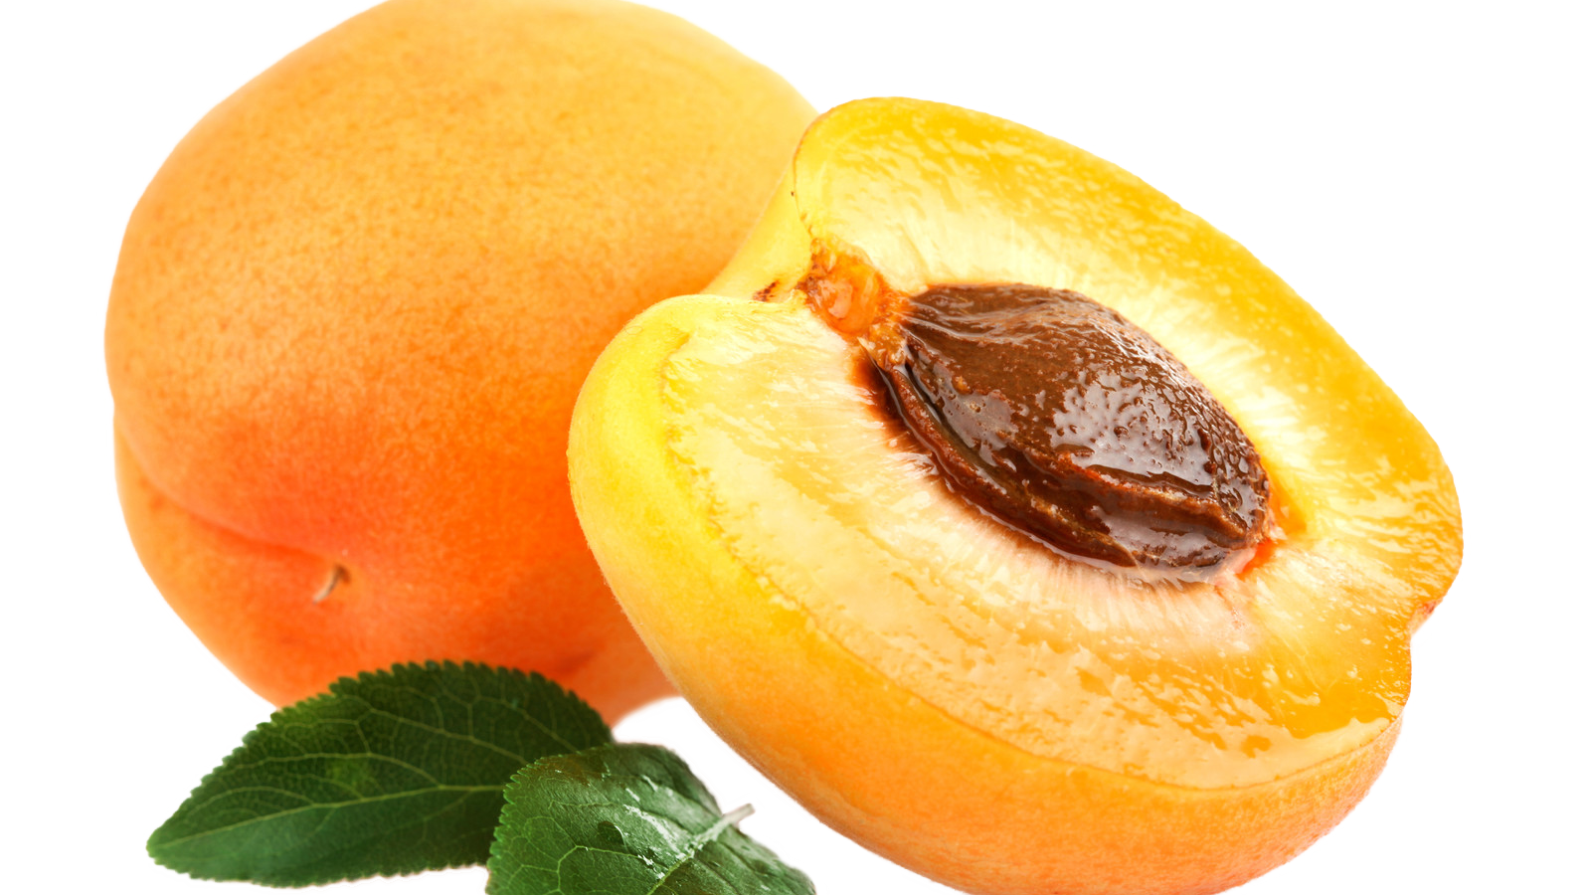
This Photo by Unknown Author is licensed under CC BY-NC

Slide 4
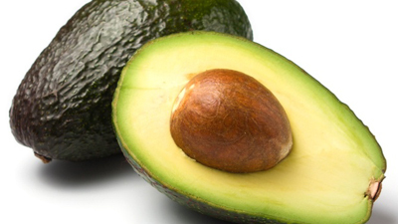
This Photo by Unknown Author is licensed under CC BY-SA-NC

Slide 5
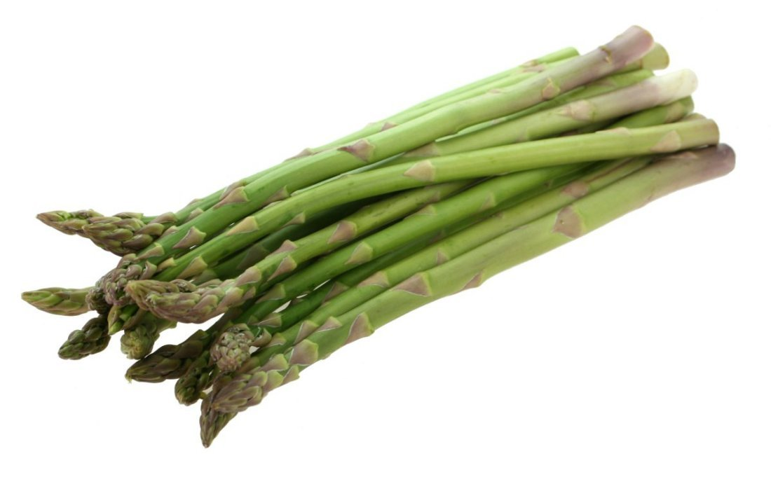
This Photo by Unknown Author is licensed under CC BY-SA

Slide 6
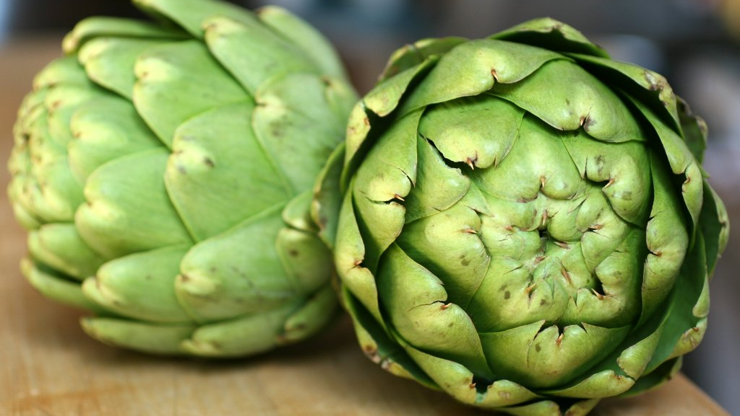
This Photo by Unknown Author is licensed under CC BY-NC-ND

Slide 7


Slide 8

‘Love your neighbour.’ (The Bible)
‘By the morning brightness. And by the night when it is stillest. Your Lord has not forsaken you.’
(The Qur’an)
Prayer

Slide 9
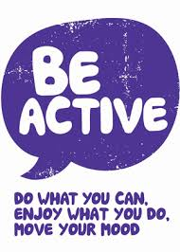
Be a good steward of your physical body!
‘Your body is a temple of the Holy Spirit.’ (The Bible)

Slide 10

Buddhist practices of mindfulness and meditation
Contemplation and practice of thanksgiving prayer

Slide 11

Be a good steward of your intelligence!
Jewish tradition of learning a section of the Torah for bar/bat mitzvah

Slide 12

Langar meal
Charity
Help those in need

