Slide 1
We Need to Talk

Slide 2
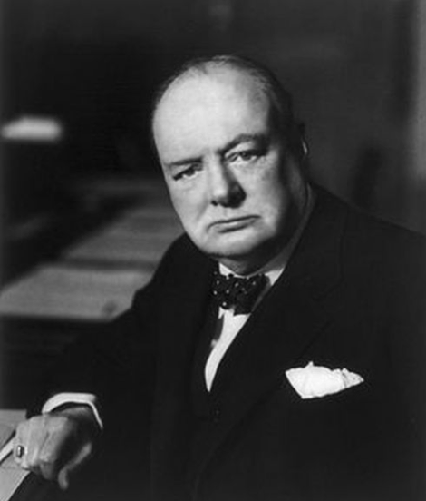

Slide 3
Depression: what helps?
  Seeking professional help
  Taking medication
  Learning to quieten the mind
  Taking regular exercise
  Keeping a mood journal
  Remembering each day what we are grateful for
  Being honest with people around us

