Slide 1
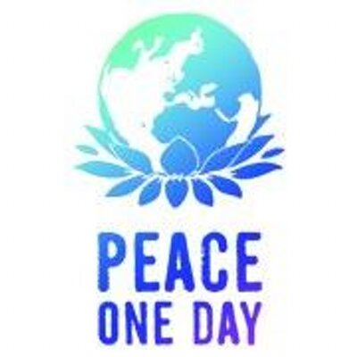

Slide 2

Peace is
“all the values, attitudes, and forms of behaviour that reflect respect for life, for human dignity and for all human rights, the rejection of violence … and commitment to … freedom, justice, solidarity and understanding between people.”

Slide 3
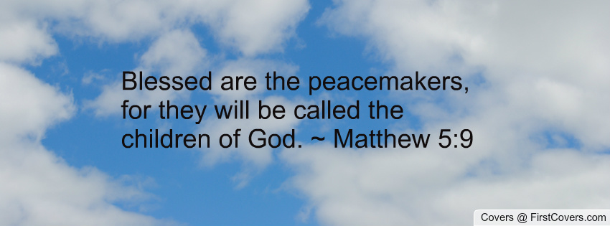

Slide 4
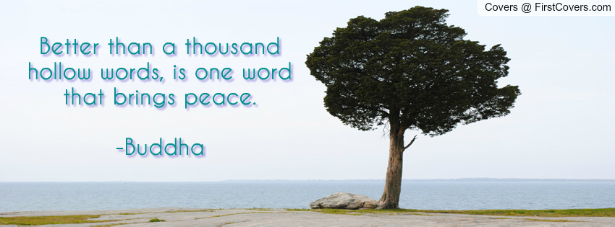

Slide 5
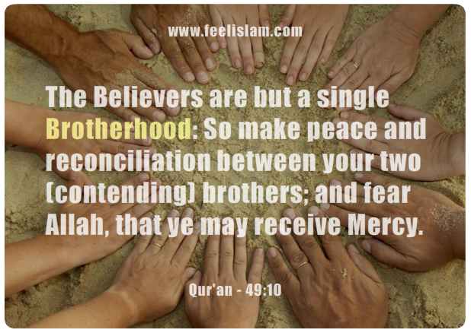

Slide 6
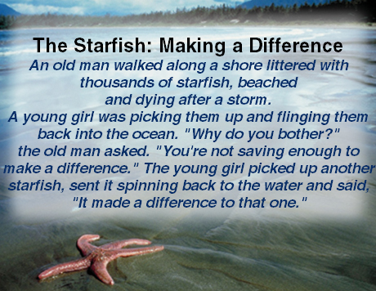

Slide 7
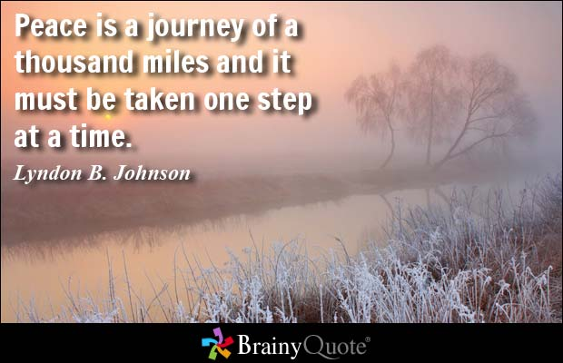

Slide 8
