Slide 1
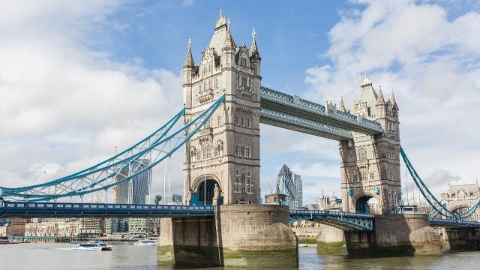
Tower Bridge in London

Slide 2
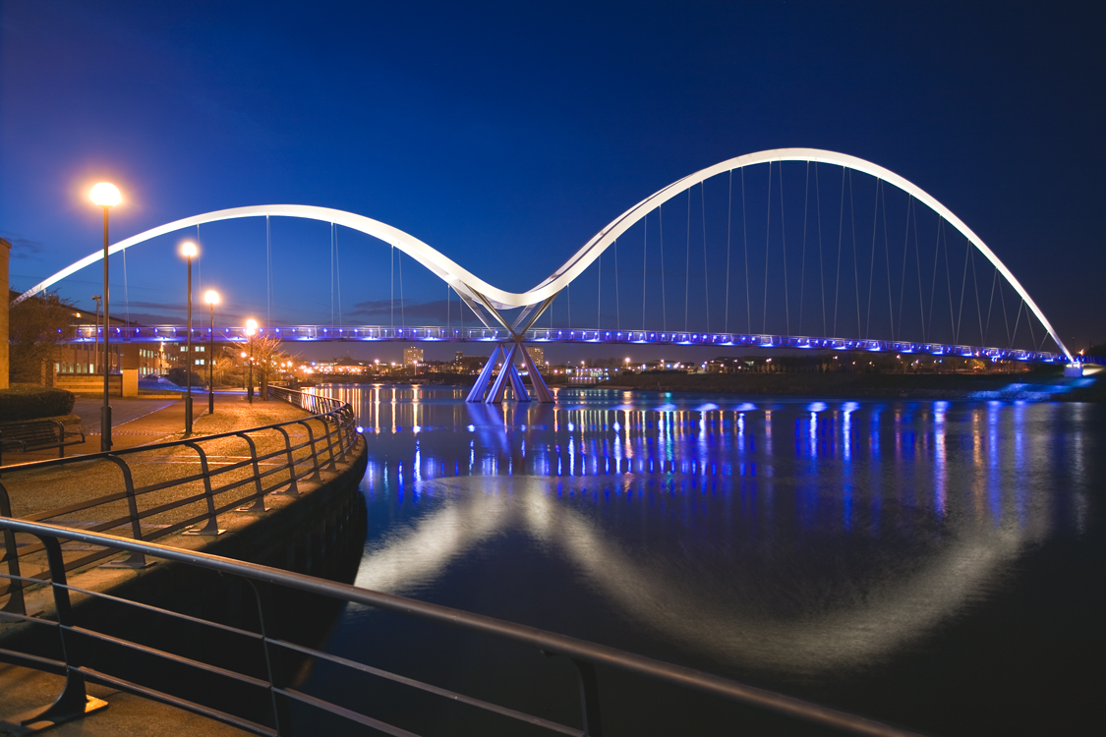
Infinity Bridge - Stockton

Slide 3
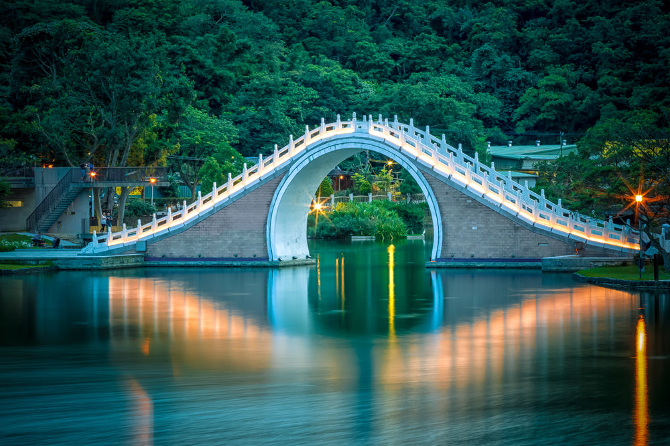
Moon Bridge – Taiwan

Slide 4
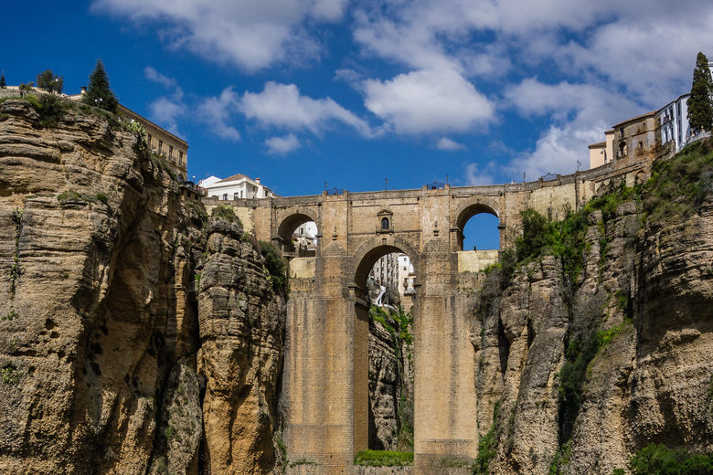
Puente Nuevo Bridge – Spain

Slide 5
Would you cross these bridges?

Slide 6
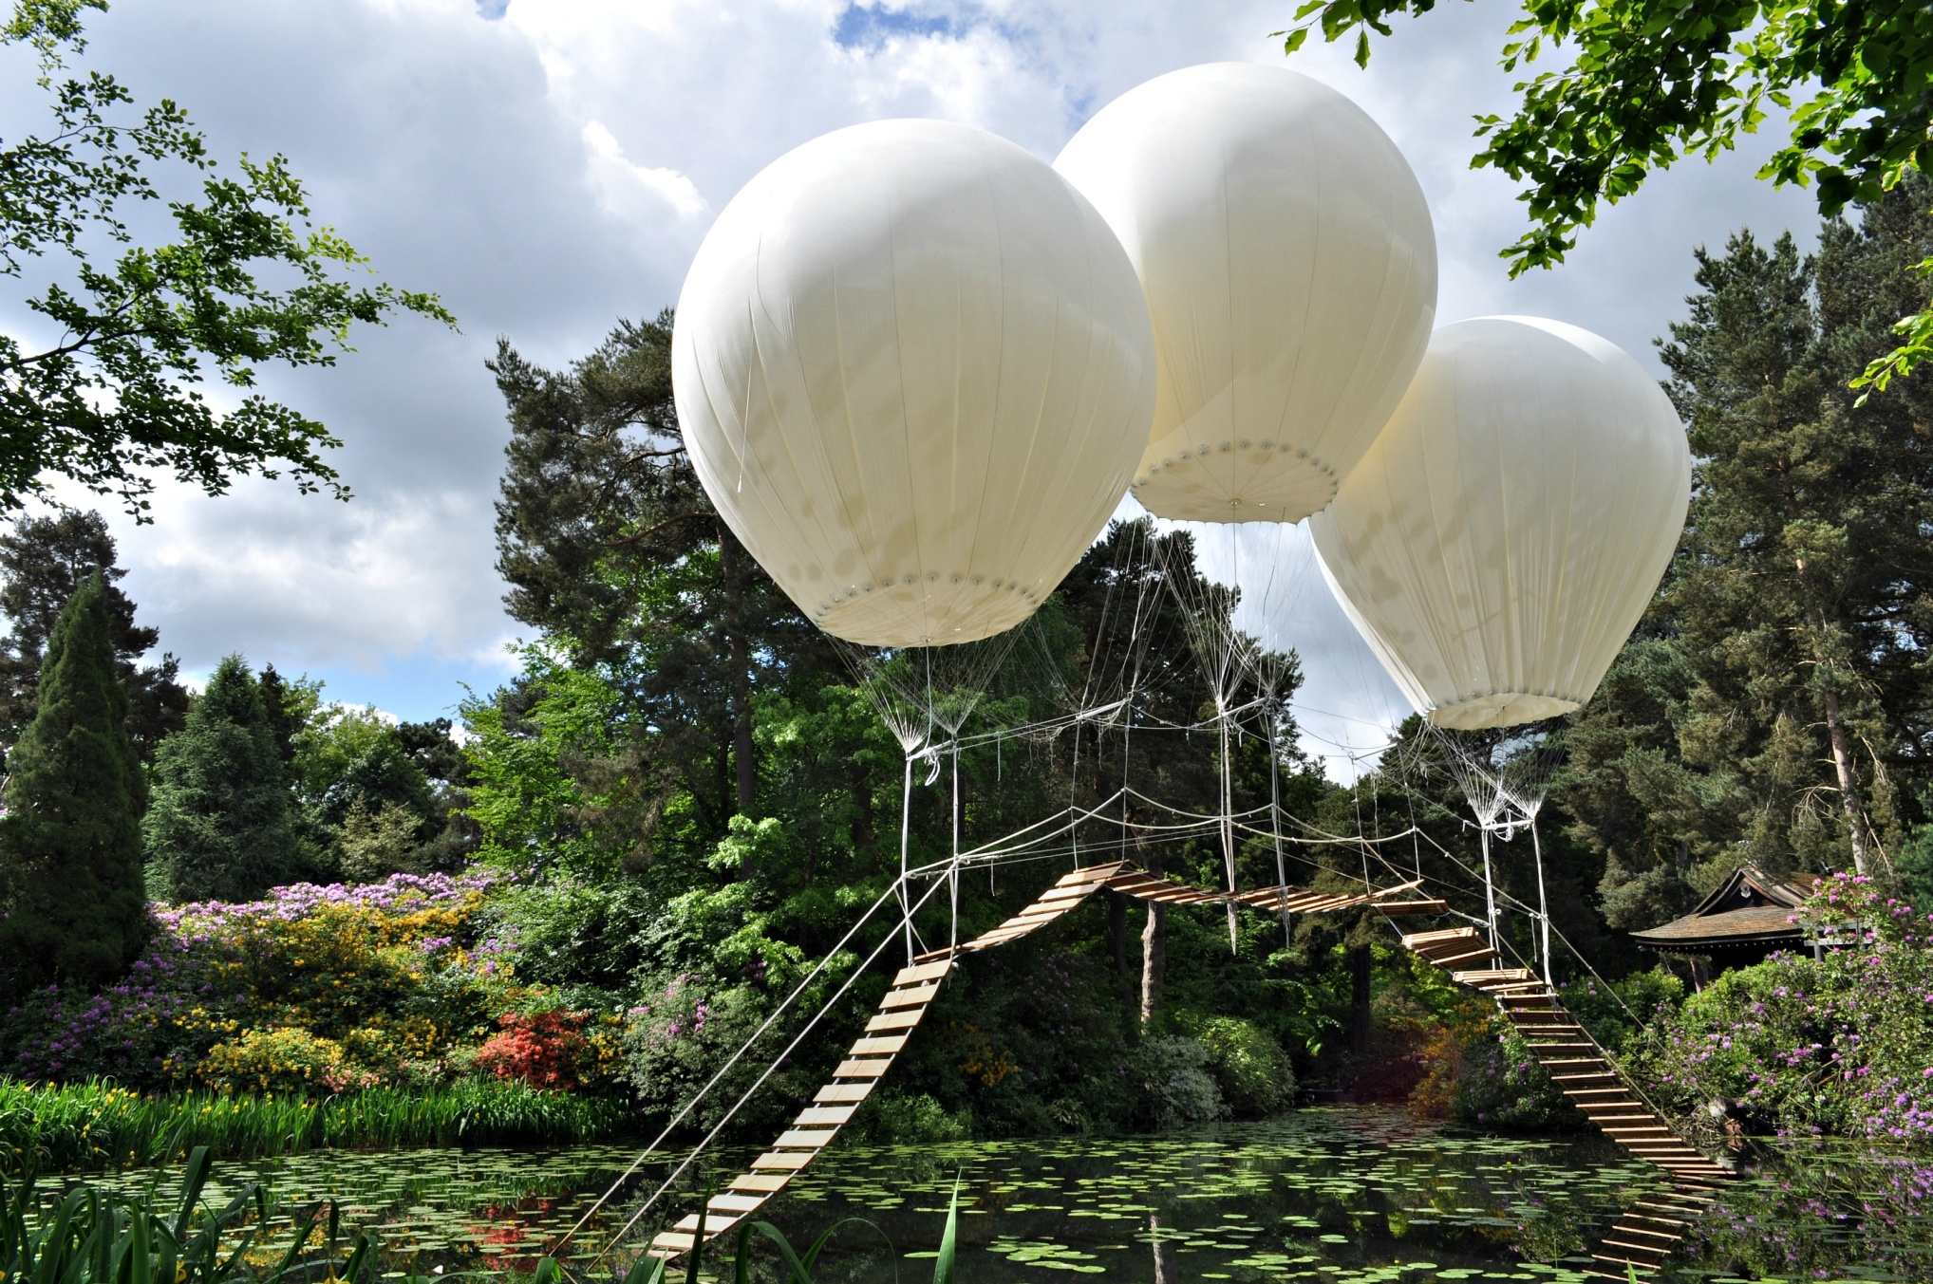
Pont de Singe Bridge – Tatton Park

Slide 7
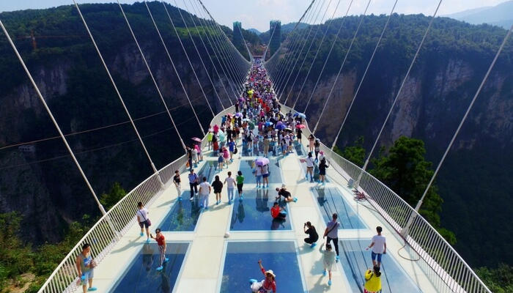
Zhangjiajie Bridge – China

Slide 8
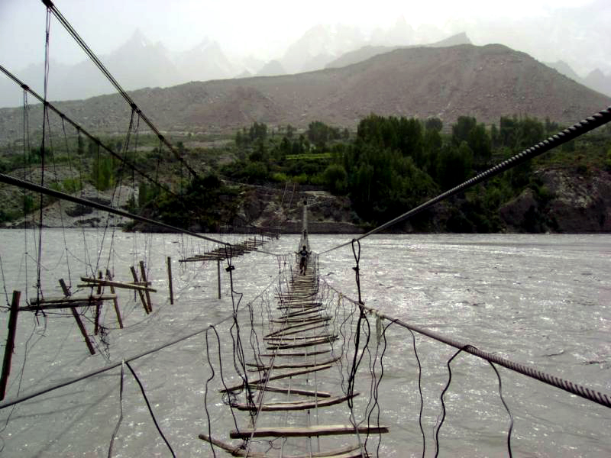
Hussaini Hanging Bridge – Pakistan.

Slide 9
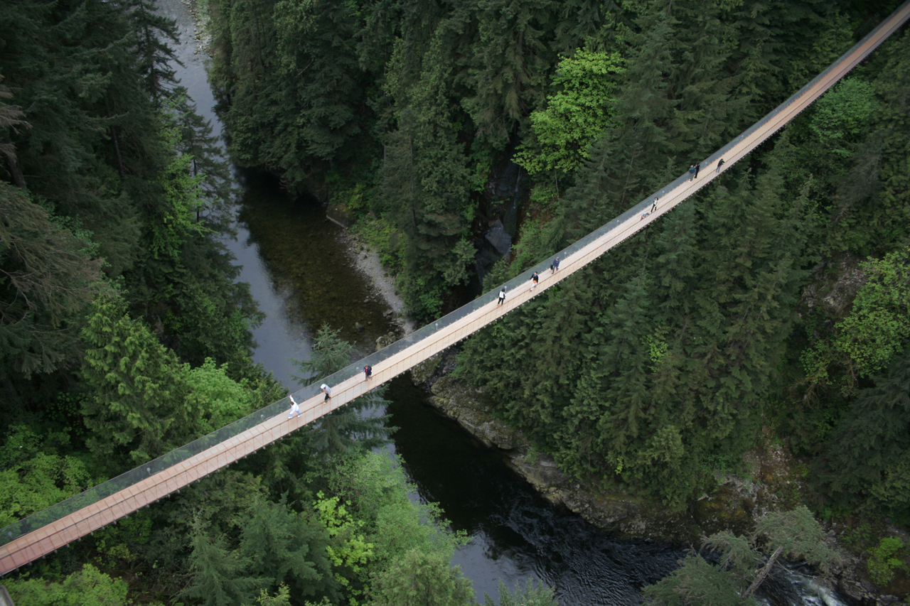
Capilano Suspension Bridge – Canada

