Slide 1
Wimbledon Stars

Slide 2
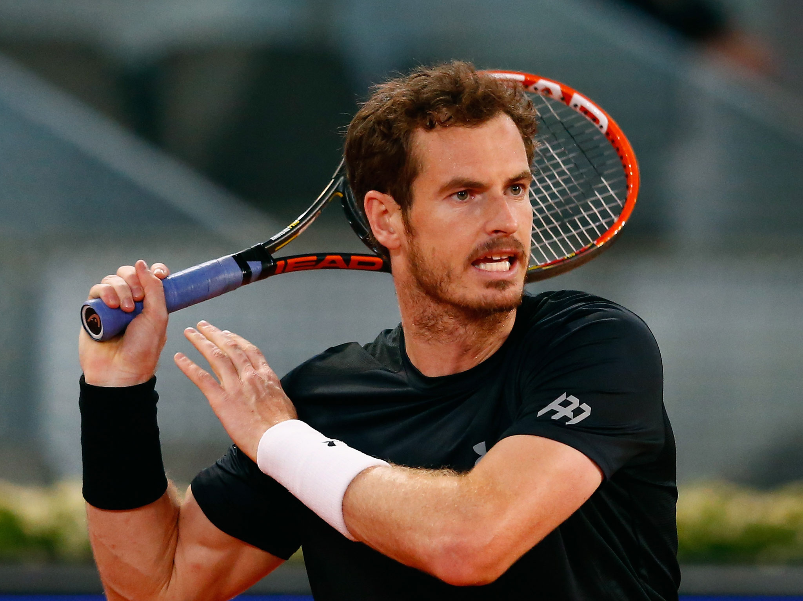

Slide 3
Last year...
...almost 485,000 people attended Wimbledon.
...39,000 spectators were in the grounds at one time!

Slide 4
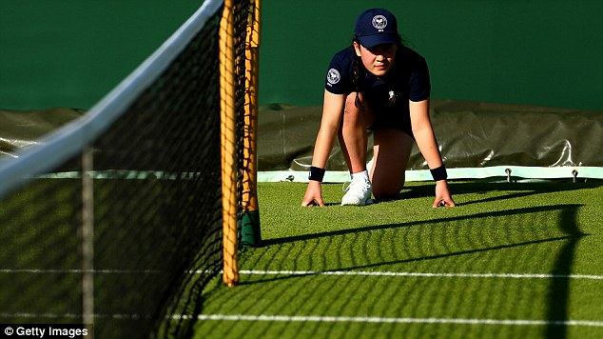
About 250 ball boys and ball girls are hired for Wimbledon.

Slide 5
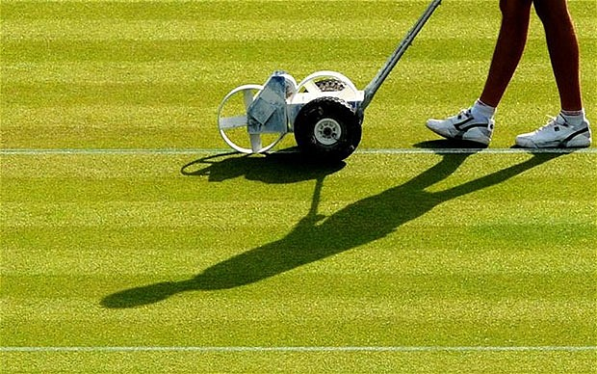
Many people are involved in the actual tennis matches.

Slide 6
There are...
- 7 ball distributors
- 151 court attendants
- 20 ground staff
- 350 umpires
- 14 physiotherapists

Slide 7
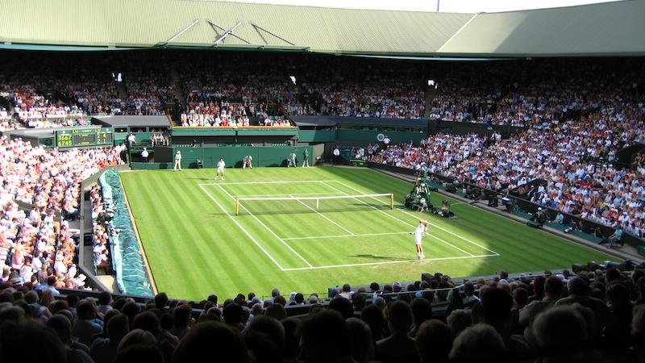
Many people look after the spectators.

Slide 8
There are...
- 191 night cleaners
- 114 day cleaners
- 30 left luggage attendants
- 30 lift operators
- 700 security guards
- 1,800 catering staff

Slide 9
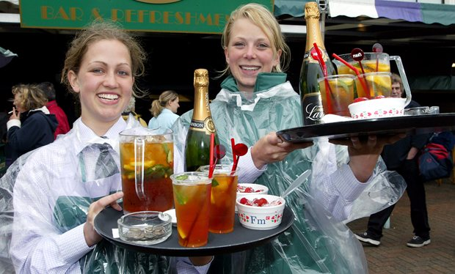
Many people enjoy the food!

Slide 10
Food served in 2015...
- 190,000 sandwiches
- 130,000 lunches
- 207,000 meals
- 32,000 portions of fish and chips
- 6,000 stone-baked pizzas
- 40,000 char-grilled meals
- 60,000 sausage baguettes
- 142,000 portions of strawberries

Slide 11
Also...
- 320 transport drivers
- 38 media staff
- Rufus, the harrier hawk!

Slide 12
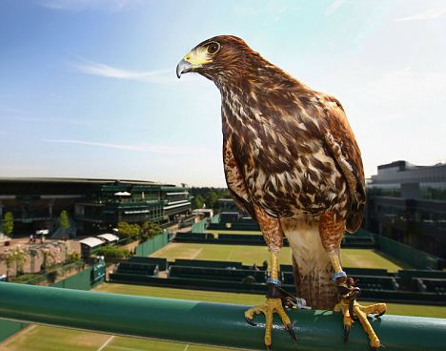

Slide 13

Everyone is a star!

