Slide 1
Welcome to our assembly

Slide 2


Slide 3
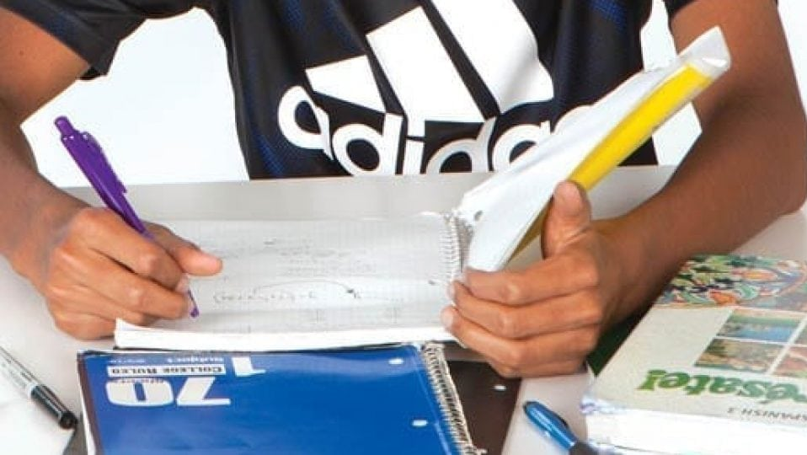

Slide 4


Slide 5
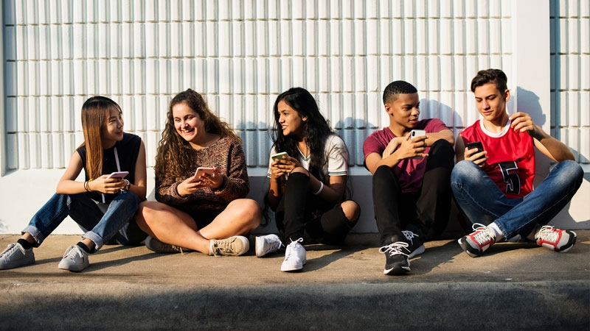
England captain Bobby Moore collecting the World Cup Trophy from Queen Elizabeth II back in 1966

Slide 6


Slide 7
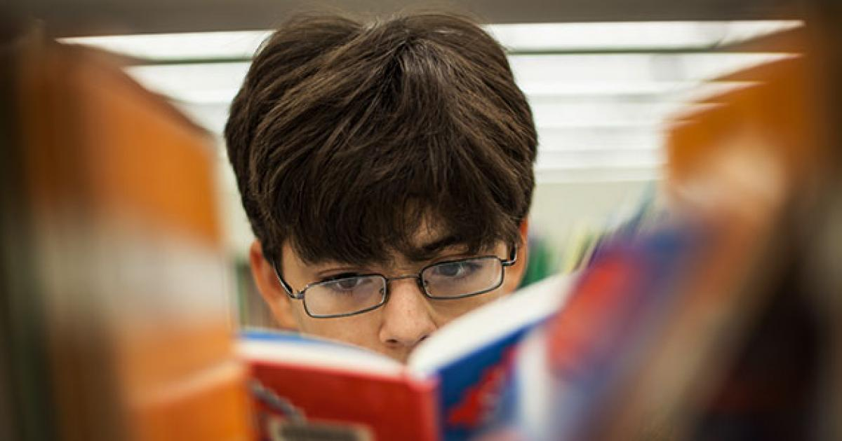

Slide 8
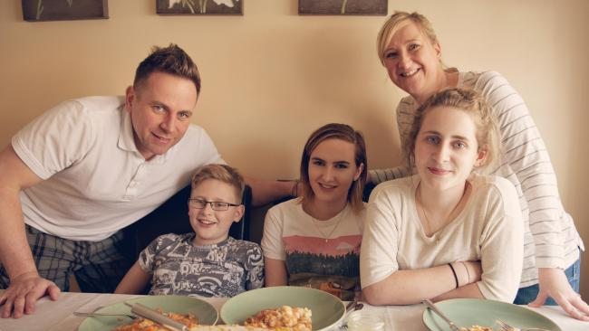

Slide 9


Slide 10
Name and contact details of local carers support services.
Details can be found at https://www.childrenssociety.org.uk/youngcarer/young-carers-services

