Slide 1
Welcome

Slide 2



Slide 3
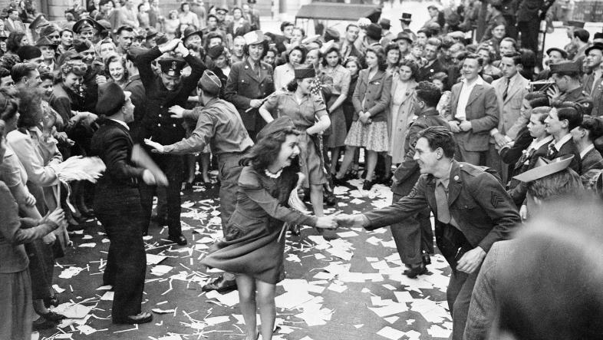

Slide 4


Slide 5


Slide 6
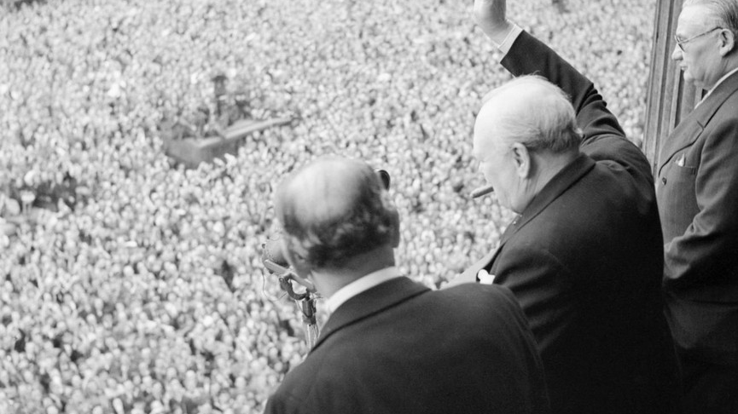
https://www.youtube.com/watch?v=NEavcsrMoMw

Slide 7
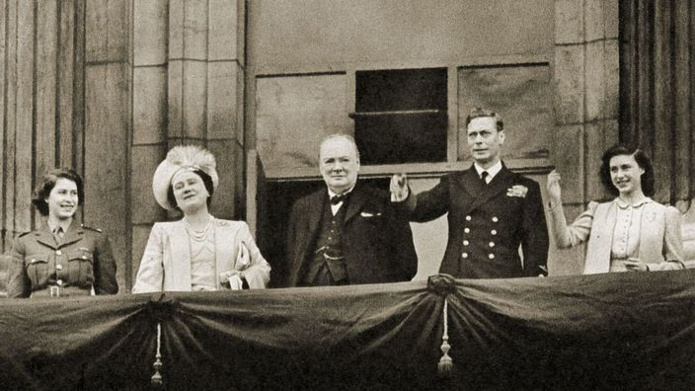

Slide 8


