Slide 1
Welcome….

Slide 2
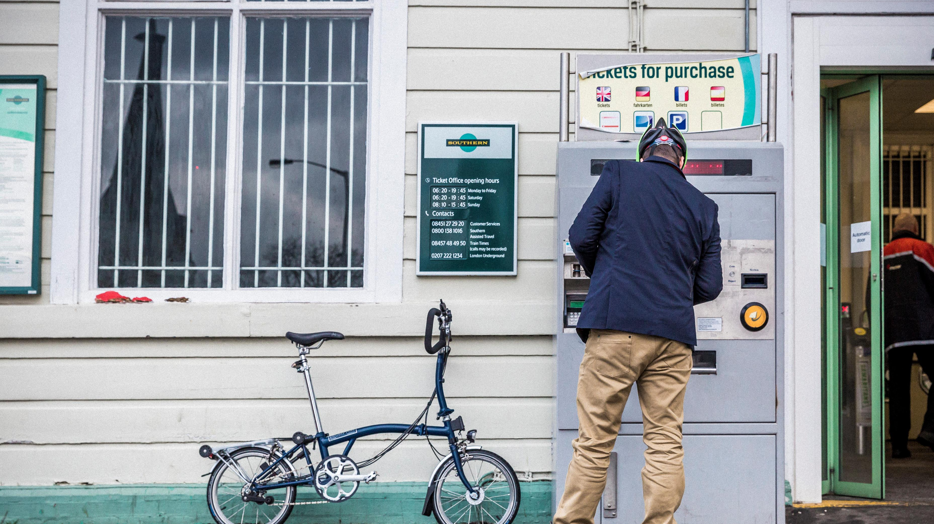

Slide 3


Slide 4

  Stress is a feeling of being overwhelmed or unable to cope as a result of pressures that are unmanageable.

Slide 5
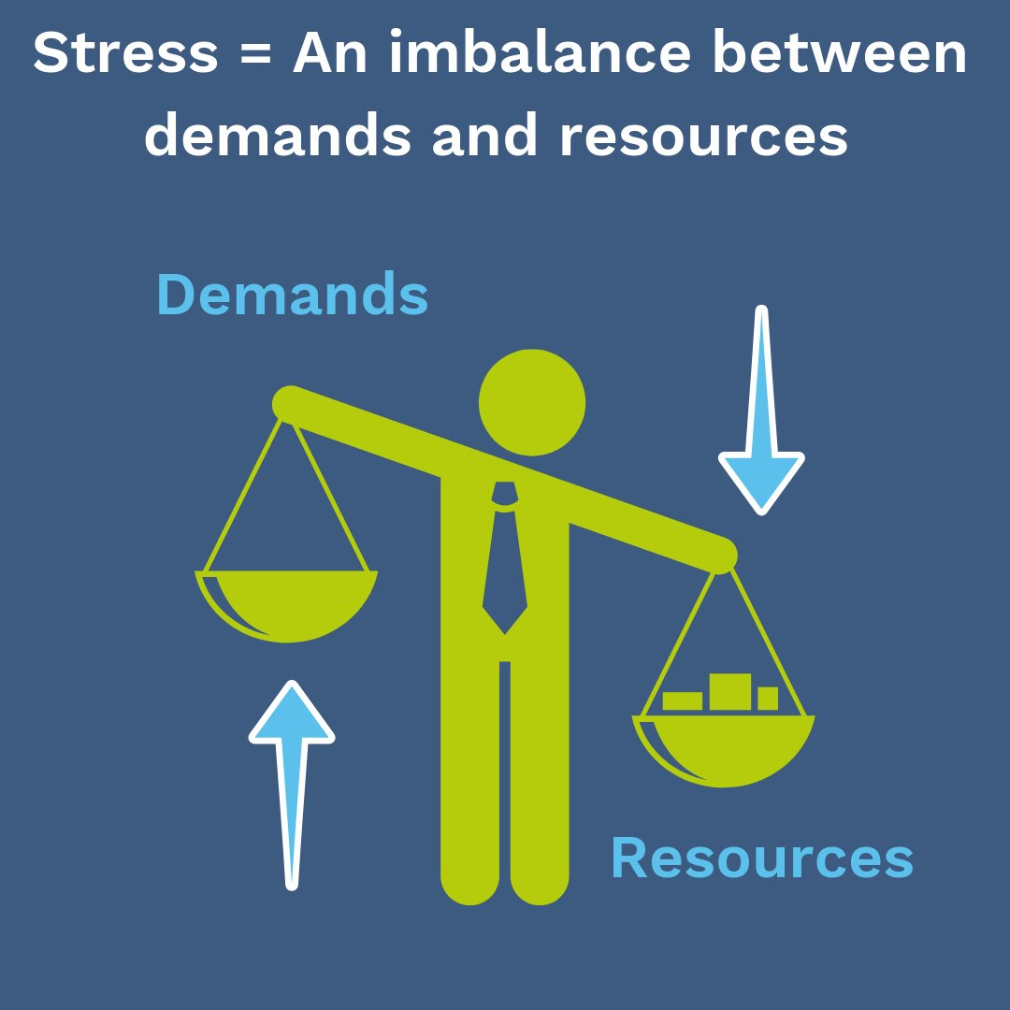

Slide 6
Find someone we trust to speak to about the pressure we feel.
Take a break - do something that we really enjoy.
Being aware of our breathing and taking some slow breaths in, and slow breaths out can calm our bodies and mind when we feel overwhelmed.
Exercise produces chemicals in your body called ‘endorphins’ which make us feel good.
Good quality sleep helps us to feel physically and mentally more able to cope.
Reminding ourselves about our goals, values and beliefs can help when we feel overwhelmed.

Slide 7
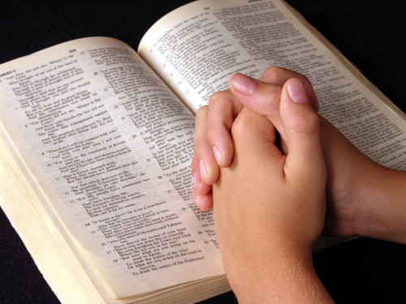
Isaiah 41:10 –’Do not fear: I am with you; do not be anxious: I am your God. I will strengthen you, I will help you, I will uphold you with my victorious right hand.’

