Slide 1
Never Again
An assembly for Holocaust Memorial Day

Slide 2
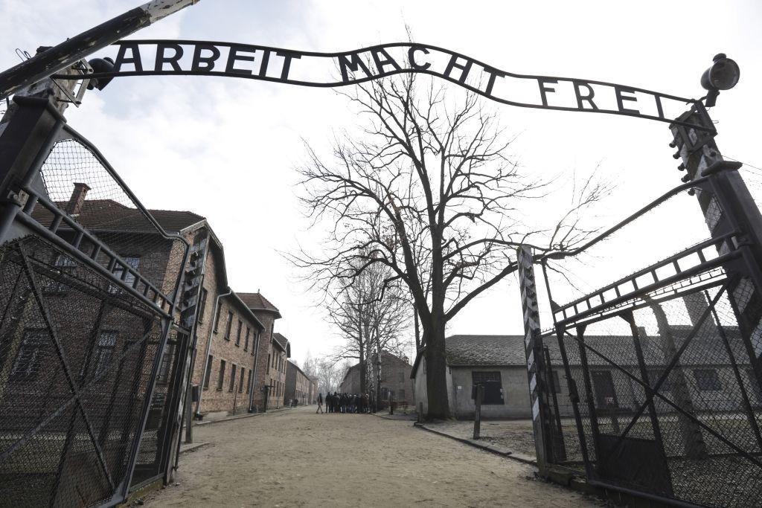
Auschwitz

Slide 3
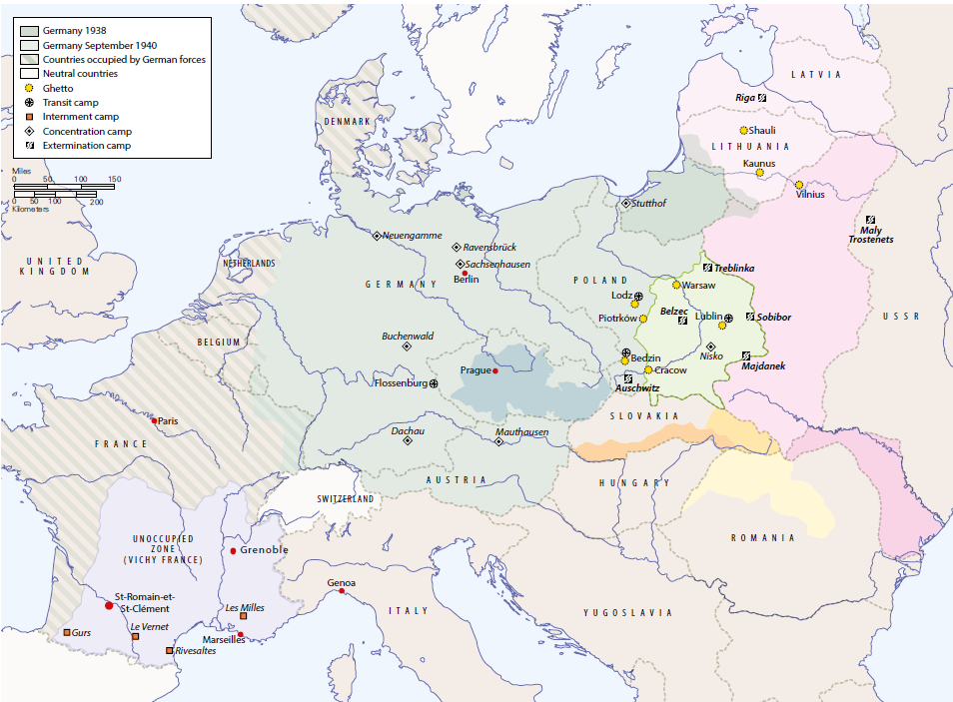
Prague
Saint-Romain-et-Saint-Clément
Grenoble

Slide 4
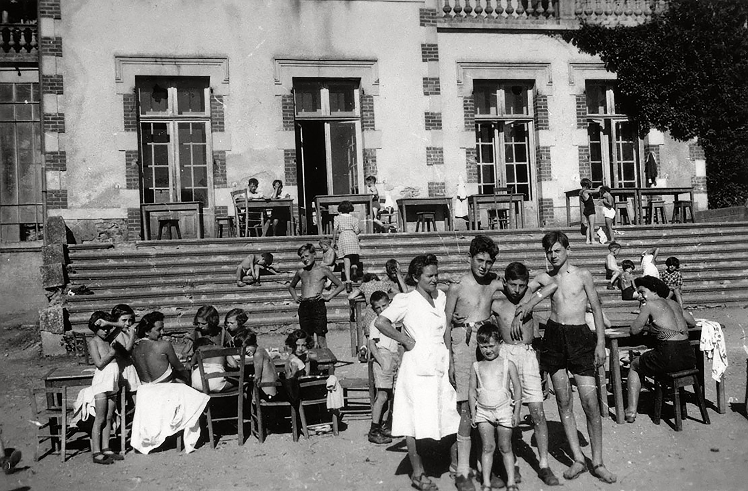
Jean, Mariette and other Jewish children found shelter in this château in France

Slide 5
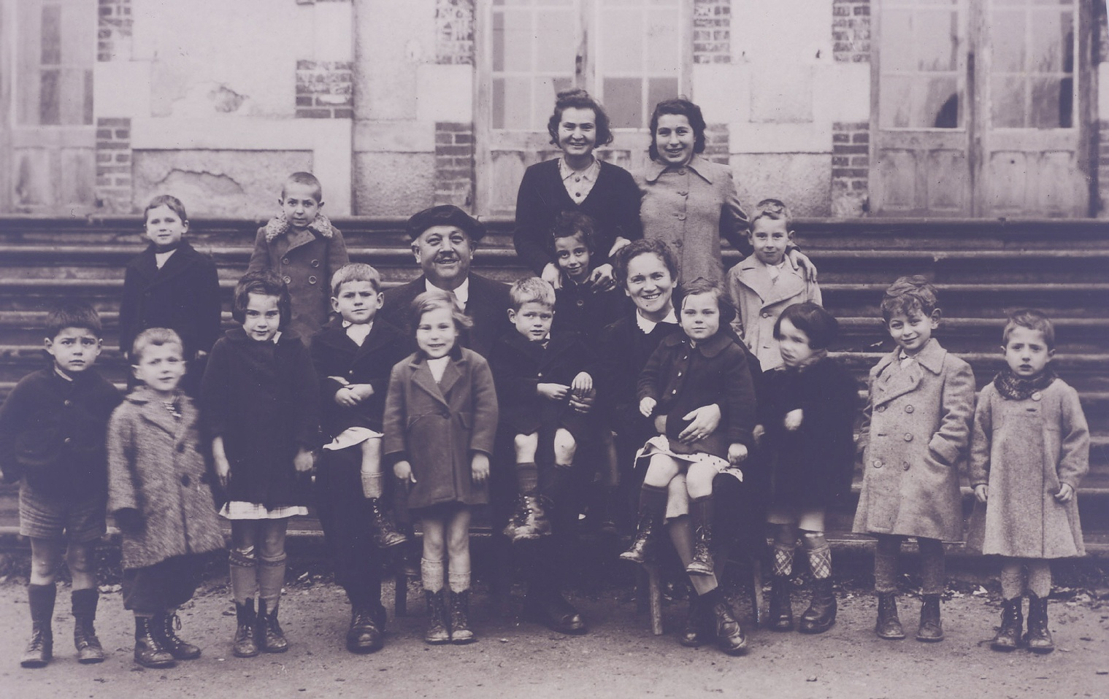
Some of the children and teachers at the château where Jean and Mariette sheltered

Slide 6
‘A person who saves one life,
it is as if they saved
an entire world.’
The Talmud

Slide 7
First they came for the Communists,
And I did not speak out
Because I was not a Communist
Then they came for the Socialists
And I did not speak out
Because I was not a Socialist
Then they came for the trade unionists
And I did not speak out
Because I was not a trade unionist
Then they came for the Jews
And I did not speak out
Because I was not a Jew
Then they came for me
And there was no one left
To speak out for me
Pastor Martin Niemöller

Slide 8
‘I come from a people who gave the Ten Commandments to the world. Time has come to strengthen them by three additional ones . . .: thou shall not be a perpetrator; thou shall not be a victim; and thou shall never, but never, be a bystander.’
Yehuda Bauer, Israeli professor

