Slide 1

Are you a good detective?

Slide 2
Now is the season of promise,
When new life’s beginning to grow.
The time for rebirth and awakening,
When blossom and buds start to show.

Slide 3
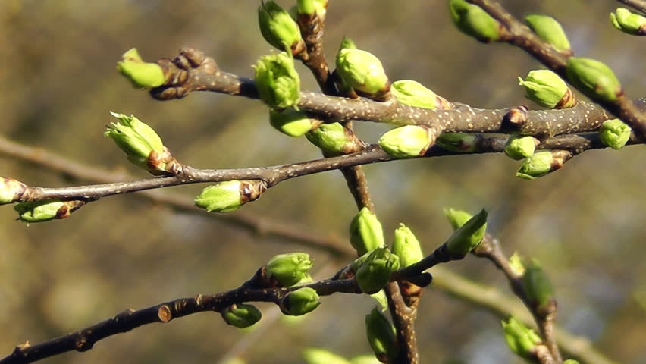

Slide 4
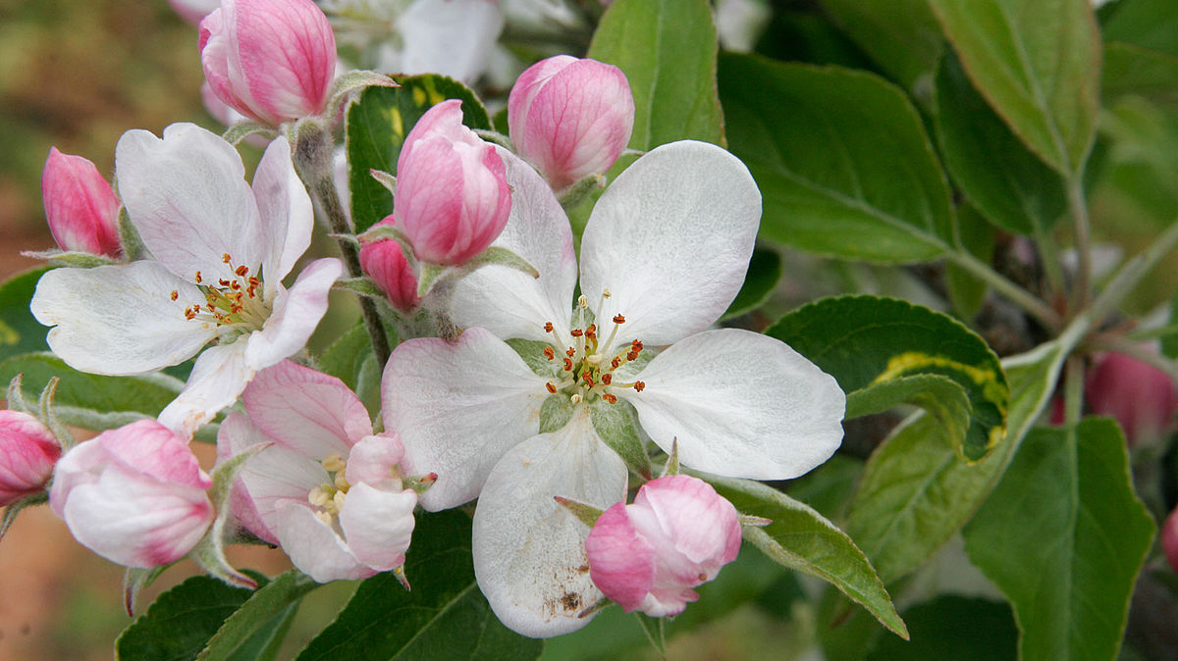

Slide 5
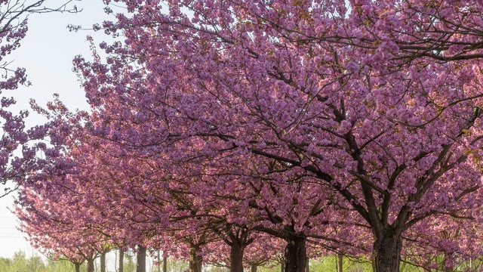

Slide 6
The newborn appear in the meadow,
On farm and in hedgerow and pond.
There’s a chorus of birds sweetly singing,
In field and in forest beyond.

Slide 7
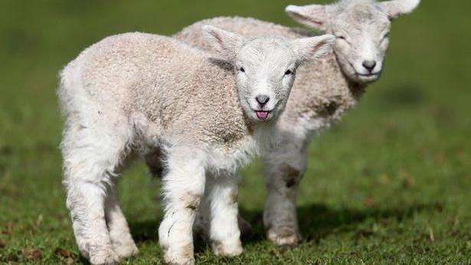

Slide 8
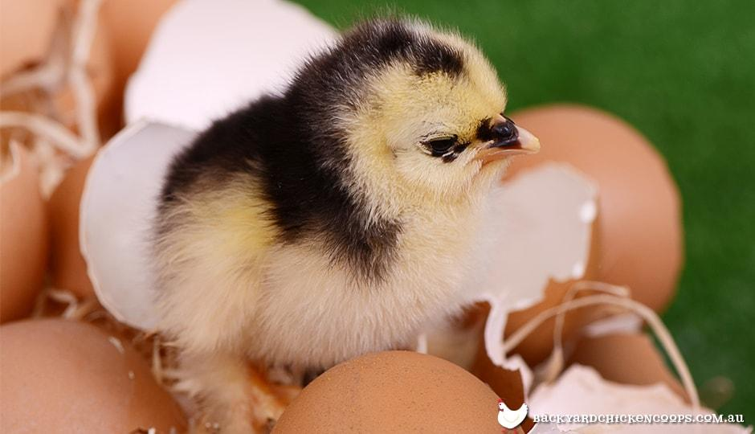

Slide 9
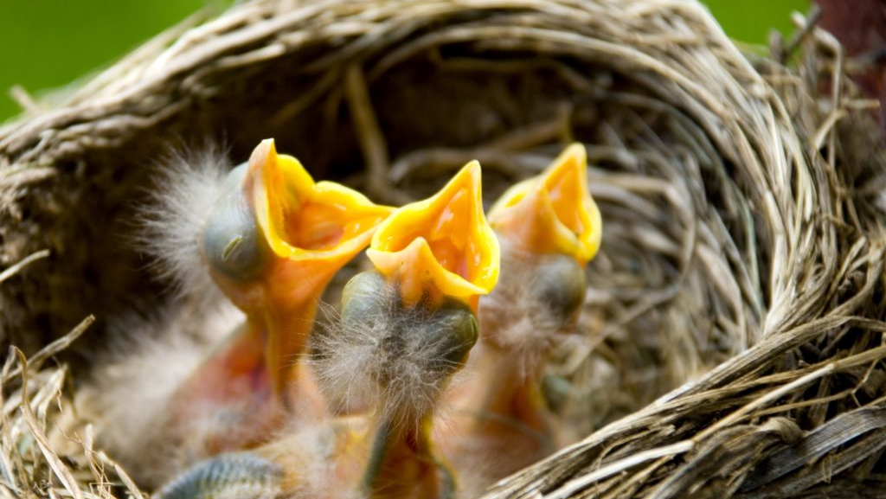

Slide 10
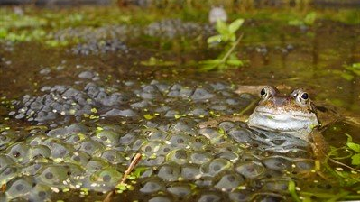

Slide 11
Daffodils brighten our gardens,
Showing that winter is past.
The snowdrop and crocus still blooming,
Tell us that spring’s here at last.

Slide 12
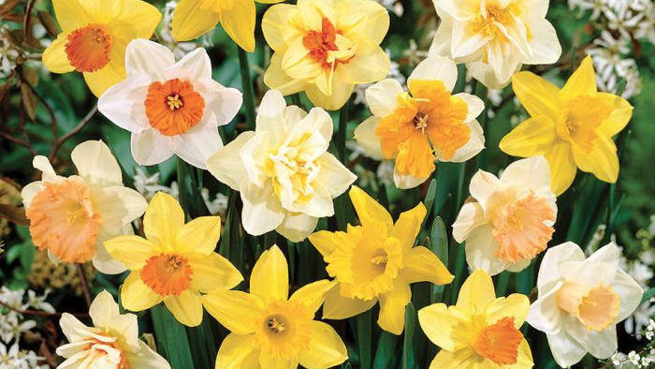

Slide 13
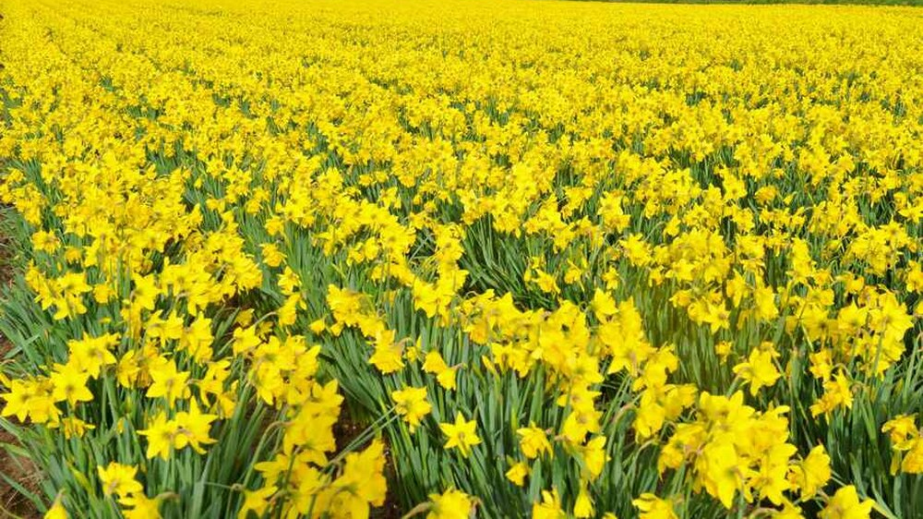

Slide 14
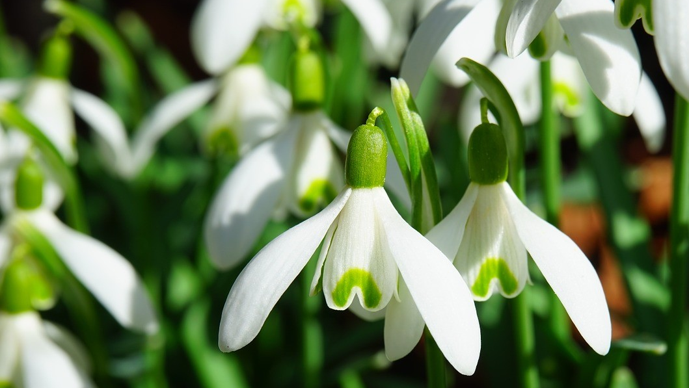

Slide 15
