Slide 1
What is your favourite animated film?

Slide 2



Quiz
Name the film!

Slide 3
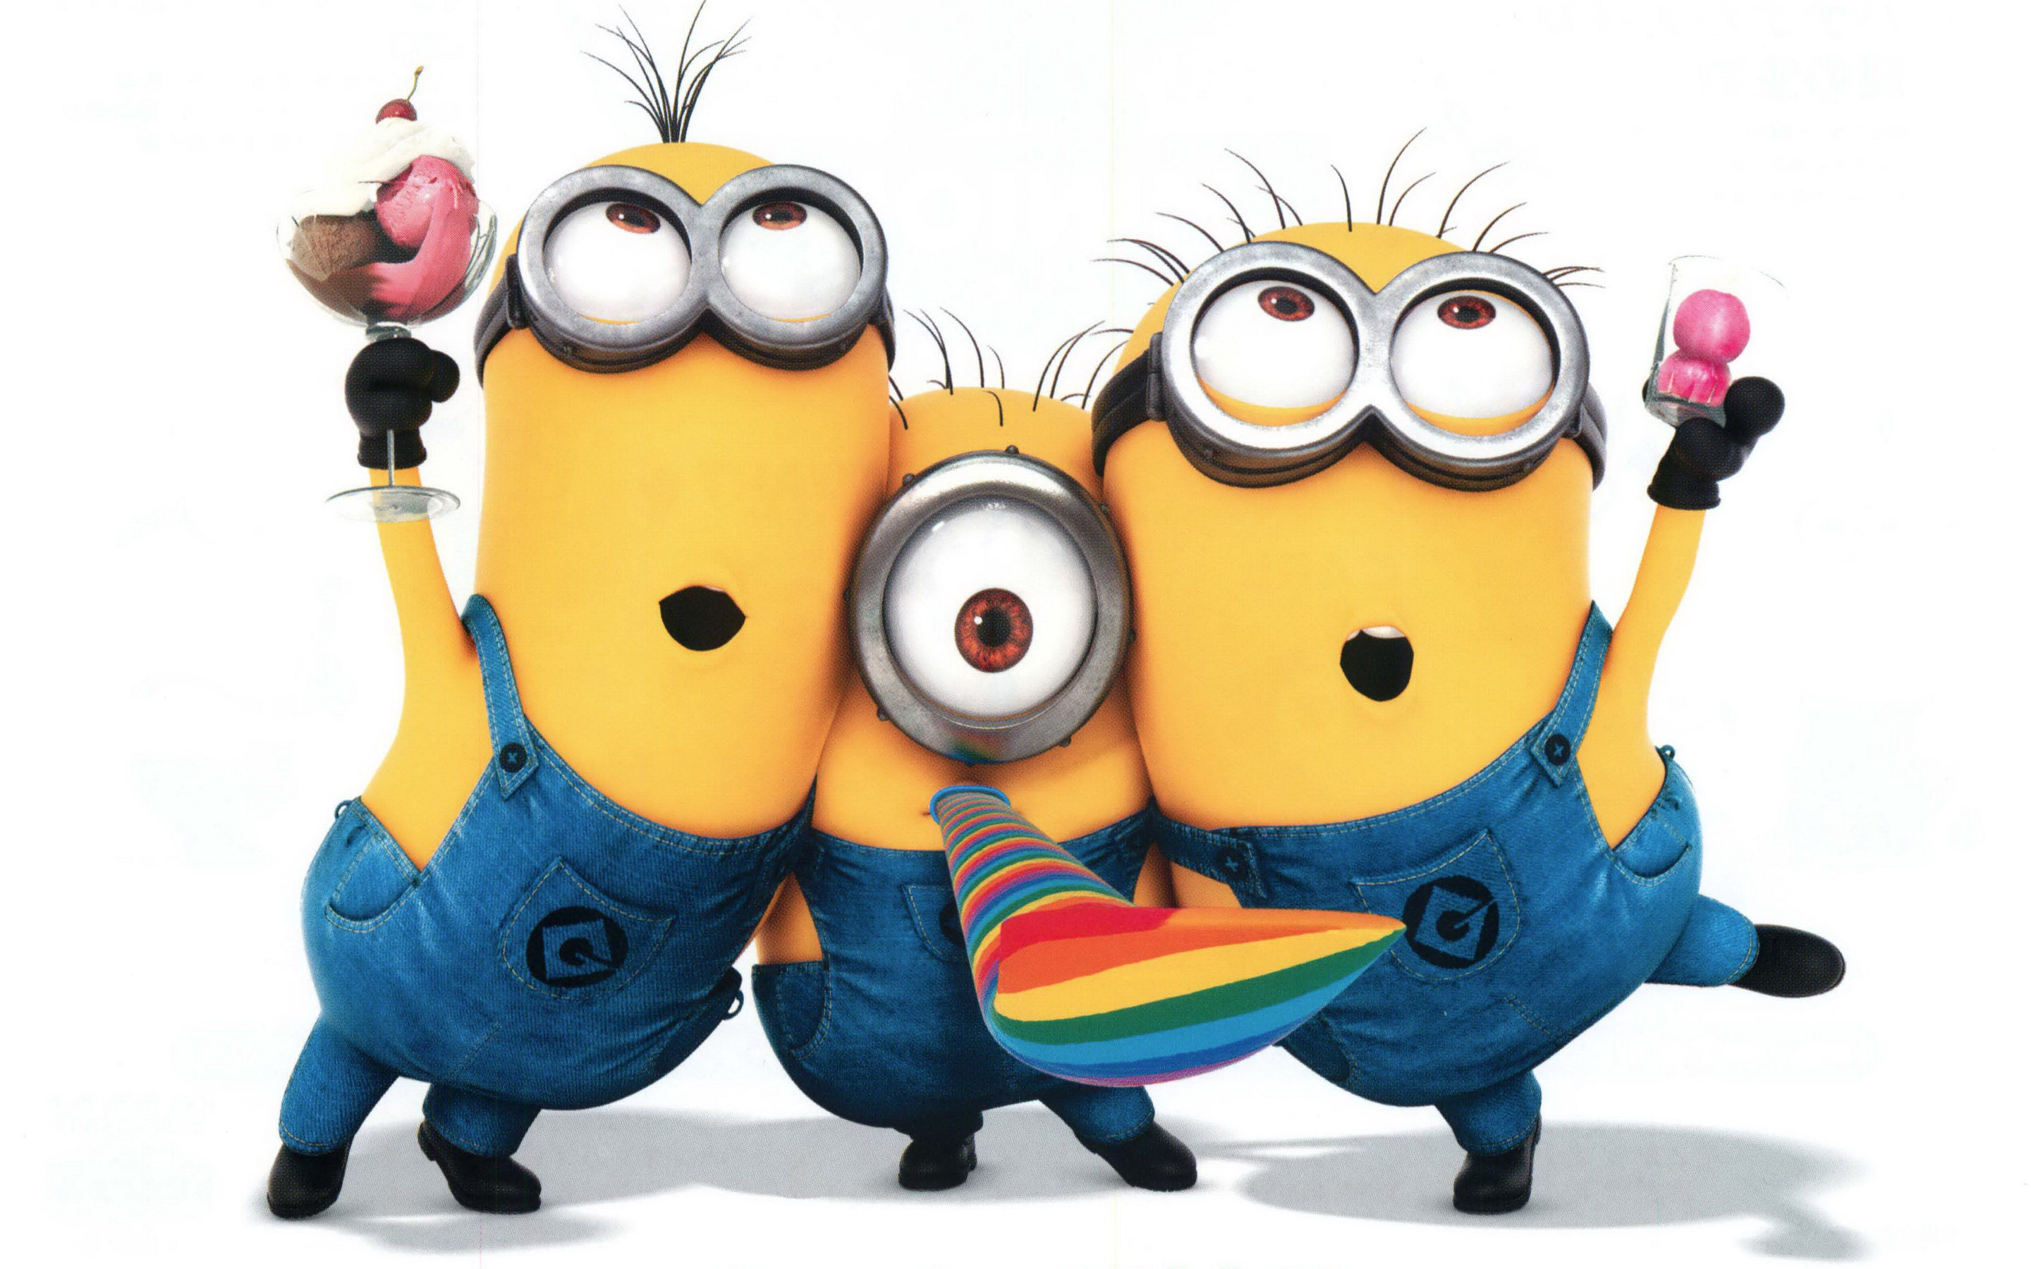

Slide 4

Despicable Me

Slide 5
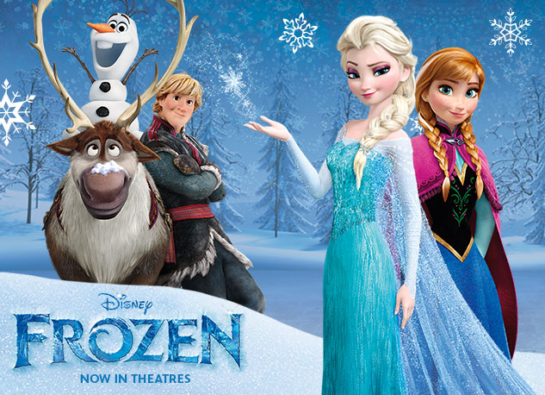

Slide 7
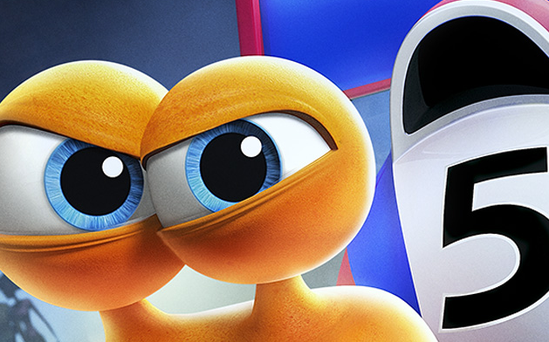

Slide 8


Slide 9
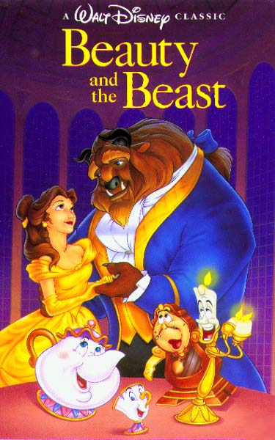

Slide 11
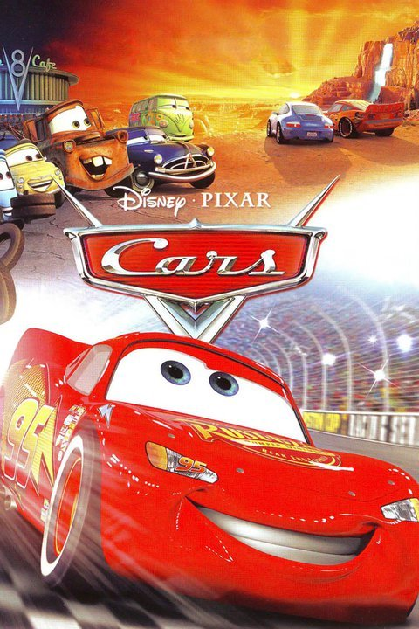

Slide 13
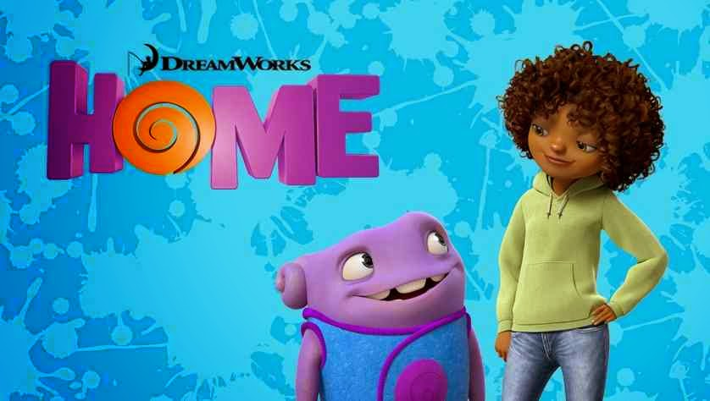

Slide 15
