Slide 1
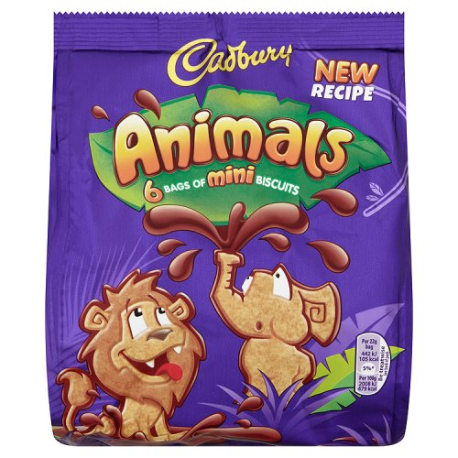

Slide 2
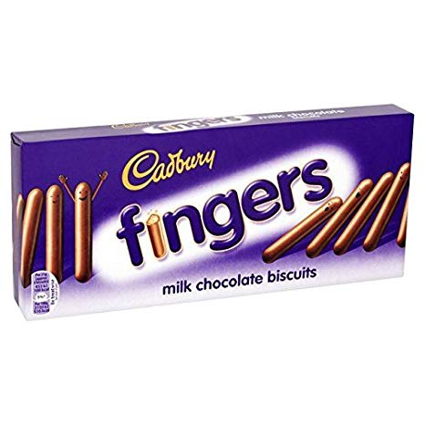

Slide 3
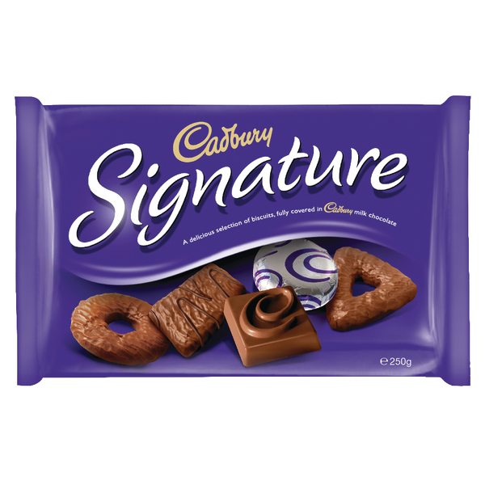

Slide 4


Slide 5
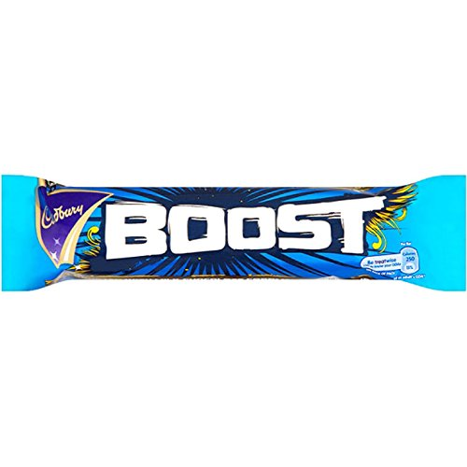

Slide 6
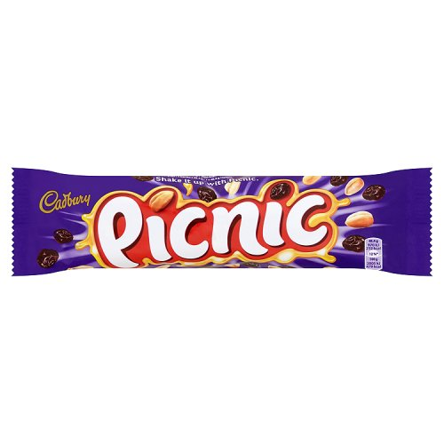

Slide 7


Slide 8
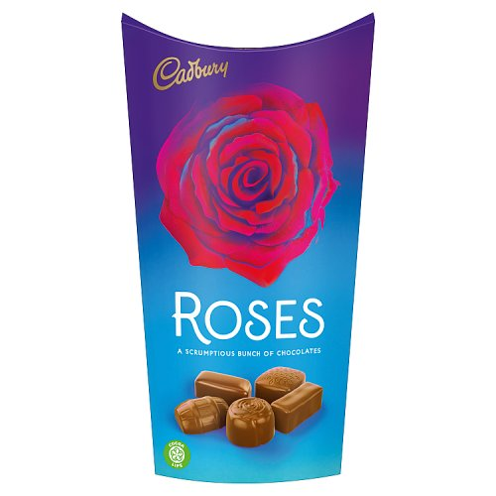

Slide 9
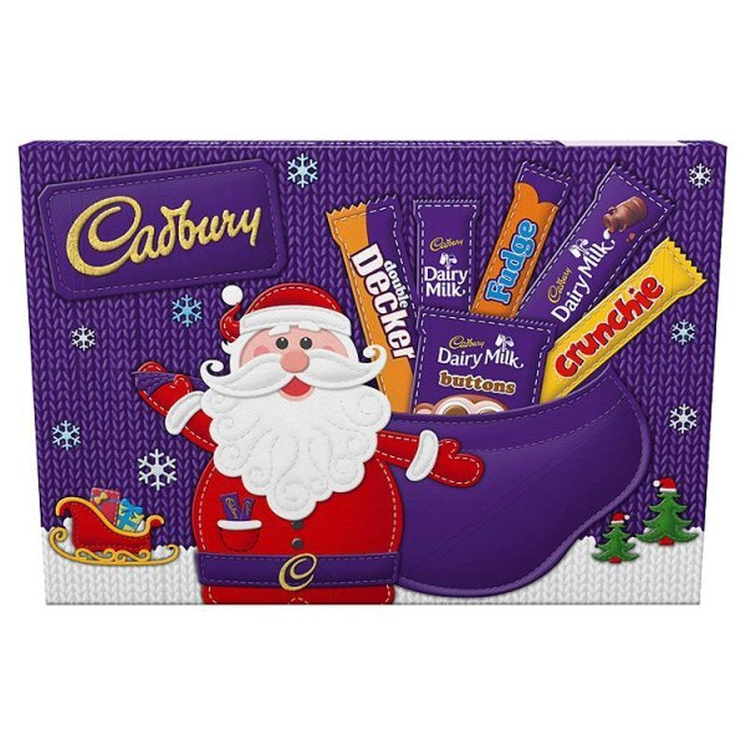

Slide 10


Slide 11
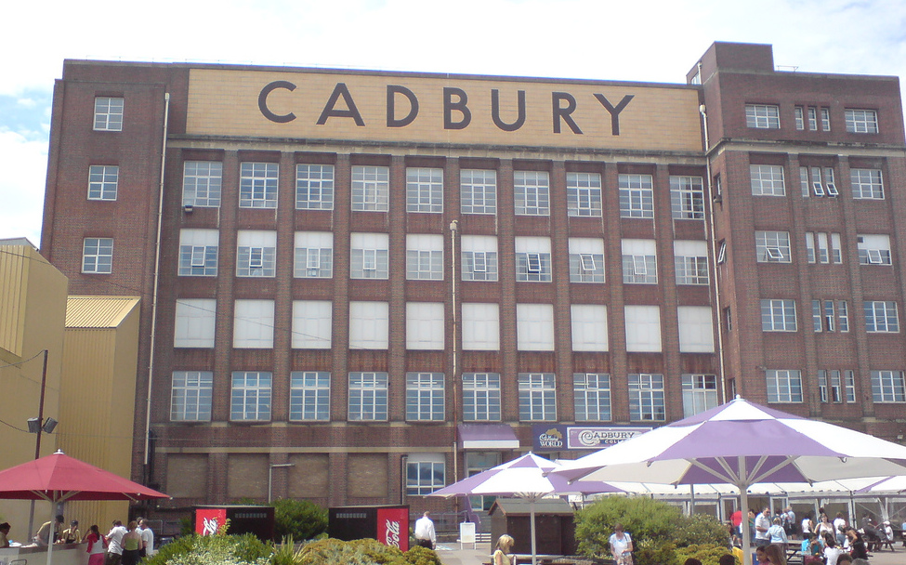

Slide 12

Every day:
1.2 million creme eggs are made!
5.5 million blocks of Dairy Milk chocolate are made!
1 million Wispas are made!

Slide 13
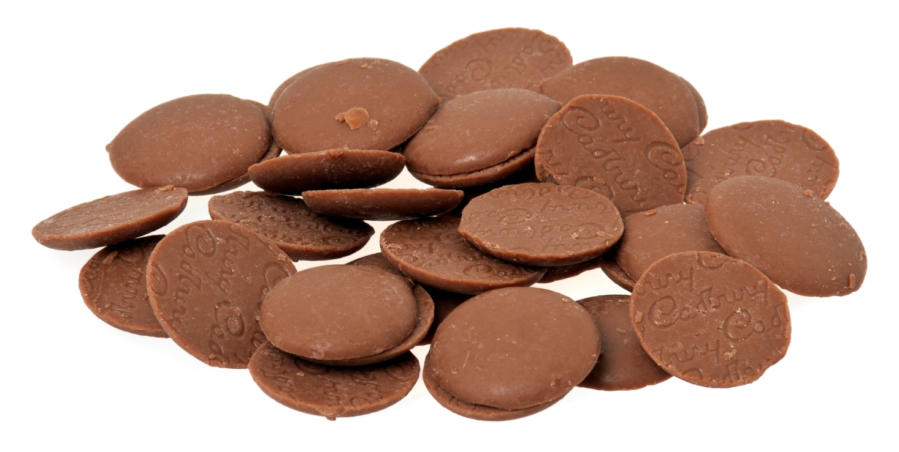
Over 250,000 Chocolate
Buttons are made each minute!’.

