Slide 1
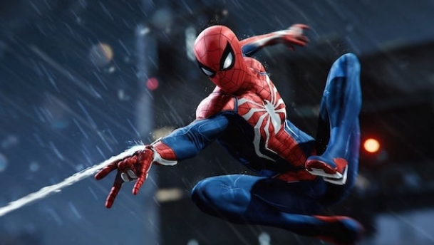

Slide 2
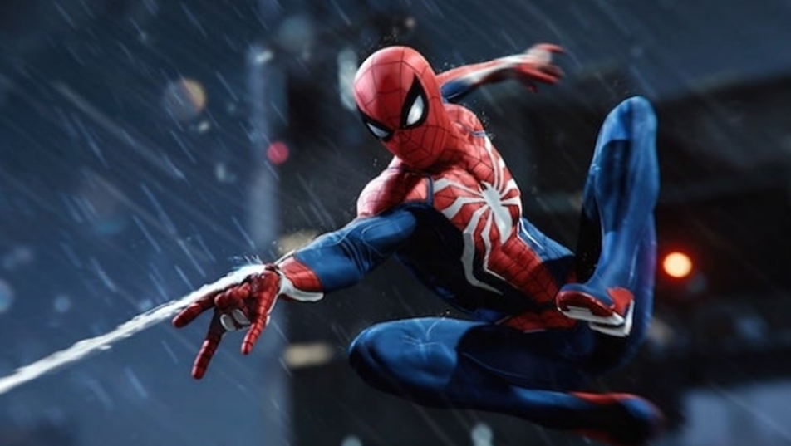
Spiderman – Web Shooter

Slide 3
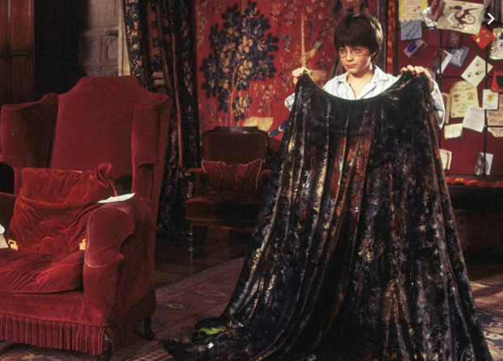

Slide 4
Harry Potter – Invisibility Cloak

Slide 5
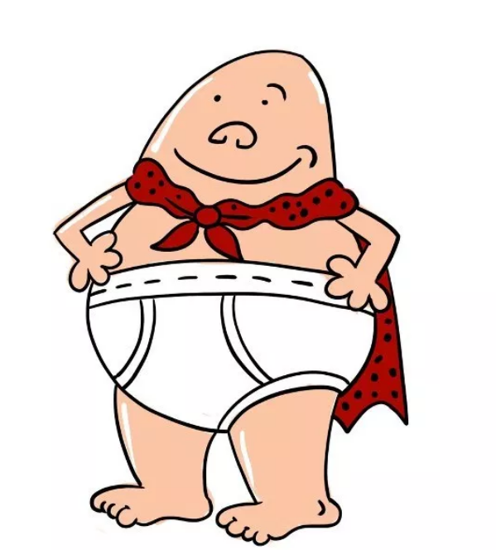

Slide 6
Captain Underpants
Superhuman strength, durability, and flight

Slide 7
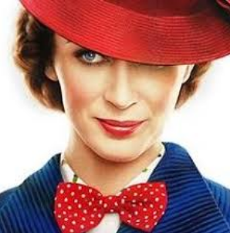

Slide 8
Mary Poppins -
Ability to make things appear and transport people to magical places

Slide 9
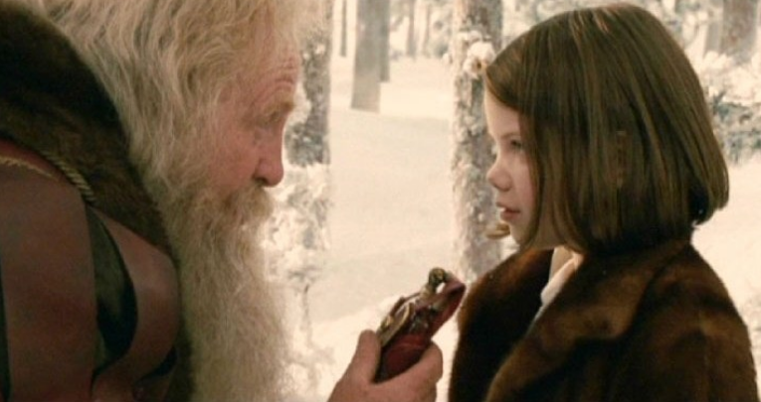

Slide 10
Lucy Pevensie – The Lion, the Witch and the Wardrobe
Healing cordial from Father Christmas

Slide 11
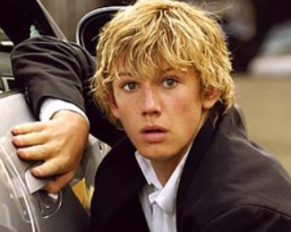

Slide 12
Alex Rider
Athletic talents

Slide 13

