Slide 1

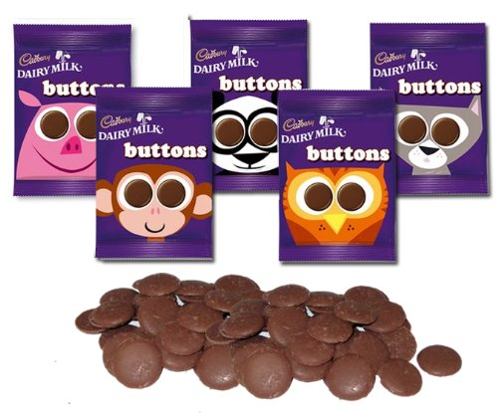

Slide 2


Slide 3
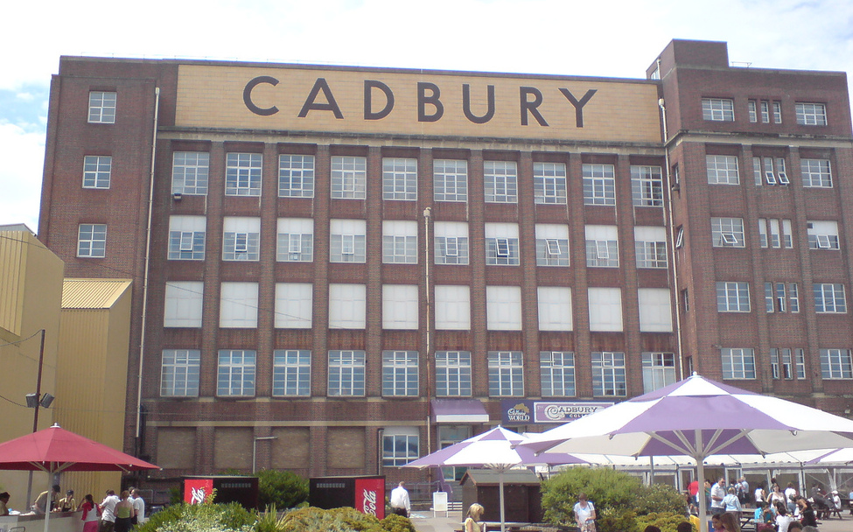

Slide 4
Every day:
1.2 million creme eggs are made!
5.5 million blocks of Dairy Milk chocolate are made!
1 million Wispas are made!

Slide 5
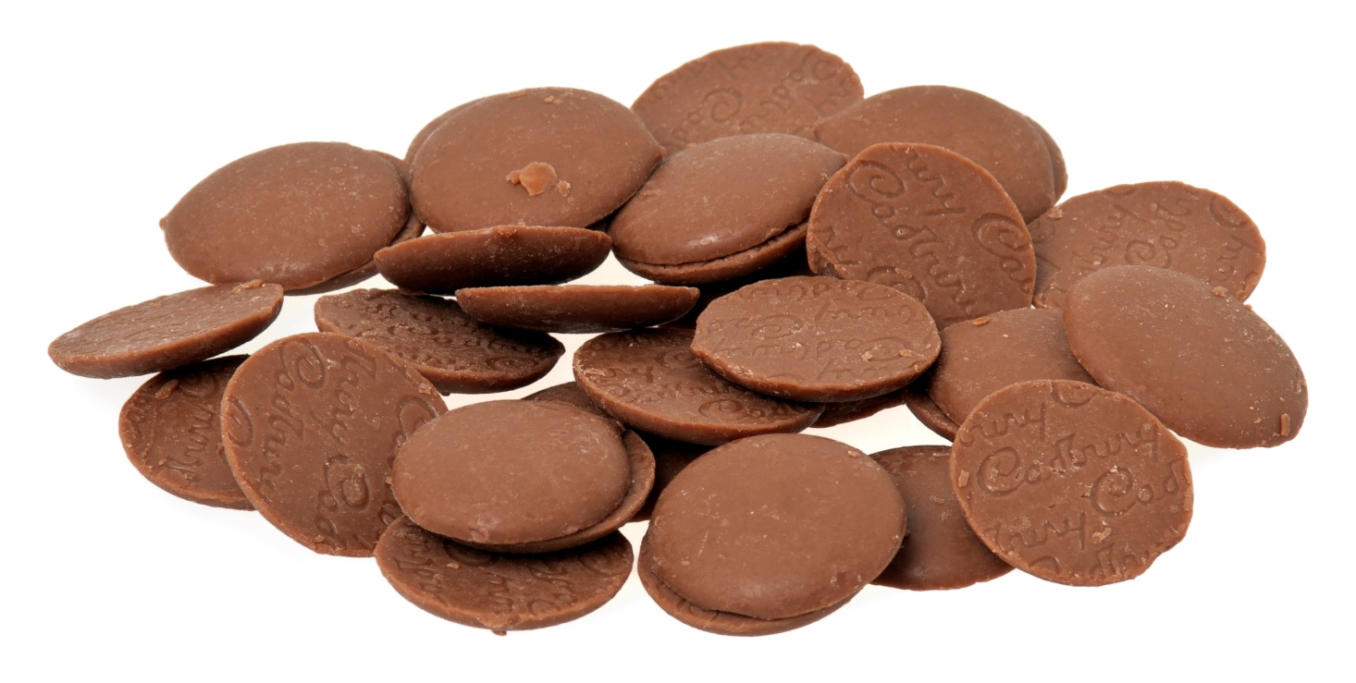
‘Over 250,000 Chocolate
Buttons are made each minute’.

