Slide 1
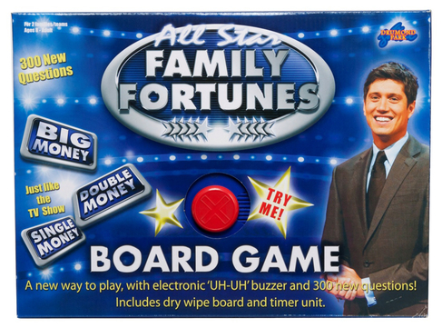
All-Star Family Fortunes Board Game

Slide 2
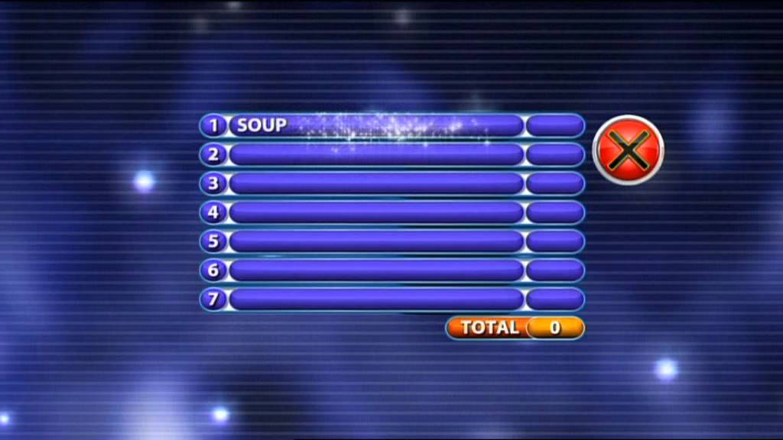
All-Star Family Fortunes Scoreboard

Slide 3
New Year’s Resolutions
Eat better
Exercise more
Spend less money
Get more sleep
Read more books

Slide 4
‘Don’t ask what the world needs.
Ask what makes you come alive and go do it, because what the world needs is people who have come alive.’
(Howard Thurman, American theologian)

