Slide 1
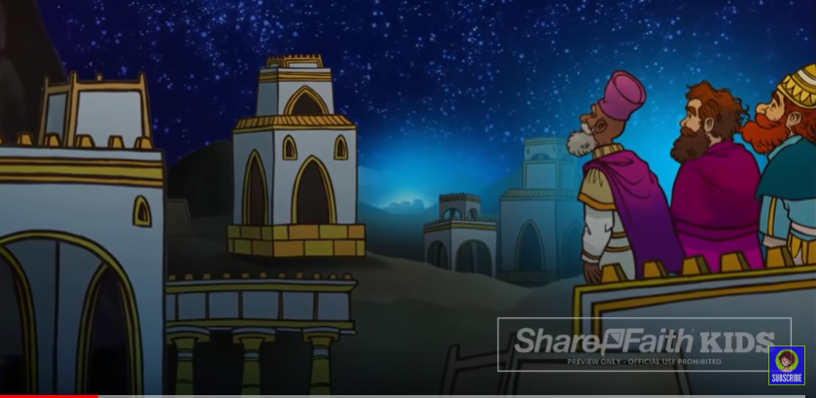
Going on a Journey
Wise Decisions

Slide 2

Going on a Journey
The Start of a Journey

Slide 3
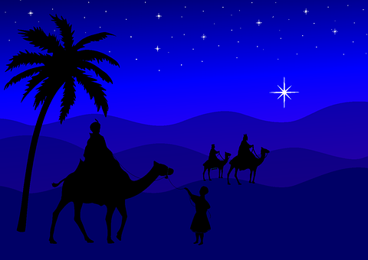
Going on a Journey
Good Times/Tough Times

Slide 4

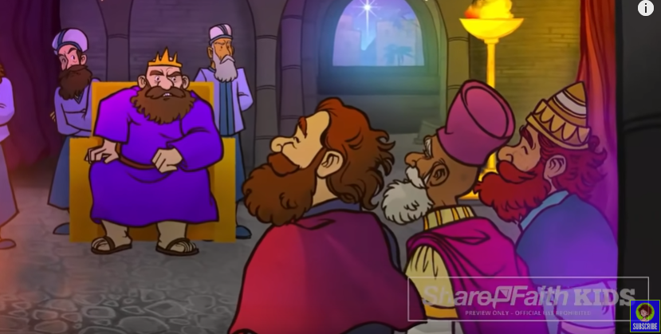

Going on a Journey
Making a Wrong Turn

Slide 5
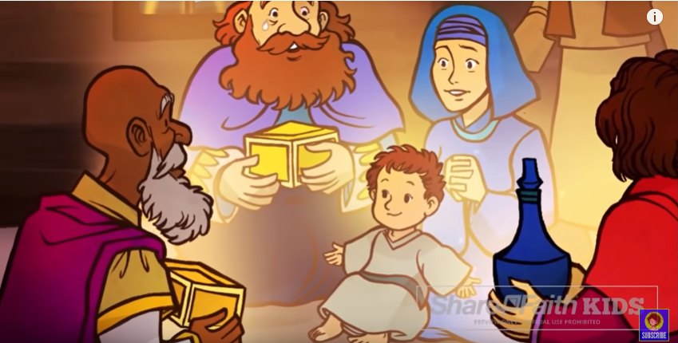
Going on a Journey
Memorable Moments

Slide 6
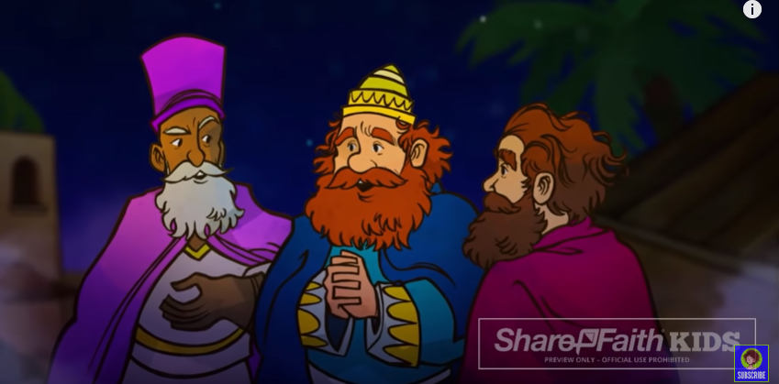
Going on a Journey
Journey’s End?

Slide 7

Going on a Journey
Epiphany – To Reveal

