Slide 1
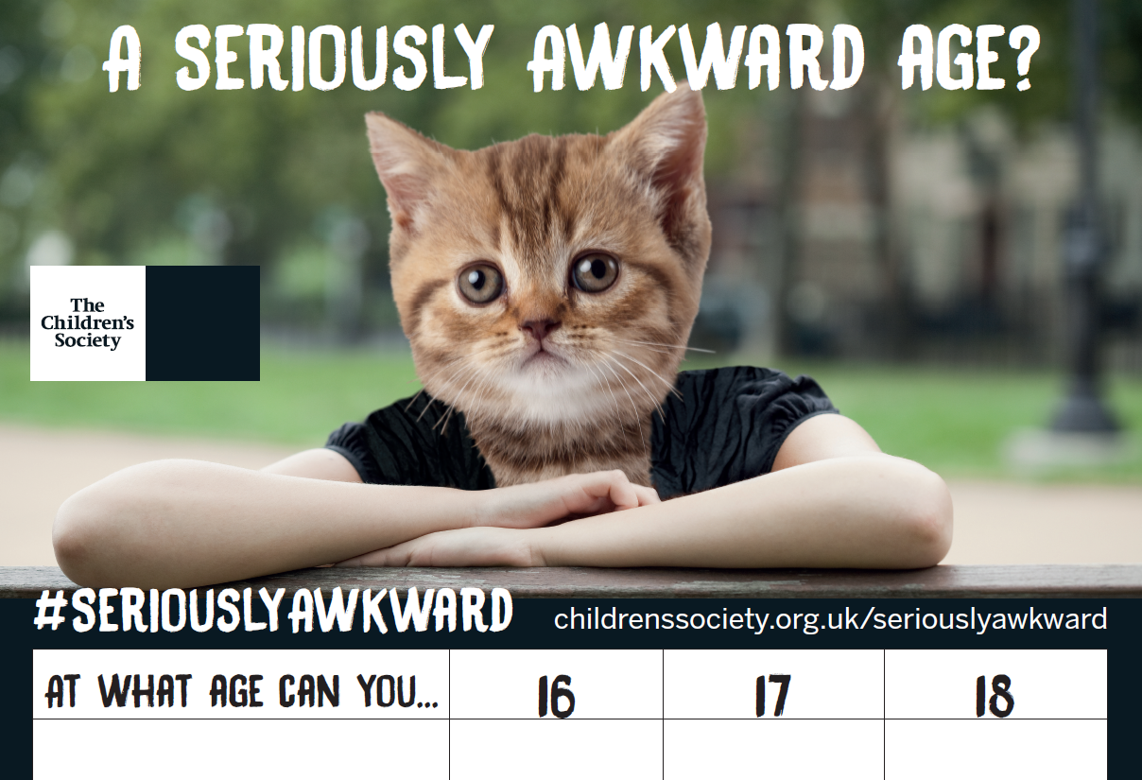


SA Quiz
Notes:
Under the Licensing Act it is illegal to sell 16 and 17 year olds tobacco products.

Slide 2


SA Quiz
Notes:
16 and 17 year olds can only get married with consent of responsible adults.

Slide 3

SA Quiz
Notes:
It is illegal to sell alcohol to under 18s, but if you are 16 you can drink a beer, wine or cider with a meal in a pub or restaurant if you are with an adult.

Slide 4

SA Quiz
Notes:
As long as you have passed your driving test and are properly insured you can drive at 17.

Slide 5

SA Quiz
Notes:
Under the Children and Young Person Act 1933, an adult cannot be prosecuted for cruelty to a child aged 16 or 17.

Slide 6

SA Quiz
Notes:
16-17 year olds at risk of homelessness can get access to housing under the Housing Act but it does not offer any additional protections, unless you agree to become a ‘looked after’ child.

Slide 7

SA Quiz
Notes:
16 year olds can rent accommodation, but a guarantor is required for everyone under 18 (this is an adult who can be responsible for them).

Slide 8
SA Quiz
Notes:
Most people over 17 can give blood as long as they are fit and healthy.

Slide 9

SA Quiz
Notes:
But if you’re 17 and under, it is an offence for someone in a position of trust who is 18 or over to engage in any kind of sexual activity with you.

Slide 10

SA Quiz
Notes:
17 year olds can be interviewed by the police without an adult present, given a reprimand or a warning.

Slide 11

SA Quiz
Notes:
In exceptional circumstances where 16-17 year olds can claim benefits, their entitlements are different to adults and they get less.

Slide 12
SA Quiz
Notes:
17 year olds can also apply for a private pilot’s licence for a helicopter or hot air balloon.

Slide 13

SA Quiz
Notes:
17 year olds can also apply for a private pilot’s licence for a helicopter or hot air balloon.

Slide 14
SA Quiz
Notes:
As long as your parents agree.

Slide 15

SA Quiz
Notes:
In some parts of the country these services are offered up to the age of 16, in others it can be up to 18 or 25 years of age.

Slide 16

SA Quiz
Notes:
Police can use a tool called a ‘Child Abduction Warning Notice’ to prevent an exploitative adult coming into contact with a child, but they can only be used to protect children under 16.

Slide 17
SA Quiz
Notes:
You have to be over 16 to buy a pet.

Slide 18
SA Quiz
Notes:
It is also illegal for under 18s to possess fireworks in a public place.

Slide 19
SA Quiz
Notes:
Young people over 16 have the right to give consent to medical, dental and surgical treatment. This includes contraceptive advice and treatment.

Slide 20

Chloe’s story
‘Social care seem to have hung on until Chloe reaches 16, when she will just be progressed onto independent living. But she is still at risk and things are getting worse.’
Chloe’s practitioner

Slide 21
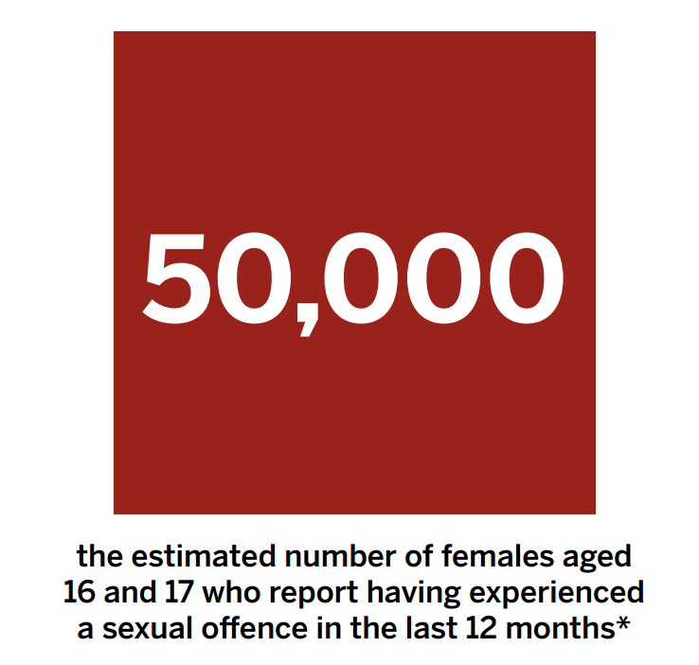
Notes:
*this number is based on our analysis of data from the Crime Survey for England and Wales

Slide 22
