Slide 1
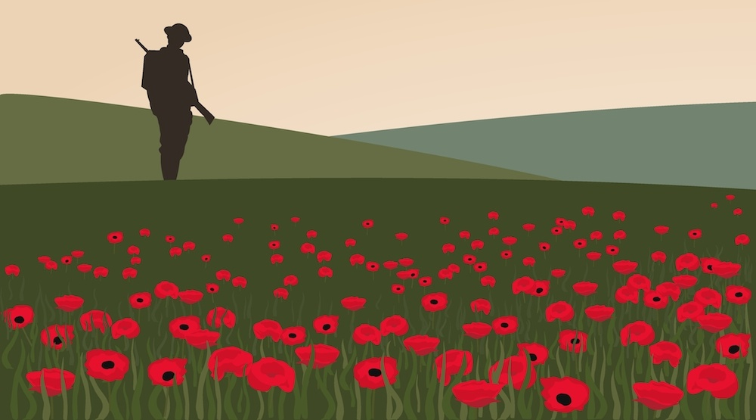
Remembrance

Slide 2
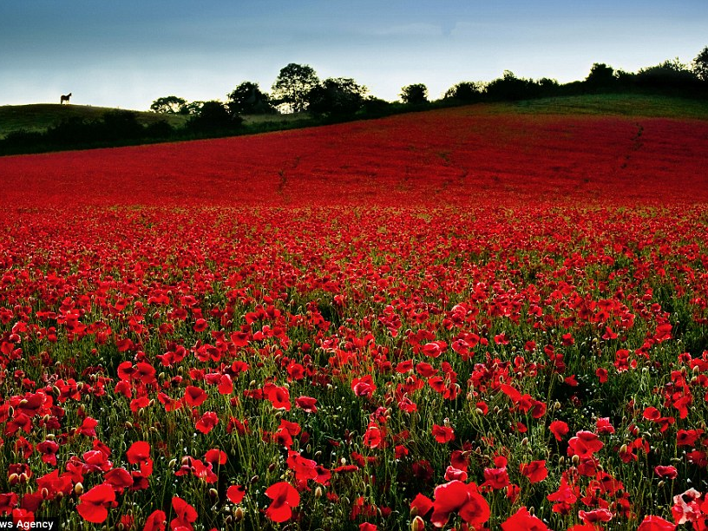

Slide 3
Thank you armed forces
A Symbol of THANK YOU

Slide 4
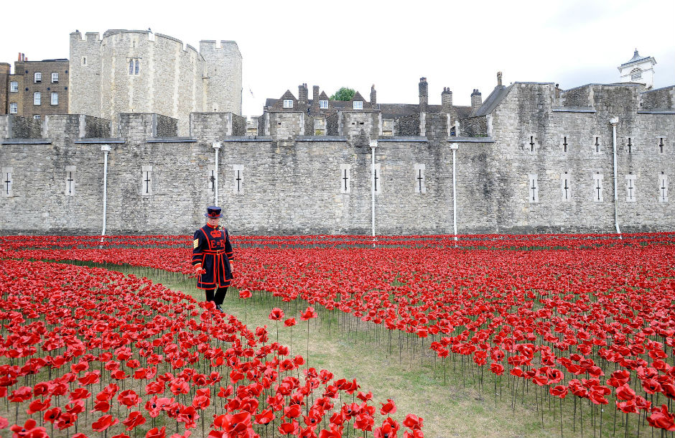
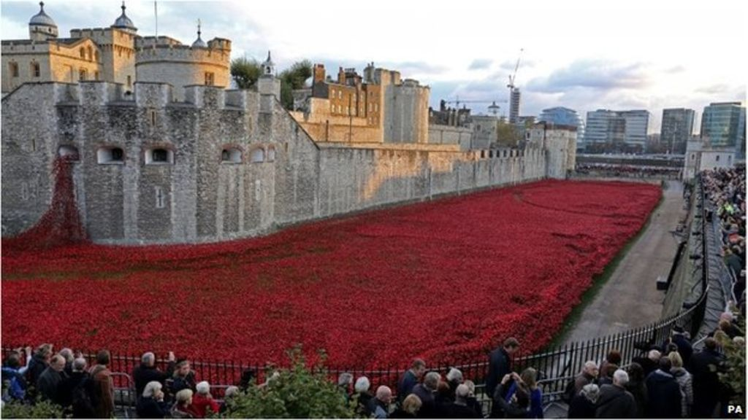
A Symbol of SACRIFICE
Tower of London
November 2014
Blood Swept Lands
and
Seas of Red
888, 246
ceramic poppies

Slide 5
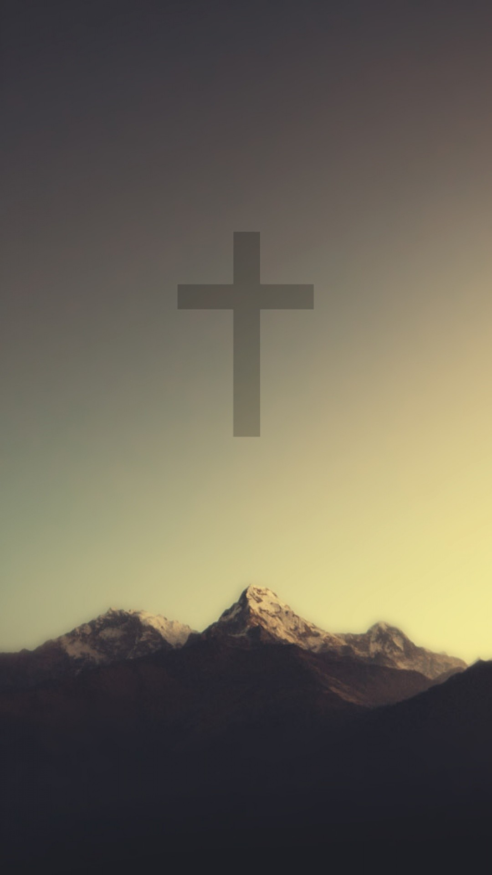
HOPE
FREEDOM
VICTORY

Slide 6
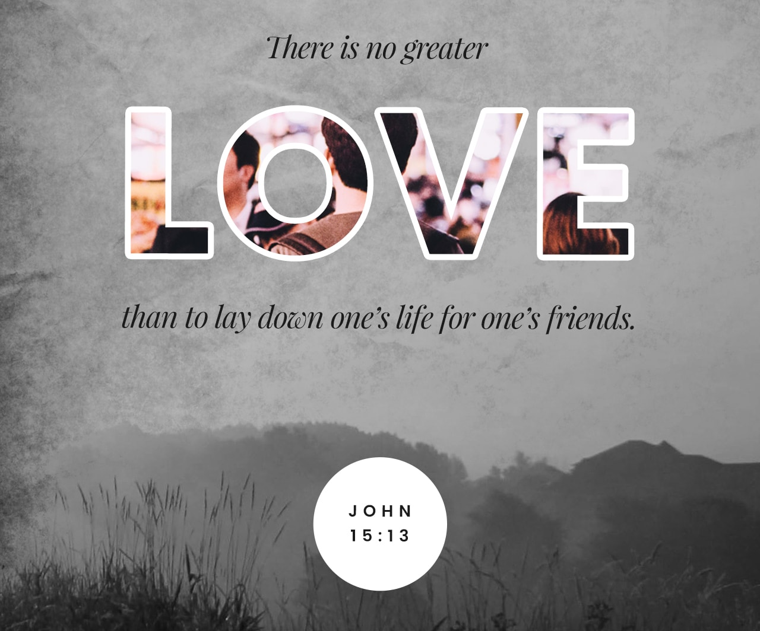

Slide 7
Remembrance

