Slide 1

Be Prepared!
Football Boots

Slide 2

Be Prepared!
Popcorn

Slide 3
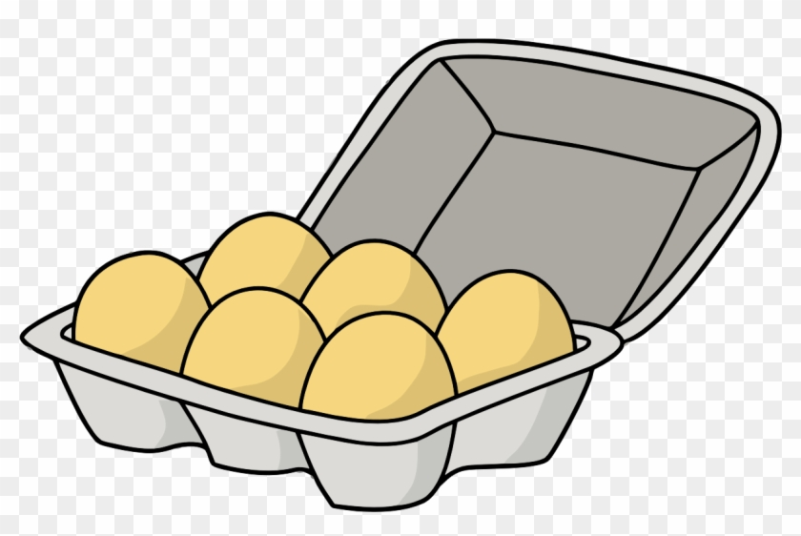
Be Prepared!
Eggs

Slide 4
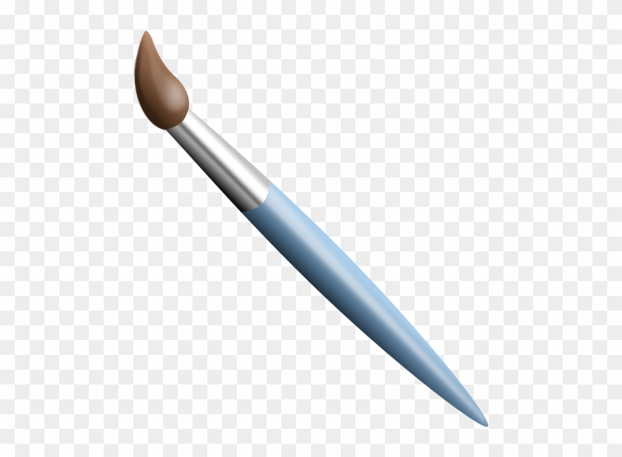
Be Prepared!
Paint Brush

Slide 5

Be Prepared!
Camera

Slide 6


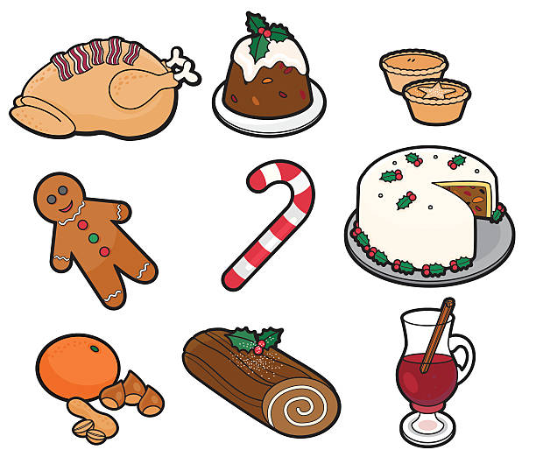
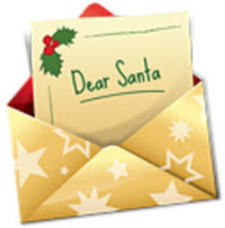
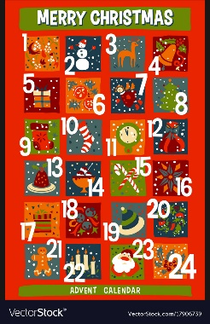
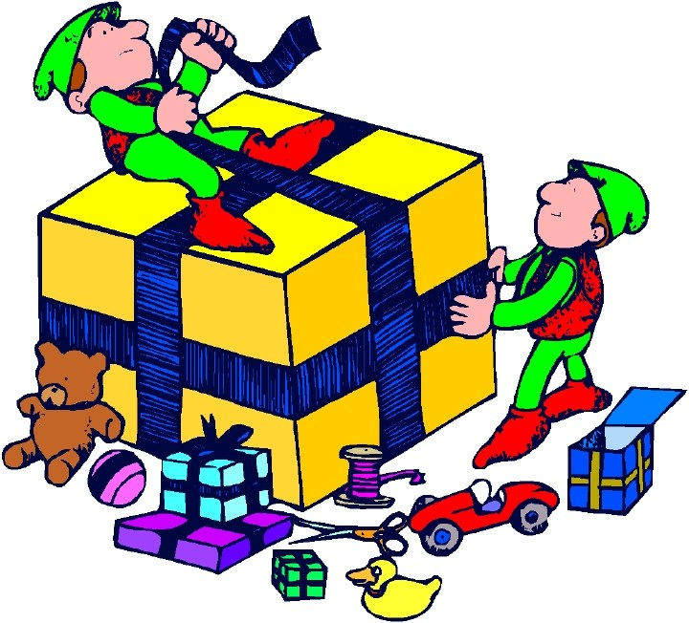
Be Prepared!

Slide 7

Be Prepared!

