Slide 1

faith

Slide 2
MATTHEW 14.25–32
Shortly before dawn, Jesus went to them, walking on the lake. When the disciples saw him walking on the lake, they were terrified.
‘It’s a ghost!’ they said and cried out in fear. But Jesus immediately said to them: ‘Take courage! It is I. Don’t be afraid.’
‘Lord, if it’s you,’ Peter replied, ‘tell me to come to you on the water.’
‘Come,’ he said.
Then Peter got down out of the boat, walked on the water and came towards Jesus. But when he saw the wind, he was afraid and, beginning to sink, he cried out, ‘Lord, save me!’
Immediately Jesus reached out his hand and caught him. ‘You of little faith,’ he said, ‘why did you doubt?’
And when they climbed into the boat, the wind died down. Then those who were in the boat worshipped him, saying, ‘Truly you are the Son of God.’

Slide 3
faith
is built through relationships

Slide 4
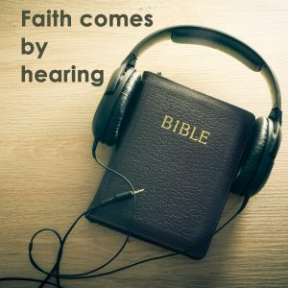

Slide 5
faith
is built on experience

Slide 6
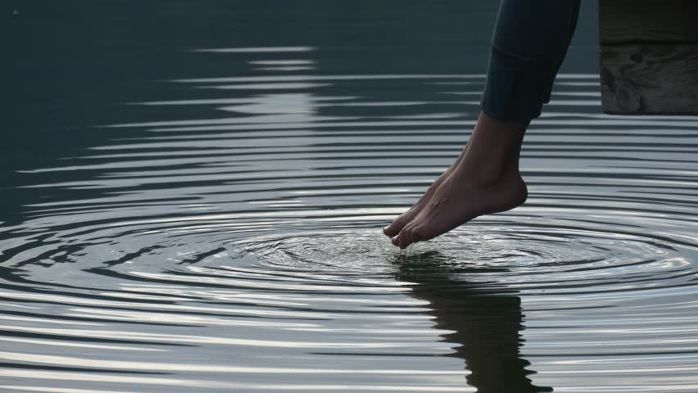
‘You see that his faith and his actions were working together, and his faith was made complete by what he did.’
James 2.22

Slide 7
faith
requires action

Slide 8
faith
affects perspective

Slide 9
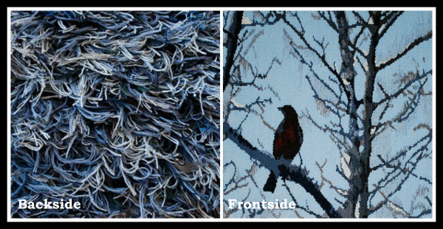

Slide 10
faith

