Slide 1
Favourite Books!

Slide 2


Slide 3


Slide 4


Slide 5
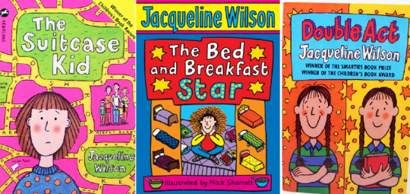

Slide 6


Slide 7


Slide 8


Slide 9







Slide 10
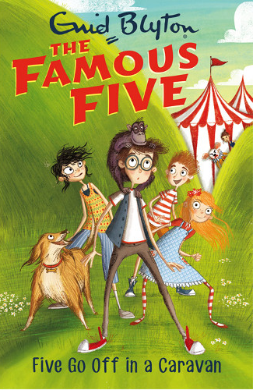

Slide 11
‘I do love the beginning of the summer holidays,’ said Julian. ‘They always seem to stretch out ahead for ages and ages.’
‘They go so nice and slowly at first,’ said Anne, his little sister. ‘Then they start to gallop.’
from Five Go Off in a Caravan

Slide 12
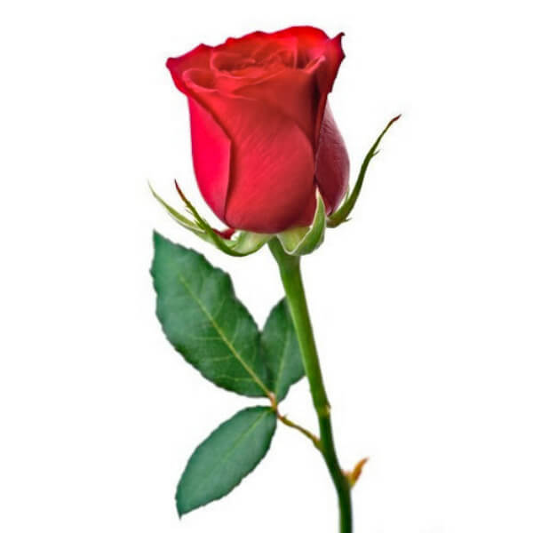
‘Remember to stop and smell the roses.’

