Slide 1

Welcome to our assembly

Slide 2

Buy an expensive gift?

Slide 3
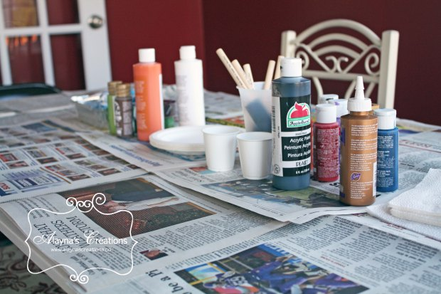
Make a gift?

Slide 4

Spend time together?

Slide 5

Do a kind deed?

Slide 6

Kenosis: self-emptying love

Slide 7
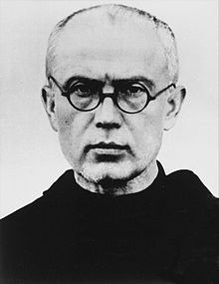
Maximilian Kolbe

