Slide 1
Welcome to our assembly

Slide 2
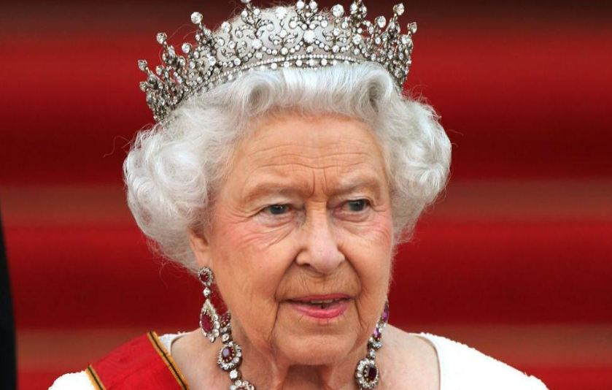
Her Majesty The Queen

Slide 3
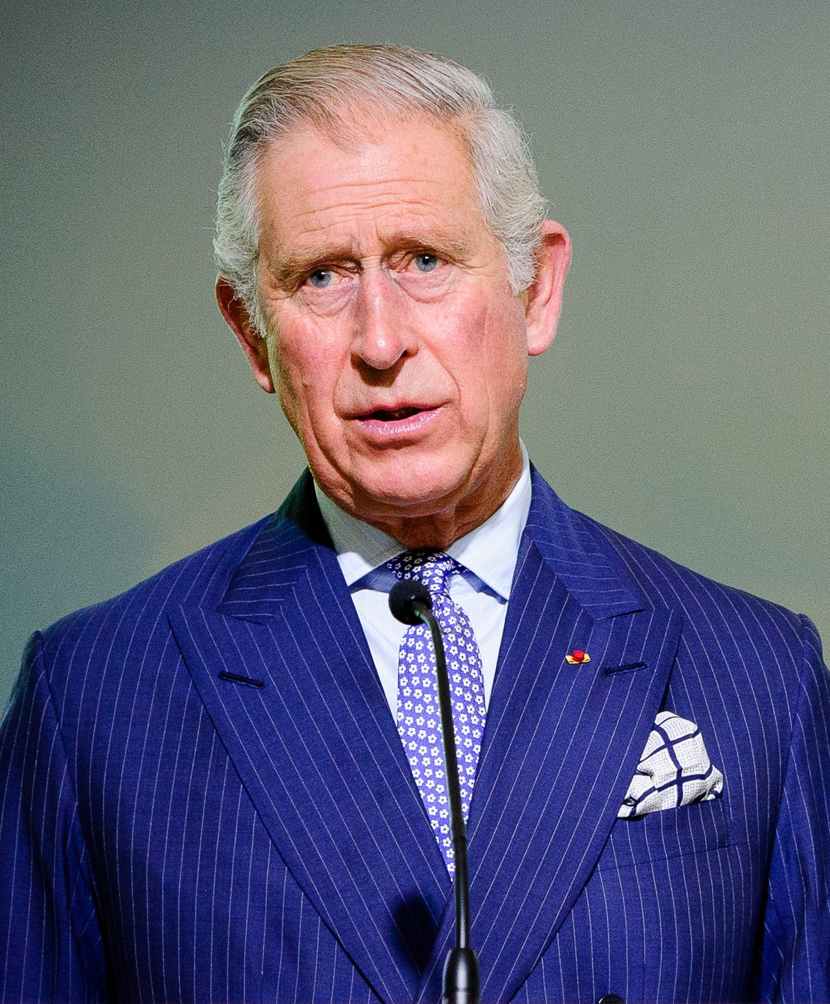
HRH Prince Charles, Prince of Wales

Slide 4
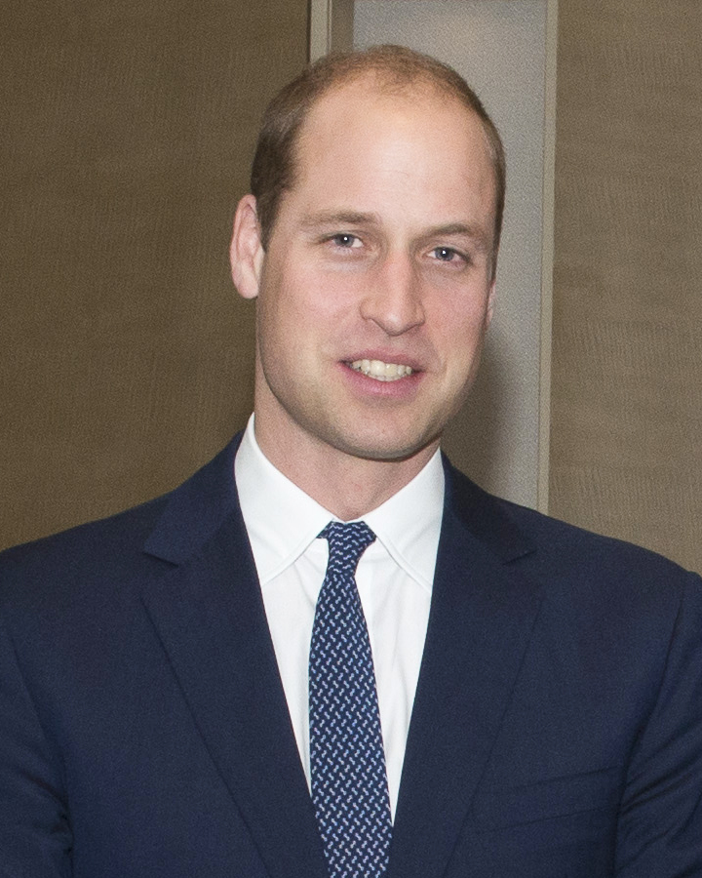
HRH Prince William, Duke of Cambridge

Slide 5
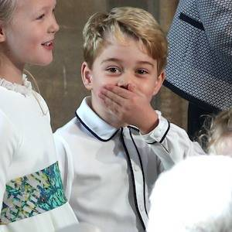
HRH Prince George
of Cambridge
This photo of five-year-old Prince George was taken at Princess Eugenie’s wedding party in October 2018

Slide 6
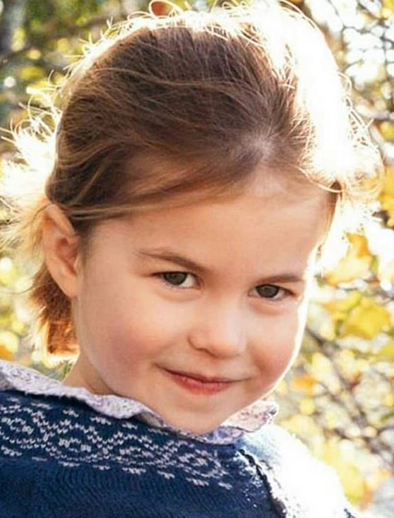
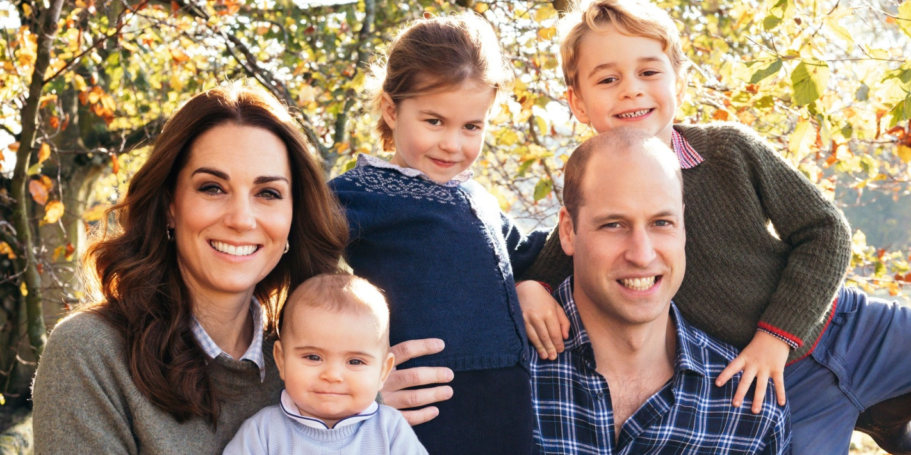
HRH Princess Charlotte of Cambridge

Slide 7
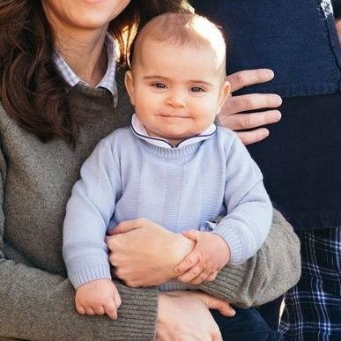
HRH Prince Louis of Cambridge

Slide 8
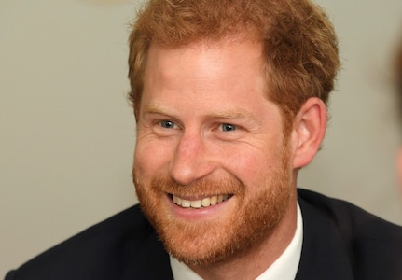
HRH Prince Harry, Duke of Sussex

Slide 9
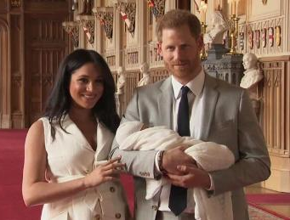
Archie Harrison Mountbatten-Windsor

Slide 10
Her Majesty The Queen

Slide 11
HRH Prince Charles, Prince of Wales

Slide 12
HRH Prince William, Duke of Cambridge

Slide 13
HRH Prince George
of Cambridge
This photo of five-year-old Prince George was taken at Princess Eugenie’s wedding party in October 2018

Slide 14
HRH Princess Charlotte of Cambridge

Slide 15
HRH Prince Louis of Cambridge

Slide 16
HRH Prince Harry, Duke of Sussex

Slide 17
Archie Harrison Mountbatten-Windsor

Slide 18
